Slide 1
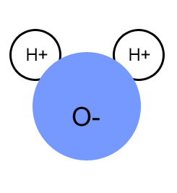
Water
Most Important Inorganic Compound = water
    H₂O
    Accounts for 60-70% of the weight of a living thing.
    Helps to dissolve substances
    Helps to carry wastes from the body
    Regulates body temperature by absorbing heat
    Essential for the processes of digestion, photosynthesis, respiration and many other chemical reactions
    Major component of cytoplasm of all cells
    # 1 compound in ALL living things

Slide 2
Properties of Water
Water is a polar molecule
  Forms hydrogen bonds with other molecules of water
  Water as a solid = ice
  Water as a liquid = water
  Water as a gas = steam
    Almost no hydrogen bonds between molecules

Slide 3
Water Density
Unlike most liquids when they freeze,
water is LESS dense when frozen
Explains why ice floats
Water’s greatest density occurs at 4 °C.
This is why the surface of a pond
freezes and yet water remains in liquid
form at the bottom of the pond.

Slide 4
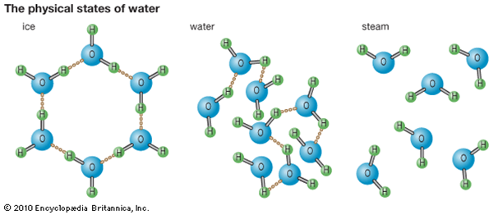
Water Density
      The angles of the hydrogen bonds form a crystal pattern, making frozen water less dense than liquid water
      Due to the unique arrangement of the polar water molecules, water expands when frozen and contracts when heated. (opposite of most substances)
      Water molecules are joined together by covalent hydrogen bonds.

Slide 5
Water is an excellent solvent
  Water can dissolve many substances (polar molecules)
  Creates a solution
  Water is the solvent
  Solute is substance being dissolved in water
    **Importance = water helps to break down molecules into smaller pieces that are small enough to move in and out of cells!**

Slide 6
Water has a high specific heat
  Water can absorb heat but its temperature changes very little
  Water can release large amounts of heat but its temperature changes very little
  Water cools surfaces as it evaporates (ex. = sweating)
    **Importance = Helps keep your body at a constant temperature; helps to keep the global (earth)temperature stable.**

Slide 7
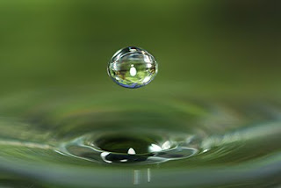
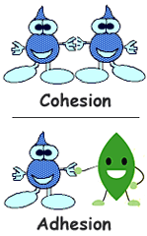
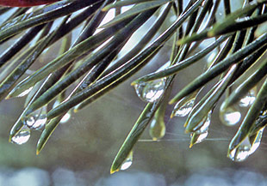
Adhesion = water is sticky = it likes to stick to other polar compounds and to surfaces.
  Examples = water droplets sticking to the grass or a plant leaf, to the window of a car, to the inside of a glass
Cohesion = water is sticky = it likes to stick to itself. Hydrogen bonds create beads of water

Slide 8
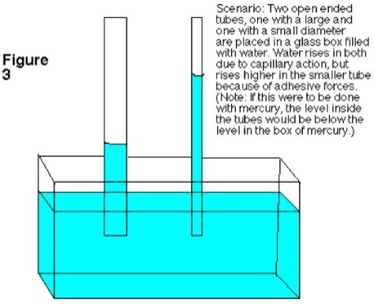
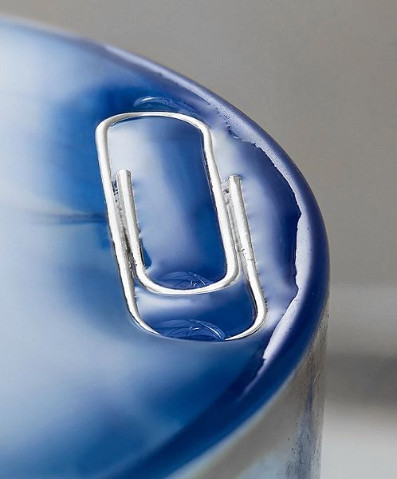
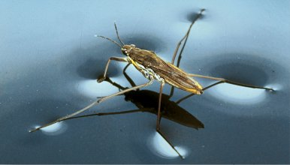
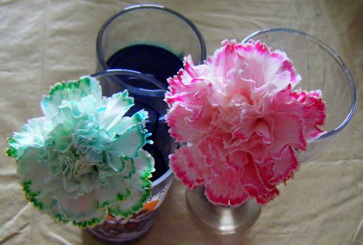
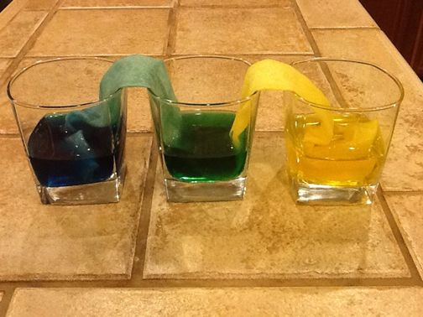
Surface tension = due to cohesion- water has a surface tension. The surface can resist a force from an object denser than water.
  Examples = a paper clip can float on the surface of water, water striders can “walk” on water
Capillary Action = adhesion and cohesion between molecules that causes water to move up in a small tube
  Example = Allows for water to move from roots to leaves in a plant through tiny tubes (veins) in plant

Slide 9
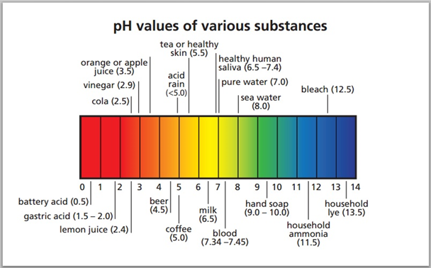
Properties of water
Pure water has a neutral pH.
  Measure of the acidity or basicity of a solution.

Slide 10
Video about water
Water Properties

