Slide 1
HISTORY OF LATIN

Slide 2
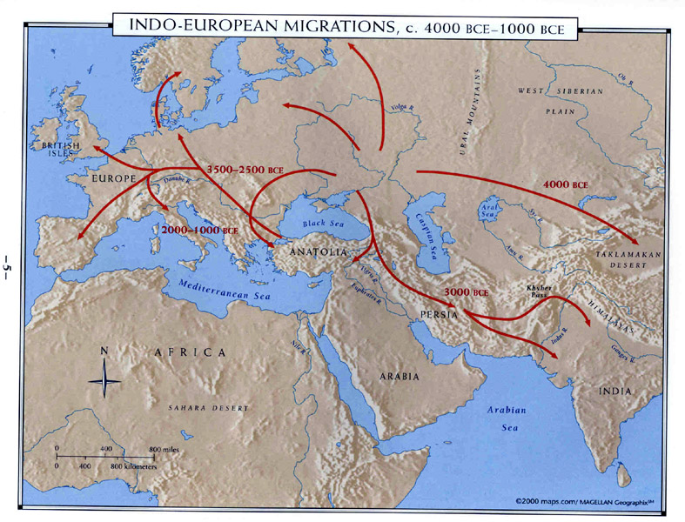
INDO-EUROPEAN
4000-1000 BC

Slide 3
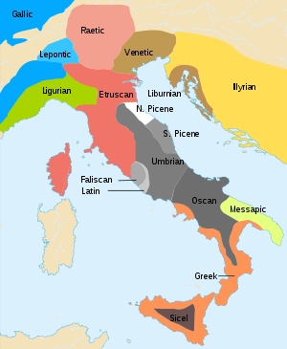
EARLY ITALIC
1000-600 BC

Slide 4
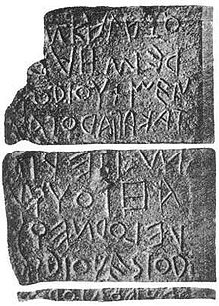
Early LATIN
600-300 BC

Slide 5
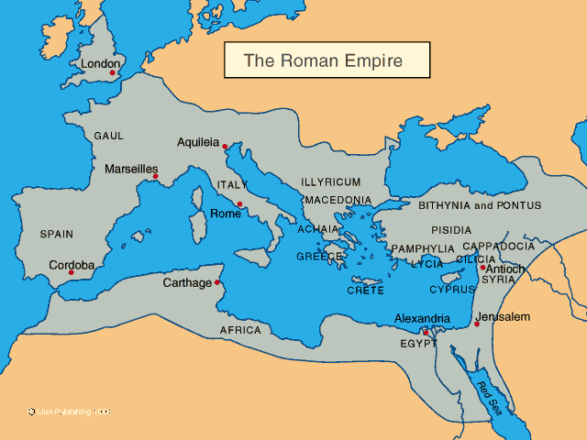
CLASSICAL LATIN
200 BC—500 AD

Slide 6
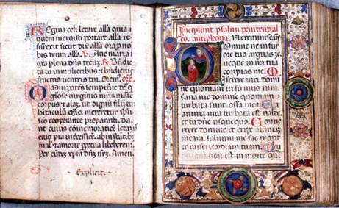
MEDIEVAL LATIN
500 AD-1500 AD

Slide 7
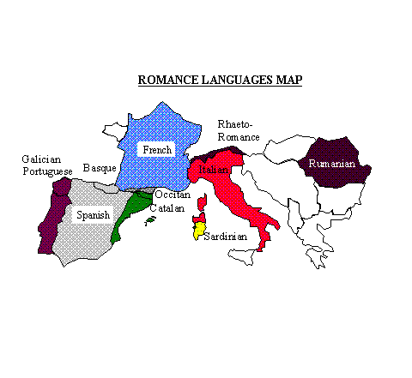
ROMANCE LANGUAGES
500 AD-800 AD

Slide 8
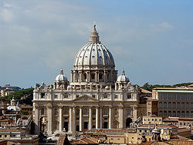
Ecclesiastical LATIn
1500 AD to present

