Slide 1
Marine Corps’ Core Values

Slide 2
Lesson Purpose
This lesson explains and provides examples of honor, courage, and commitment as they relate to Marine Corps.

Slide 3
Lesson Objectives
Define honor, courage, and commitment as they relate to the Marine Corps.
Provide examples of honor, courage, and commitment.
Understand how honor, courage, and commitment relate to the code of conduct for the Marine Corps.
Game

Slide 4
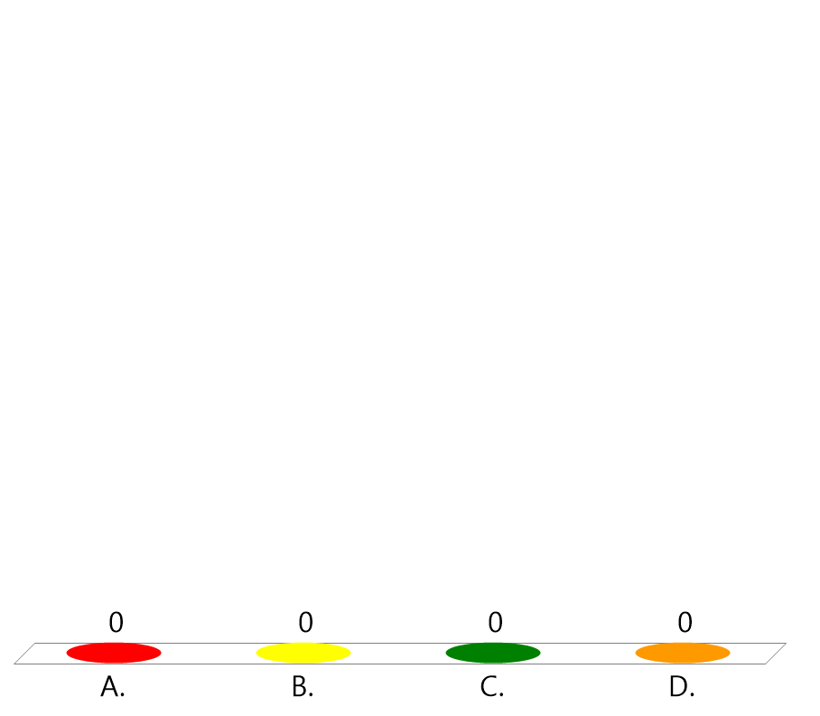
Team Assignment
Alpha
Bravo
Charlie
Delta

Slide 5

Which word do you identify with most? Why?
(LE1-C1S2T2:LQ1)
Honor
Courage
Commitment

Slide 6

A mental quality that recognizes fear of danger, but enables a leader to proceed in the face of it with calmness and firmness is _________.
(LE1-C1S2T2:LQ2)
Honor
Courage
Commitment

Slide 7
Key Words
Character
Dilemma
Justify
Climate
________ - having moral and ethical strength
________ - a difficult situation in which you have to choose between alternatives
_____ - showing that a decision, action, or idea is reasonable and/or necessary
______ - the general atmosphere or situation that exists in an environment

Slide 8
Key Word Question Slide Index
Showing that a decision, action or idea is reasonable…
Having moral and ethical strength
Atmosphere or situation that exists in an environment
A difficult situation ... choose between alternatives

Slide 9

Showing that a decision, action, or idea is reasonable and/or necessary.
(LE1-C1S2T2:KW1)
Character
Dilemma
Justify
Climate

Slide 10
Having moral and ethical strength.
(LE1-C1S2T2:KW2)
Character
Dilemma
Justify
Climate

Slide 11
The general atmosphere or situation that exists in an environment.
(LE1-C1S2T2:KW3)
Character
Dilemma
Justify
Climate

Slide 12
A difficult situation in which you have to choose between alternatives.
(LE1-C1S2T2:KW4)
Character
Dilemma
Justify
Climate

Slide 13

Marine Corps Values

Slide 14
Opening Question
You want to fit in with the popular group at school. They are making fun of your strange-looking neighbor. They want you to join in the “fun.” What would you do?
Note to Instructors:
Click the Show/Hide Response Display Button

Slide 15
Core Values
Honor
The quality that guides Marines to exemplify ethical and moral behavior.
Never lie, cheat, or steal
Abide by an uncompromising code of integrity
Respect human dignity
Respect and concern for each other
Maturity, dedication, trust, and dependability
Accountability for your actions
Fulfillment of obligations

Slide 16
Core Values
Courage
A mental quality that recognizes danger or criticism, but enables a leader to proceed in the face of it with calmness and firmness.
Courage is a quality of mind that leaders:
  Take control over fear
  Take responsibility
  Act properly in a threatening situation

Slide 17
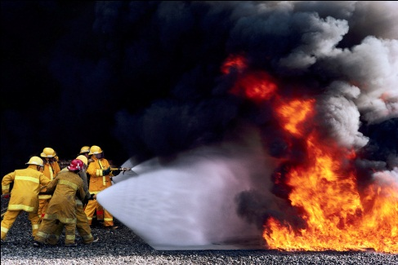
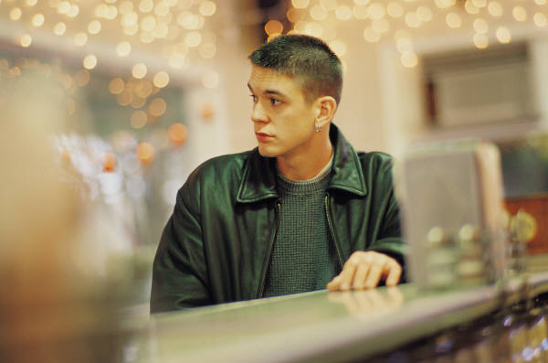
Core Values
Courage
There are two types of courage:
Physical courage: The ability to overcome the fear of bodily harm and push yourself beyond your physical limits.
Moral Courage: The ability to stand firm in your values, morals, and convictions.

Slide 18
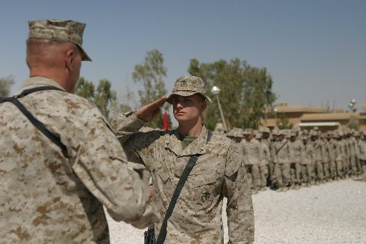
Core Values
Commitment
The dedication to carry out all unit tasks and to serve the values of the country, MCJROTC, and the unit.
Being proud of your unit
Having concern for others
Being determined to achieve excellence in any endeavor

Slide 19

Identify the two types of courage.
(LE1-C1S2T2:LQ3)
Spiritual and Emotional
Random and Constant
Moral and Physical
Fire and Ice

Slide 20
Your friends want you to by illegal drugs. You decide that drugs are not something that will help you in your life so you say "NO." What value did you primarily rely on to take this stand?
(LE1-C1S2T2:LQ3)
Honor
Courage
Commitment

Slide 21
Pressures of Leadership
Leaders are often put in situations where two or more values conflict, otherwise known as a _______.
dilemma
If you make the right decision when faced with an ethical problem, you will build your character and leadership.
easy
However, if you fall into the trap of taking the ____ way out, you will tend to erode your character and lose the respect of your fellow cadets.

Slide 22
Historical Case Studies
Three historical case studies are provided in your student text.
  Story of Lieutenant Presley Neville O’Bannon
  Story of John Henry Quick
  Story of Corporal John F. Mackie
Read these three case studies and answer the following questions.

Slide 23

Lieutenant O'Bannon showed courage by...
(LE1-C1S2T2:LQ5)
continuing his march across the desert of Baraca for 45 days.
capturing the fort at Derne with seven Marines and support from naval gunfire.
convincing the enemy to surrender.
Both A and B

Slide 24

Sergeant John Quick showed honor by...
(LE1-C1S2T2:LQ6)
standing in the middle of friendly fire to signal the ship's crew to cease-fire.
giving members of his patrol the fortitude to complete their mission in Samar.
displaying dynamic leadership throughout his career.
All of the above

Slide 25
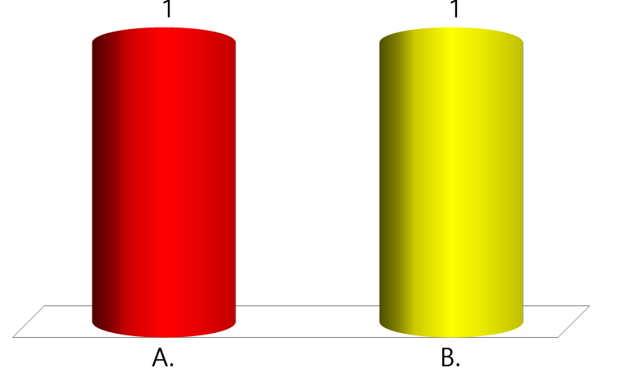
True or False:
Corporal John F. Mackie was the second U.S. Marine to ever receive the Medal of Honor.
(LE1-C1S2T2:LQ7)
True
False

Slide 26
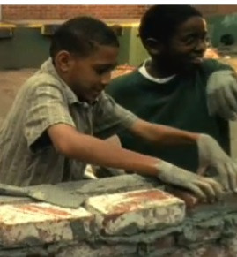
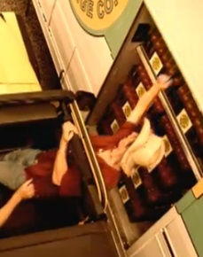
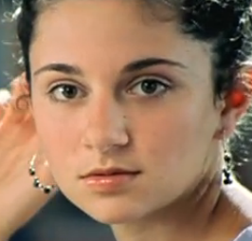
Optional Video Questions
Watch these three videos, then answer
Video Questions (1-10).
The Wall
The Reach
The Cafeteria

Slide 27

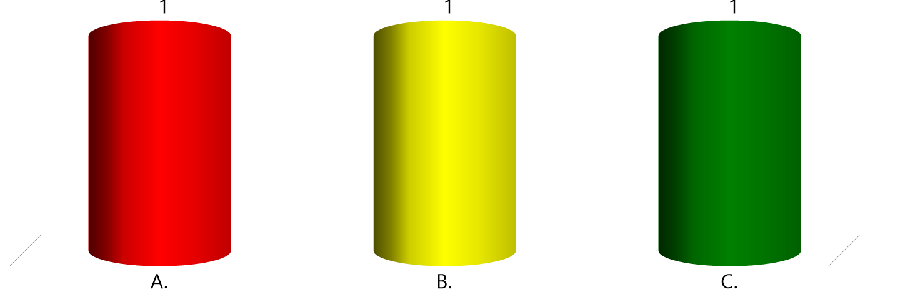



Which video most clearly demonstrates the Marine Corps' Core Value of honor? Why?
(LE1-C1S2T2:VQ1)
The Wall
The Reach
The Cafeteria

Slide 28

How would you rate yourself RIGHT NOW in terms of your ability to act honorably. That is, to do the right thing even when it is not easy or cool? BE HONEST!
(LE1-C1S2T2:VQ2)
Very low - I really struggle with this.
Low - I have a lot of room for improvement.
I can go either way, depending on the situation.
High - I have made a lot of progress in this area.
Very high - I see myself as a role model to others in this area.

Slide 29

Acting with honor is rarely an easy thing to do, particularly when around certain people. Which of the following reasons make it the HARDEST for YOU to do the right thing?
(LE1-C1S2T2:VQ3)
My friends don’t really think doing the right thing is very cool.
I don’t have many people in my life that value honor.
I have not really ever thought about the importance of acting honorably.
Other response

Slide 30

Which of the following strategies could be something you could do to develop honorable behavior in your life?
(LE1-C1S2T2:VQ4)
Find a group of friends that also value honor
Find a mentor to talk to as I develop honor in my life
Study examples of people who acted with honor
Other response

Slide 31
Which video most clearly demonstrates the Marine Corps Core Value of moral courage? Why?
(LE1-C1S2T2:VQ5)
The Wall
The Reach
The Cafeteria

Slide 32

How would you rate yourself right now in the area of moral courage?
(LE1-C1S2T2:VQ6)
Very low - I tend to give in to peer pressure and fear in many areas.
Low - I could respond better in this area.
Moderate - I can go either way, depending on the situation.
High - I have made a lot of progress in this area.
Very high - I see myself as a role model to others in the area of moral courage.

Slide 33

Who in your life is the best model of someone with moral courage? That is, someone who does what is right, admits their errors, and enforces their decisions when they are sure they are correct. Why?
(LE1-C1S2T2:VQ7)
My mother
My father
My brother, sister, or other family
One of my teachers at school
A friend
Other Person

Slide 34
Which video most clearly demonstrates the Marine Corps Core Value of commitment? Why?
(LE1-C1S2T2:VQ8)
The Wall
The Reach
The Cafeteria

Slide 35

How would you rate yourself right now in terms of commitment?
(LE1-C1S2T2:VQ9)
Very low - I really struggle with commitment.
Low - I have a lot of room for improvement.
Moderate - I can go either way, depending on the situation.
High - I have made a lot of progress in this area.
Very high - I see myself as a role model to others in this area.

Slide 36

The following achievements require a great amount of commitment. Choose the one that you would be most interested in accomplishing. Once you have chosen, write down the resources you would need AND the barriers you would have to overcome?
(LE1-C1S2T2:VQ10)
Running a Marathon
Getting a college degree
Learning a musical instrument
Competing at a high level in drill
Competing at a high level in marksmanship

Slide 37
Closing Question
Which of the three men in the historical case studies do you most admire?
List 2-3 reasons why.
Note to Instructors:
Click the Show/Hide Response Display Button

Slide 38

Questions

Slide 39
Copyright Information
Images in this lesson were taken from:
    Microsoft© Clip Art Gallery
    Marine Corps Combat Camera
    Values.com

Slide 40
Participant Leaders
Points | Participant | Points | Participant

Slide 41
Team Scores
Points | Team | Points | Team

Slide 42
Team MVP
Points | Team | Participant

Slide 43
Fastest Responders
Seconds | Participant | Seconds | Participant

Slide 44
Whiteboard

