Slide 1
Marine Corps Rank Structure

Slide 2
Lesson Purpose
This lesson introduces you to the Marine Corps Rank Structure, including information on officer and enlisted rank, grades, and insignia.

Slide 3

Lesson Objectives
Identify Marine Corps officer rank, grade, and insignia.
Identify Marine Corps enlisted rank, grade, and insignia.
Differentiate between Marine Corps officer and enlisted rank and insignia.
Identify Marine Corps officer and enlisted rank structure in sequence.
Notes:
Example:

Slide 4
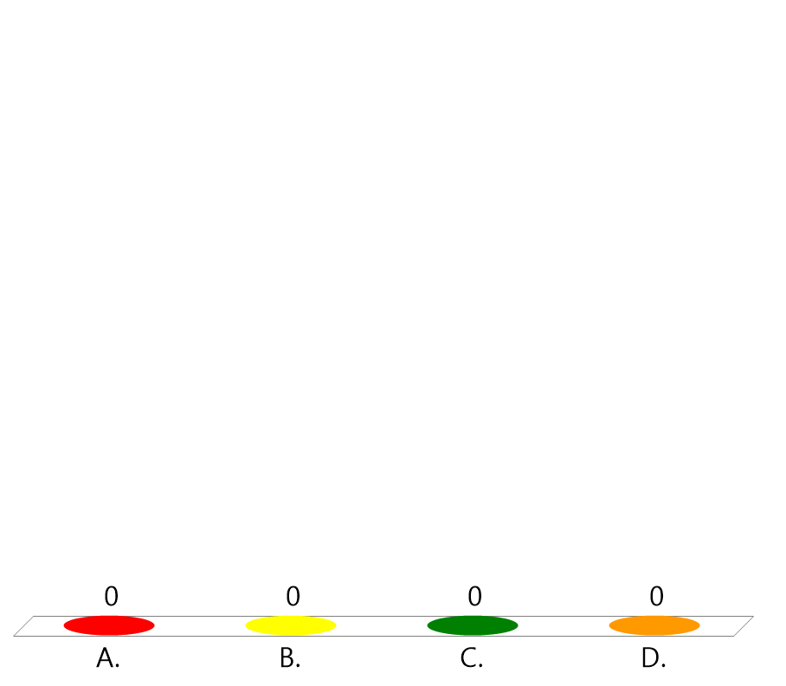
Team Assignment
Alpha
Bravo
Charlie
Delta

Slide 5

How difficult do you think it will be for you to learn the Marine Corps Rank Structure?
(LE1-C5S5T2:LQ1)
Extremely hard - I have a hard time memorizing.
Very hard - I can do it, but will take a lot of practice.
Easy - I am pretty good at memorizing.
Very easy - I have already memorized all of the ranks for the Marine Corps.

Slide 6
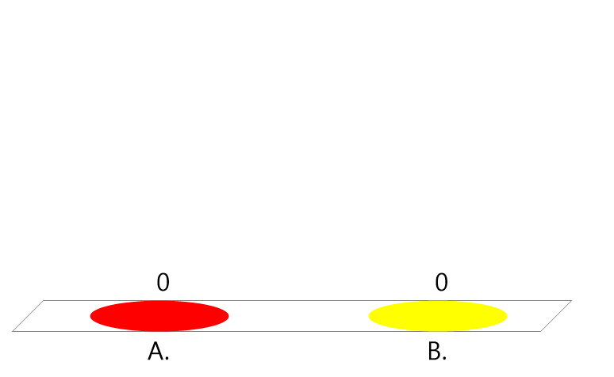
True or False:
The MCJROTC rank structure is very different from the Marine Corps rank structure.
(LE1-C5S5T2:LQ2)
True
False

Slide 7
Key Words
Rank
Insignia
Warrant Officer
Warrant
_____ - an official position such as a sergeant or captain
_______ - a device attached to the uniform that indicates a person’s rank
____________ - prior enlisted Marine officers who are technical experts
_______ - official certificate of appointment to a specific enlisted or warrant officer rank
Notes:
Example:

Slide 8
Key Word Question Slide Index
Official certificate of appointment to a specific enlisted or warrant officer rank
A device attached to the uniform that indicates a person's rank
An official position such as a sergeant or a captain
Prior enlisted Marine officers who are technical experts

Slide 9

Official certificate of appointment to a specific enlisted or warrant officer rank
(LE1-C5S5T2:KW1)
Rank
Insignia
Warrant Officer
Warrant

Slide 10
A device attached to the uniform that indicates a person's rank
(LE1-C5S5T2:KW2)
Rank
Insignia
Warrant Officer
Warrant

Slide 11
An official position such as a sergeant or a captain
(LE1-C5S5T2:KW3)
Rank
Insignia
Warrant Officer
Warrant

Slide 12

Prior enlisted Marine officers who are technical experts
(LE1-C5S5T2:KW4)
Rank
Insignia
Warrant Officer
Warrant

Slide 13
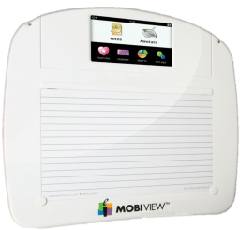
Opening Question
List 2-3 things that you already know about the Marine Corps rank and insignia?
Note to Instructors:
Click the Show/Hide Response Display Button

Slide 14
Background
Rank and grade in the Marine Corps is used for:
personnel planning
recruitment
selection for training
development of training needs
promotions
assignments
Notes:
Example:

Slide 15
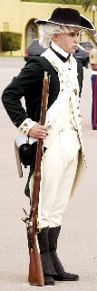
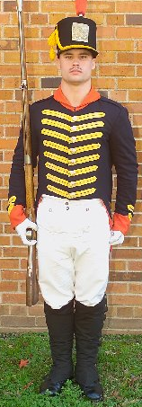
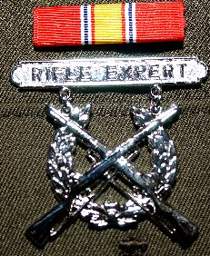
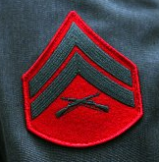
History
Through the ages, rank has included symbols such as feathers, sashes, stripes, and showy uniforms.
Notes:
Example:

Slide 16
History
Chevrons (enlisted insignia) are V-shaped stripes whose use in military go back at least the twelfth century.
The British and French used chevrons (the French word for “roof”) to signify ______________.
length of service
Notes:
Example:

Slide 17
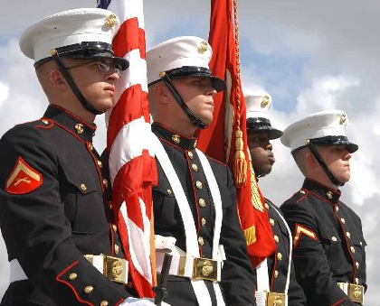
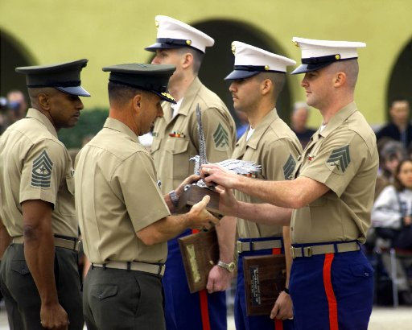
Marine Corps Rank Structure
One of the most distinguishing features about the Marine Corps is the uniform.
Notes:
Example:

Slide 18





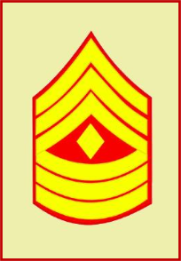



Marine Corps Rank Structure
Rank, grade, and insignia identify Marines as officers and enlisted.
Notes:
Example:

Slide 19
Marine Corps Rank Structure
A warrant officer is a prior enlisted Marine with specialties in a certain field such as knowledge, training, and experience with particular systems or equipment.
A commissioned officer holds a rank of second lieutenant or above.
Notes:
Example:

Slide 20
The British and French used chevrons to signify ________.
(LE1-C5S5T2:LQ3)
rank
level of courage
years of service
None of the above

Slide 21
True or False:
A commissioned officer is a prior enlisted Marine with specialties in a certain field.
(LE1-C5S5T2:LQ4)
True
False

Slide 22










Officer Rank Structure
 | 0-1 | 0-2 | 0-3 | 0-4 | 0-5 | 0-6
Company and Field Grade Officer
 | 2nd Lieutenant | 1st Lieutenant | Captain | Major | Lieutenant Colonel | Colonel
 | 0-7 | 0-8 | 0-9 | 0-10
General Officer
 | Brigadier General | Major General | Lieutenant General | General
Notes:
Example:

Slide 23


Warrant Officer Rank Structure
 | W-1 | W-2 | W-3 | W-4 | W-5
Warrant Officer
 | Warrant Officer | Chief Warrant Officer-2 | Chief Warrant Officer-3 | Chief Warrant Officer-4 | Chief Warrant Officer-5
Notes:
Example:

Slide 24












Enlisted Rank Structure
 | E-1 | E-2 | E-3 | E-4 | E-5 | E-6
Enlisted
 |  | Private First Class | Lance Corporal | Corporal | Sergeant | Staff Sergeant
 | E-7 | E-8 |  | E-9
 | Gunnery Sergeant | Master Sergeant | First Sergeant | Master Gunnery Sergeant | Sergeant Major | Sergeant Major of the M.C.
No
Insignia
Notes:
Example:

Slide 25

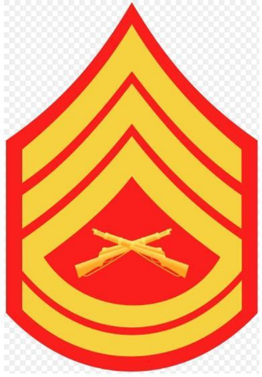
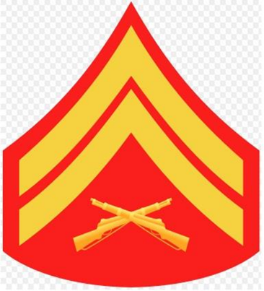
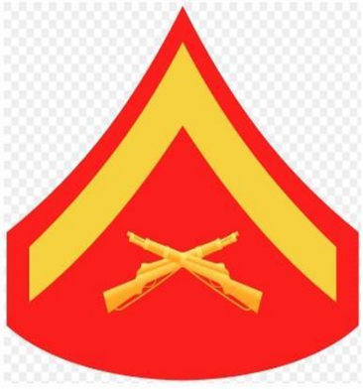
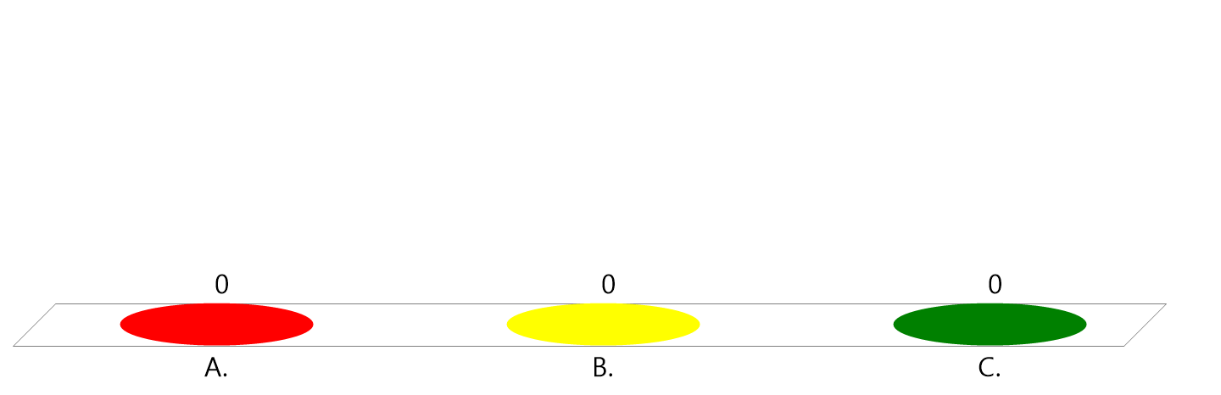
Of the ranks displayed, which is the highest?
(LE1-C5S5T2:LQ5)
A.
B.
C.
Captain
Lt Col
Major

Slide 26



Of the ranks displayed, which is the highest?
(LE1-C5S5T2:LQ6)
A.
B.
C.
Captain
Lt Col
Major

Slide 27
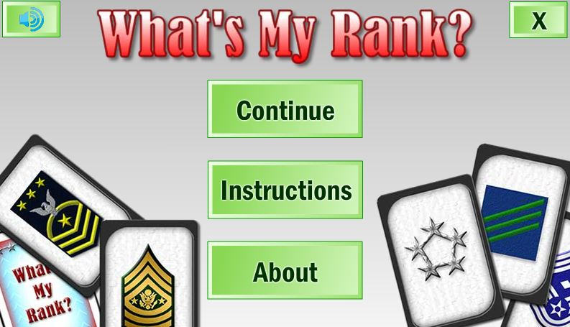
Optional Game –
What’s My Rank?

Slide 28
Closing Question
What are the most significant differences between the MCJROTC and the Marine Corps rank and structure?
Note to Instructors:
Click the Show/Hide Response Display Button

Slide 29

Questions

Slide 30
Copyright Information
Images in this lesson were taken from:
    Microsoft© Clip Art Gallery
    Marine Corps Combat Camera
    Marine Corps OCS
    MCJROTC Student Text

Slide 31
Participant Leaders
Points | Participant | Points | Participant

Slide 32
Team Scores
Points | Team | Points | Team

Slide 33
Team MVP
Points | Team | Participant

Slide 34
Fastest Responders
Seconds | Participant | Seconds | Participant

Slide 35
Whiteboard

