Slide 1
Leadership Defined

Slide 2
Lesson Purpose
This lesson explores the Marine Corps definition of leadership and identifies the characteristics of successful leaders.

Slide 3
Lesson Objectives
Understand how influencing others toward a common goal is a key aspect of leadership.
Explain the three aspects of leadership: purpose, direction, and motivation.
Game

Slide 4
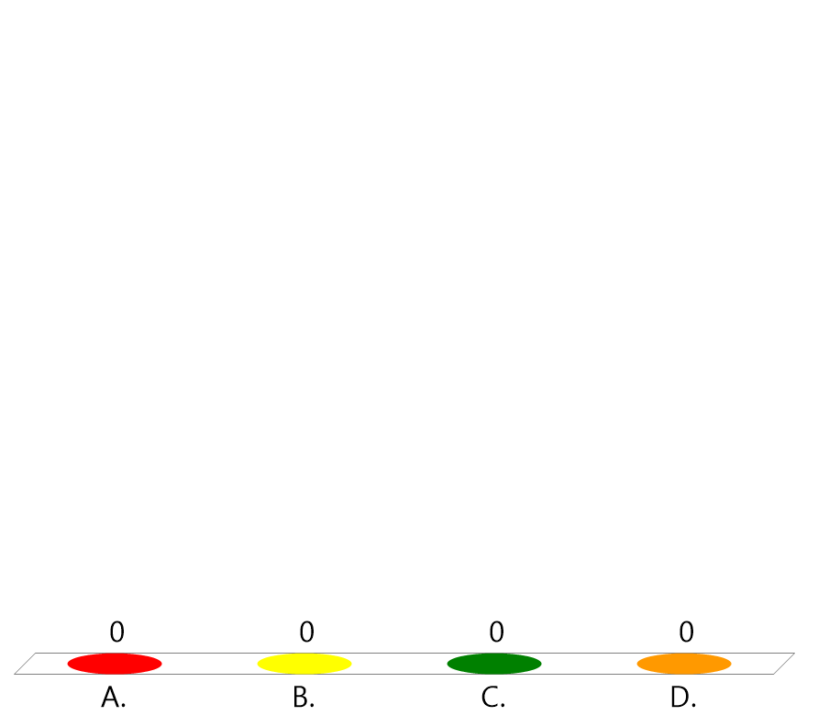
Team Assignment
Alpha
Bravo
Charlie
Delta

Slide 5

How many examples of "good leaders" have you had in your personal life (e.g., friends or family)?
(LE1-C1S1T1:LQ1)
I have had many (5-10) good leaders in my personal life.
I have had a few (3-4) examples of good leaders in my personal life.
I can only think of 1-2 examples.
I can't think of any examples of good leaders that I have known personally.

Slide 6

The process of leadership development...
(LE1-C1S2T1:LQ2)
is a one time event.
is continuous.
requires self-study, education, and training.
B and C

Slide 7
Key Words / Word Wall
Leader
Influence
Obedience
______ – a person who is in control of a group or organization
________ - the power to make other people agree with your opinions or do what you want
_________ - doing what you are told

Slide 8
Key Words / Word Wall
Respect
Confidence
_______ – having a favorable opinion of someone’s rank, character, or ideas
__________ - having faith in your abilities or that of another

Slide 9
Key Word Question Slide Index
Doing what you are told
Influence
The "President" is to the "United States" as...
Scenario #1
Scenario #2

Slide 10

Doing what you’re told
(LE1-C1S1T1:KW1)
Leader
Influence
Obedience
Respect

Slide 11

Influence
(LE1-C1S1T1:KW2)
Having a good opinion of someone's rank, character, or ideas.
A person who is in control of a group or organization.
Doing what you are told
The power to make other people agree with your opinions or do what you want

Slide 12

The "President" is to the "United States" as...
(LE1-C1S1T1:KW3)
"Citizen" is to "country"
"Leader" is to "country"
"Flag" is to "country"

Slide 13
Cadet Jones receives _______ from those in his unit because he is fair, consistent, and shows good leadership skills.
(LE1-C1S1T1:KW4)
Motivation
Leadership
Respect

Slide 14
Cadet Nixon was not sure about going to college because none of his family did. However, after receiving encouragement from his best friend, he gained the _________ to start the application process.
(LE1-C1S1T1:KW5)
Motivation
Leadership
Respect

Slide 15
Opening Question
List 2-3 people you know personally that you would call a leader. What qualities do they display?
Note to Instructors:
Click the Show/Hide Response Display Button

Slide 16
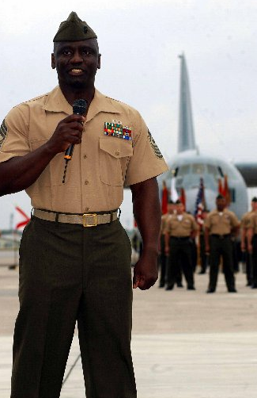
Introduction
MCJROTC leadership development will give you the skills, confidence, and character necessary to become a good leader.
You will identify leadership behaviors you have and link those behaviors to a definition of leadership.

Slide 17
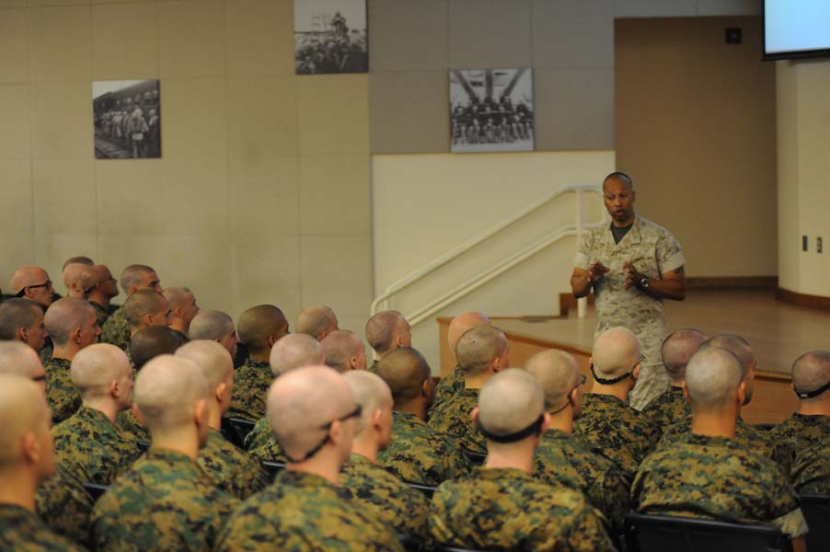
Definition
Leadership – the ability to influence, lead, or guide others to accomplish a _______
mission
Purpose – gives others a reason for why they should do something

Slide 18

Definition
Direction – gives others the “knowledge” to complete the task
Motivation – gives others the will to do what they are capable of doing

Slide 19
Lesson Question
Read each Case Study, then answer
Lesson Questions 3-6.
Notes:
Example:

Slide 20
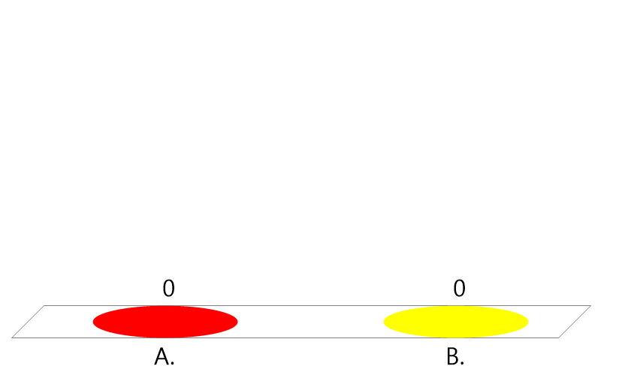
Read Case Study #1 (pg. 2-3)
Would you like to be a member of Jon’s team?
(LE1-C1S2T1:LQ3)
YES
NO

Slide 21
Read Case Study #2 (pg. 3)
Would you like to be a member of Maria’s team?
(LE1-C1S2T1:LQ4)
YES
NO

Slide 22
Read Case Study #3 (pg. 3-4)
Would you like to be a member of Brian’s team?
(LE1-C1S2T1:LQ5)
YES
NO

Slide 23
A new squad leader is struggling with his confidence in his role and wants to quit. You explain to him that it is important that he continue so he can apply these new skills to other areas in his life. Other cadets also encourage him to continue and give him a pep talk. However, after several more weeks he still seems frustrated and says, I just don’t know what I am doing. Which objective of leadership have YOU failed to provide to him?
(LE1-C1S2T1:LQ6)
Purpose
Direction
Motivation
None of the above

Slide 24
Case Study #1
What are Jon’s desirable and undesirable characteristics?
Note to Instructors:
Click the Show/Hide Response Display Button

Slide 25
Case Study #2
What are Maria’s desirable and undesirable characteristics?
Note to Instructors:
Click the Show/Hide Response Display Button

Slide 26
Case Study #3
What are Brian’s desirable and undesirable characteristics?
Note to Instructors:
Click the Show/Hide Response Display Button

Slide 27
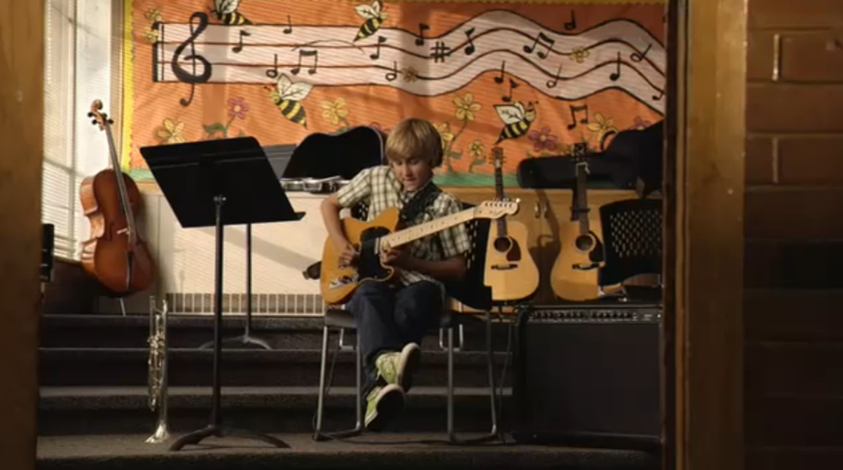
Optional Video Questions
Watch this video, then answer
Video Questions (3-5).

Slide 28

One of the most important qualities of a leader is the ability to influence others to achieve their mission. If a cadet under your command was learning a new skill, which method would you use to help him achieve his mission?
(LE1-C1S2T1:VQ1)
Tell him how bad he is.
Encourage him to keep practicing.
Give him guidance on how to improve.
Both B and C
All of the above

Slide 29


Which method of influencing others is your strength? After you select, provide an example of when you influenced someone else, or someone influenced you, in a positive way. Why was it successful?
(LE1-C1S2T1-VQ2)
Teaching (Showing how something is done)
Encouraging (Providing support)
Coaching (Giving direction and guidance)
Mentoring (Being a role model)

Slide 30
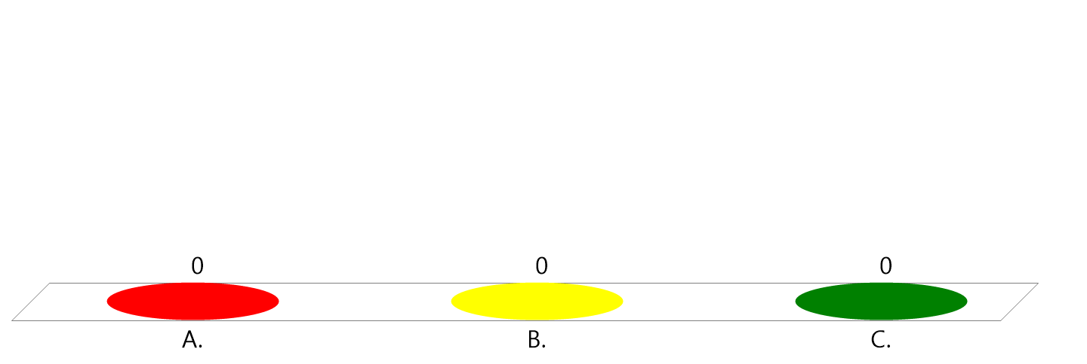
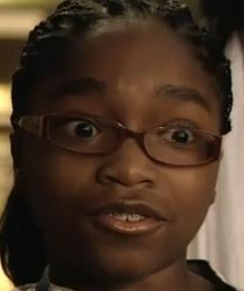
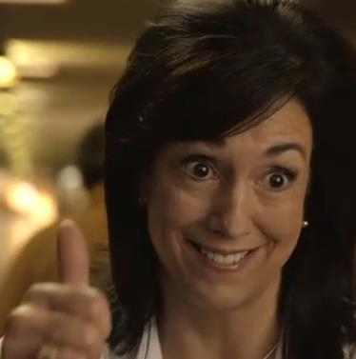
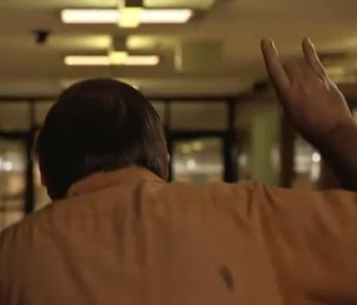
Which person was the most effective at influencing the student to keep practicing?
(LE1-C1S2T1-VQ3)
Girl
Teacher
Janitor

Slide 31

Who in your life encourages you the MOST to keep trying at things you are just learning?
(LE1-C1S2T1-VQ4)
My mother
My father
Another family member
My Marine Corps JROTC instructor
Another teacher/staff at my school
A friend
Other person

Slide 32

Are YOU the type of person that supports others when they are trying something new and need encouragement and motivation?
(LE1-C1S2T1-VQ5)
Yes, I am this type of person.
I am sometimes this type of person, but could use some growth in this area.
I want to be this type of person, but it does not come naturally.
I am not this type of person, but need to learn how to develop this quality.

Slide 33
Closing Question
List 2-3 leadership traits you would like to adopt.
Note to Instructors:
Click the Show/Hide Response Display Button

Slide 34

Questions

Slide 35
Copyright Information
Images in this lesson were taken from:
    Microsoft© Clip Art Gallery
    Marine Corps Combat Camera

Slide 36
Participant Leaders
Points | Participant | Points | Participant

Slide 37
Team Scores
Points | Team | Points | Team

Slide 38
Team MVP
Points | Team | Participant

Slide 39
Fastest Responders
Seconds | Participant | Seconds | Participant

Slide 40
Whiteboard

