Slide 1
Wear and Care of the Service Uniforms

Slide 2
Lesson Purpose
This lesson describes the proper wear and care of the different kinds of Service Uniforms.

Slide 3

Lesson Objectives
Describe the three types of Service Uniforms.
Demonstrate the proper wear and care of the Service Uniforms.
Demonstrate the proper care of footwear.

Slide 4

Team Assignment
Alpha
Bravo
Charlie
Delta

Slide 5

Which describes your knowledge of the care and wear regulations for the Utility and Physical Training uniforms?
(LE1-C5S3T4:LQ1)
Low - I didn't know we had care and wear regulations.
Moderate - I know some of the care and wear regulations.
High - I know how to care for and wear the Service uniforms.

Slide 6

True or False:
The Service Uniforms can be worn for most day-to-day activities.
(LE1-C5S3T4:LQ2)
True
False

Slide 7

Opening Question
List 2-3 occasions when the service uniform is worn.
Note to Instructors:
Click the Show/Hide Response Display Button

Slide 8
Introduction
For most day-to-day activities, Marine personnel wear what are termed service uniforms.
There are three forms of service uniforms, designated A, B, and C.
Although both male and female personnel use the same designations for service uniforms, there are naturally differences between them.

Slide 9
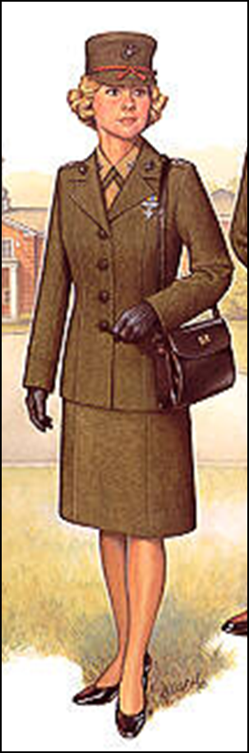
Female Service A Uniform
Garrison Cap or Service Cap
Service Coat
Long Sleeve Khaki Shirt
Green Neck tab
Service Skirt
Service Trousers
Black Pumps or Black Oxfords

Slide 10
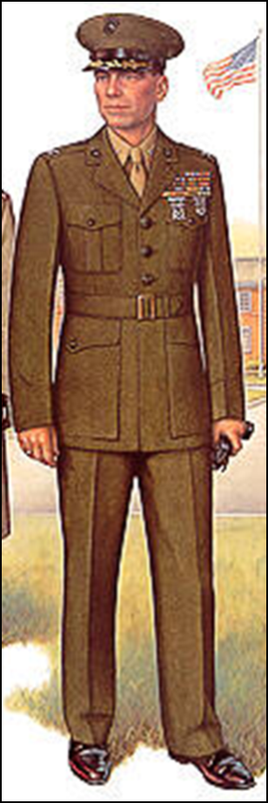
Male Service A Uniform
Garrison / Service Cap
Coat
Long Sleeve Khaki Shirt
Necktie w/ Tie Clasp
Trousers
Belt w/ Buckle
Black Socks & Black Shoes

Slide 11

Service A Uniform
Maybe worn when reporting for duty or assigned to court martials.
When worn as the uniform of the day, the coat may be removed when inside office buildings.

Slide 12


Female Service B & C Uniforms
Shirts are worn on the outside of the skirts and slacks.
The neck tab is worn underneath the collar of the long sleeve shirt.
Shirts will be tucked in w/ the duty belt or when the sword is worn.

Slide 13
Male Service B & C Uniforms
Shirts will be tucked in.
A hand tied or clip on tie will be worn.
Standard knot.
Tie clasp worn between 3rd and 4th button.
Service “B”
Service “C”

Slide 14
Service B & C Uniforms
The Service B & C uniforms may be worn as the uniform of the day and for leave and liberty unless otherwise prescribed by the commander.
These uniforms may be prescribed for formations at parades or ceremonies.
These uniforms will not be worn for formal or semi-formal social events.

Slide 15

Which of the following uniform is NOT a Service uniform?
(LE1-C5S3T4:LQ3)
Alphas "A"
Bravos "B"
Charlies "C"
Deltas "D"

Slide 16
True or False:
When the Service A uniform is worn as the uniform of the day, the coat may be removed when inside office buildings.
(LE1-C5S3T4:LQ4)
True
False

Slide 17
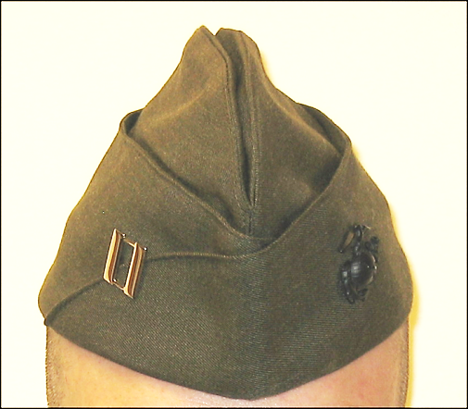
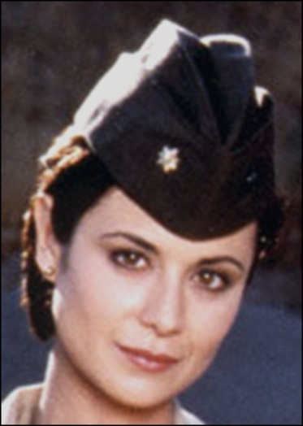
Garrison Service Covers
Officers wear rank insignia on the right side midway on arc of flap.
All wear the left Eagle Globe and Anchor insignia on opposite side of cover.

Slide 18
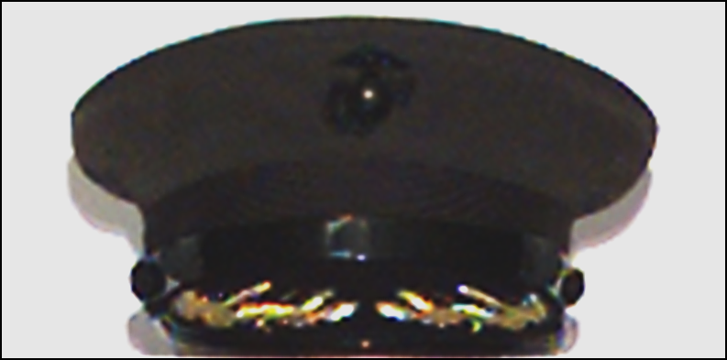
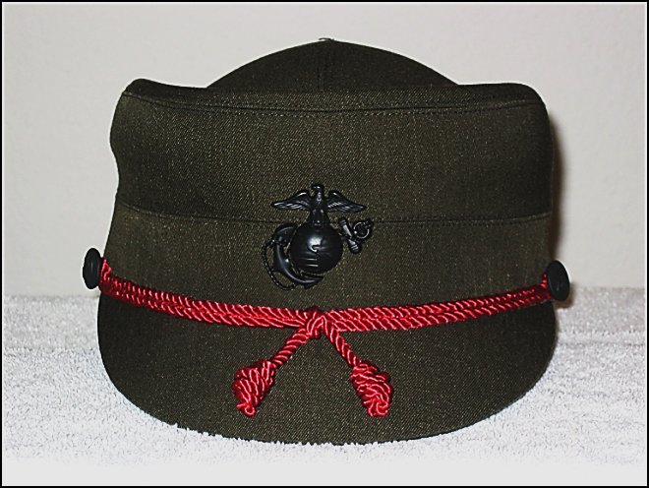
Service Covers
Also known as the “barracks cover.”
Branch insignia on front.
The male cover is interchangeable with dress service cover.

Slide 19
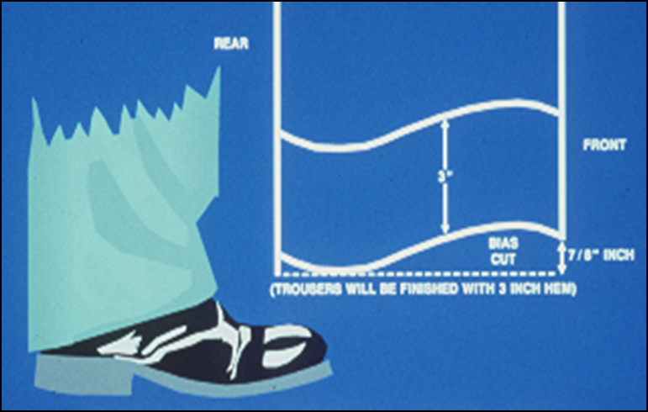
Service Trousers and Slacks
Breaks slightly over shoe in front.
Reaches welt of shoe in rear.
2 – 3” trouser hem.
Crease extends from bottom of hem to 2” above crotch.

Slide 20
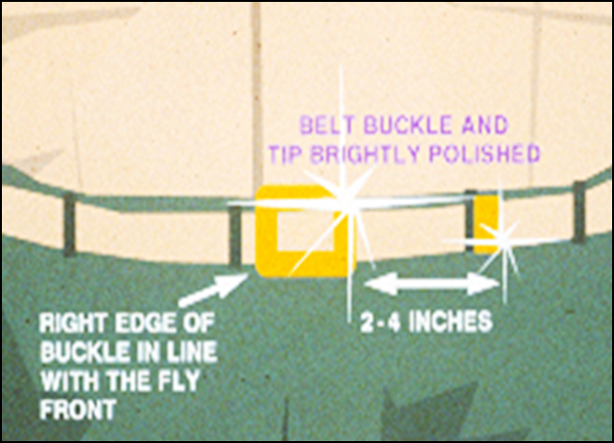
Khaki Web Belt
Tip should end between 2 – 4” from left edge of belt buckle.
Right edge of buckle should align with fly and shirt edge (Gig Line).

Slide 21
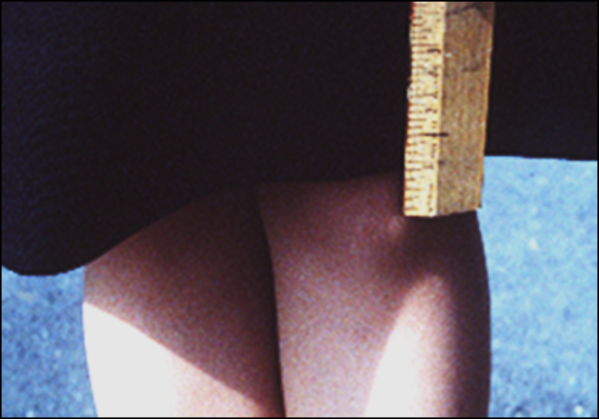
Service Uniform Skirt
Hem of 2–3”.
Bottom of skirt is no more than 1” above or 1” below the knee.
Nylon hose that matches skin tone will be worn with the skirt.

Slide 22
Being “Out of Uniform”
Being out of uniform refers to unauthorized mixing of uniform combinations or with civilian clothing.
Care must be taken to ensure fit, size, footwear, and other elements of your uniform to conform to standards.
All personnel will maintain a high standard of dress and appearance.

Slide 23
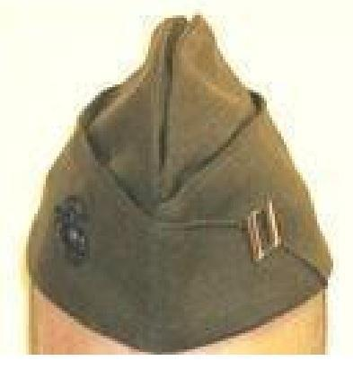

What is wrong with this picture?
(LE1-C5S3T4:LQ5)
The rank insignia is on the wrong side.
The Eagle and Globe insignia is on the wrong side.
Both A and B
Nothing, this picture is correct.

Slide 24
True or False:
For the female Service uniform, the bottom of the skirt is not more than 2" above or 2" below the knee.
(LE1-C5S3T4:LQ6)
True
False

Slide 25
Care of Uniforms
Uniforms should be carefully put on and buttoned.
When not worn uniforms should be on hangers or folded to preserve their original shape.
The service uniforms should be dry cleaned.
Proper wear should be a matter of personal pride.
Proper care and conforming to regulations gives confidence and improves self-esteem.

Slide 26
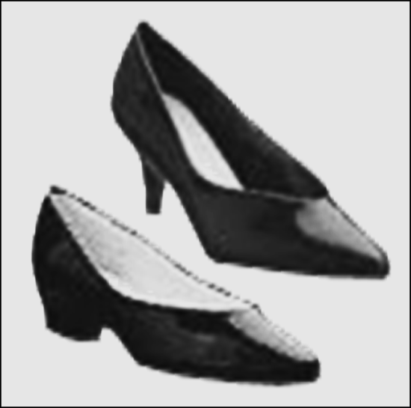
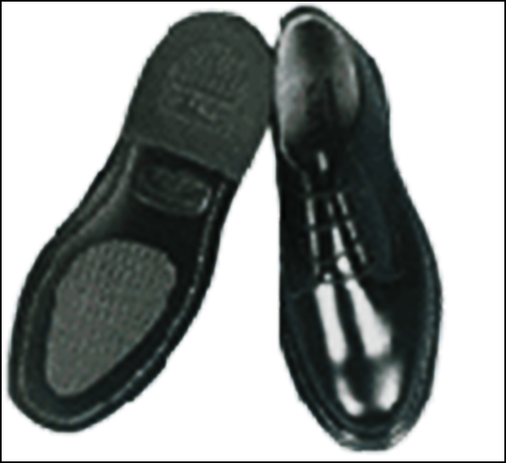
Female Service Uniform Shoes
Pumps are conservative cut with closed toes.
Heel is between 1-2 ½” in height.
Stockings will be skin tone, socks will be black.
Black shoes are Oxfords.

Slide 27
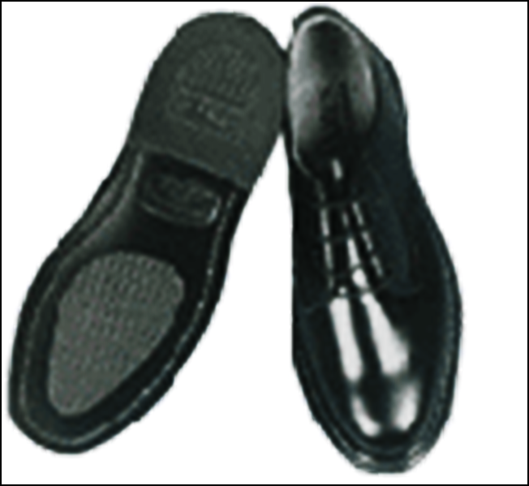
Male Service Uniform Shoes and Socks
Black socks are plain with no ornamental stitching.
Black shoes are Oxford or Chukka style.

Slide 28
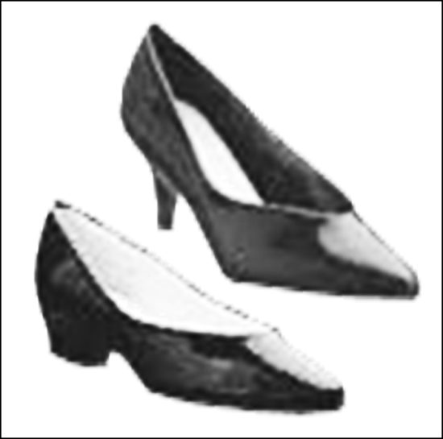
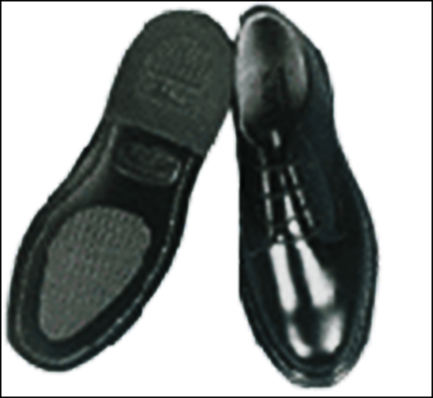
Care of Footwear
Shoes should be kept clean of sand and dirt.
Leather shoes should be polished.
Coraform shoes should be wiped clean.

Slide 29

Which Marine Corps Service Uniform can be worn for reporting for duty or when assigned to a court martial?
(LE1-C5S3T4:LQ7)
Service "A" uniform
Service "B" uniform
Service "C" uniform

Slide 30
Closing Question
List 2-3 reasons for understanding the proper wear and care of the Service Uniforms.
Note to Instructors:
Click the Show/Hide Response Display Button

Slide 31

Questions

Slide 32
Copyright Information
Images in this lesson were taken from:
    Microsoft© Clip Art Gallery
    Marine Corps Combat Camera

Slide 33
Participant Leaders
Points | Participant | Points | Participant

Slide 34
Team Scores
Points | Team | Points | Team

Slide 35
Team MVP
Points | Team | Participant

Slide 36
Fastest Responders
Seconds | Participant | Seconds | Participant

Slide 37
Whiteboard

