Slide 1
Professional Personal Appearance

Slide 2
Lesson Purpose
This lesson will provide cadets with the knowledge required to maintain a professional personal appearance.

Slide 3

Lesson Objectives
Explain the importance of a good professional personal appearance.
Describe the personal traits that make up a professional personal appearance.
Describe the specific Marine Corps requirements for maintaining a professional personal appearance.

Slide 4
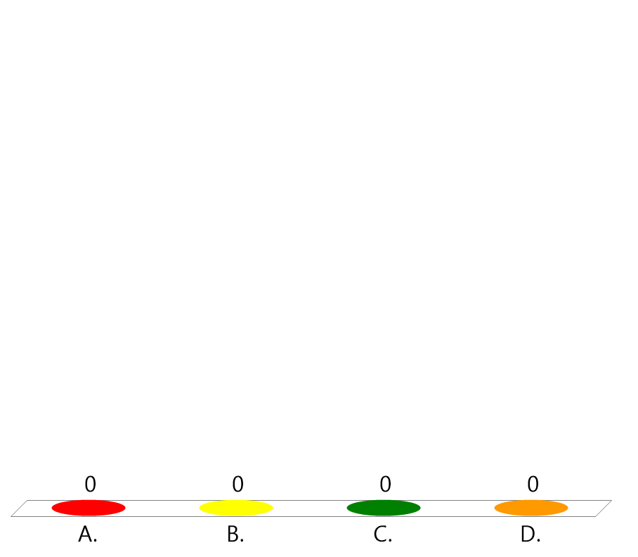
Team Assignment
Alpha
Bravo
Charlie
Delta

Slide 5

Which sentence best describes your grooming habits and personal appearance?
(LE1-C5S3T1:LQ1)
I just get up and go. I don't worry about it.
I shake the wrinkles out and glance in the mirror.
I clean up sometimes for special occasions.
I am always clean and dressed to impress.

Slide 6
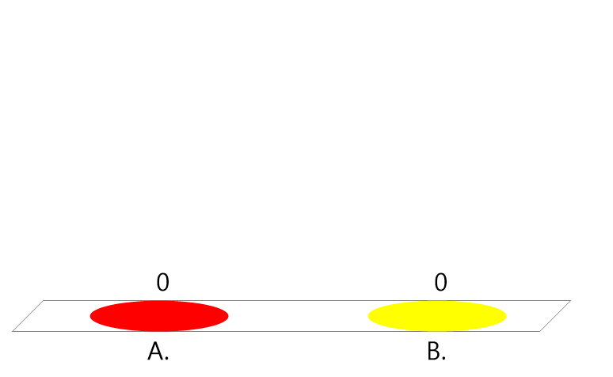
True or False:
As a cadet, people will tend to judge you more critically than other students on your personal appearance.
(LE1-C5S3T1:LQ2)
True
False

Slide 7
Key Words
Good posture
Proper weight
Good muscle tone
Good grooming
____________ - sitting, walking, bending, and
lifting properly
____________ - not being too thin or overweight
________________ - having a well rounded exercise
program
_____________ - proper personal hygiene; taking
care of your body

Slide 8
Key Word Question Slide Index
Sitting, walking, bending and lifting properly
Being too thin or overweight can affect your self- image as well as your health. A balanced diet is the key to _______.
Well-rounded exercise programs like swimming, bicycling, walking, and tennis can help to build ________.
Daily showers, brushing your teeth, and proper amounts of sleep are signs of _________.

Slide 9

Sitting, walking, bending and lifting properly
(LE1-C5S3T1:KW1)
Proper weight
Good posture
Good grooming
Good muscle tone

Slide 10
Being too thin or overweight can affect your self- image as well as your health. A balanced diet is the key to _______.
(LE1-C5S3T1:KW2)
proper weight
good posture
good grooming
good muscle tone

Slide 11

Well-rounded exercise programs like swimming, bicycling, walking, and tennis can help to build ________.
(LE1-C5S3T1:KW3)
proper weight
good posture
good grooming
good muscle tone

Slide 12
Daily showers, brushing your teeth, and proper amounts of sleep are signs of _________.
(LE1-C5S3T1:KW4)
proper weight
good posture
good grooming
good muscle tone

Slide 13
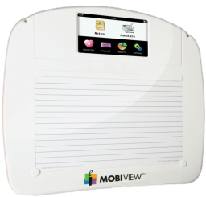
Opening Question
List 2-3 ways you demonstrate your personal professional appearance.
Note to Instructors:
Click the Show/Hide Response Display Button

Slide 14
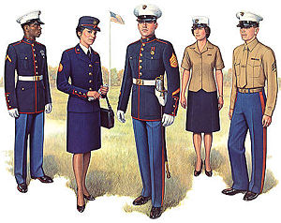
Introduction
Maintaining and presenting a professional personal appearance is important.
A professional appearance projects your affiliation with MCJROTC and your attitude.

Slide 15
Your Personal Appearance
Standing tall is a part of good posture as is sitting, walking, bending, and lifting properly.
A balanced diet is the key to proper weight.
Bicycling and walking are types of regular exercise that help with good muscle tone.
Daily showers or baths along with brushing your teeth are good grooming habits.

Slide 16
Maintaining A Professional Personal Appearance
The main objective of a professional appearance is to be visibly identified with a group or associated attribute.
A professional appearance projects your affiliation and attitude.
Maintaining a professional appearance is an important leadership trait.
Your appearance both in and out of uniform must be immaculate.

Slide 17

Which type of "personal appearance factor" can alleviate backaches, digestive trouble, and fatigue?
(LE1-C5S3T1:LQ3)
Proper weight
Good grooming
Good posture
Good muscle tone

Slide 18
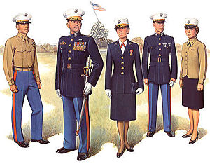
Factors That Affect Appearance
The perfect fitting uniform still requires adherence to other guidelines for an outstanding appearance.

Slide 19
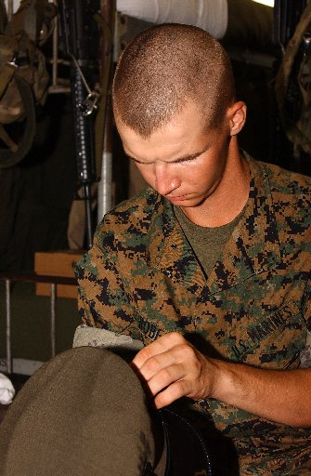
Factors That Affect Appearance
Care for your hair and fingernails.
Know how to wear the uniform properly.
Know to care and clean the uniform. A proper appearance requires a pressed and cleaned uniform.

Slide 20
Guidelines for Personal Appearance in the MCJROTC Uniform
Males: Hair neatly trimmed with sideburns not lower than the bottom of the ear opening and shaved and face freshly shaved.
Females: Hair styled so that it does not fall below the bottom edge of the collar and the cover can be worn.
Keep fingernails short and clean and no longer than ¼ inch.

Slide 21
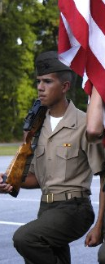
Guidelines for Wearing Your MCJROTC Uniform
Tuck shirts into trousers maintaining military alignment.
Button all buttons except the top or collar button.
Clean, polished, and properly displayed brass.
Conservative wristwatch and not more than two rings.

Slide 22

Guidelines for Wearing Your MCJROTC Uniform
Females may wear a gold round earring (1/4 inch max) in all uniforms except for MARPATs.
Males may not wear earrings.
No bulky objects in any pockets.
Wear the cover at all times when outdoors.

Slide 23

For males, hair should not be lower than...
(LE1-C5S3T1:LQ4)
The bottom of the ear
The top of the ear
The bottom of the ear opening

Slide 24
True or False:
Males can wear ear rings.
(LE1-C5S3T1:LQ5)
True
False

Slide 25
Closing Question
Based on what you learned in this lesson, list 2-3 areas where you could improve your personal appearance.
Note to Instructors:
Click the Show/Hide Response Display Button

Slide 26
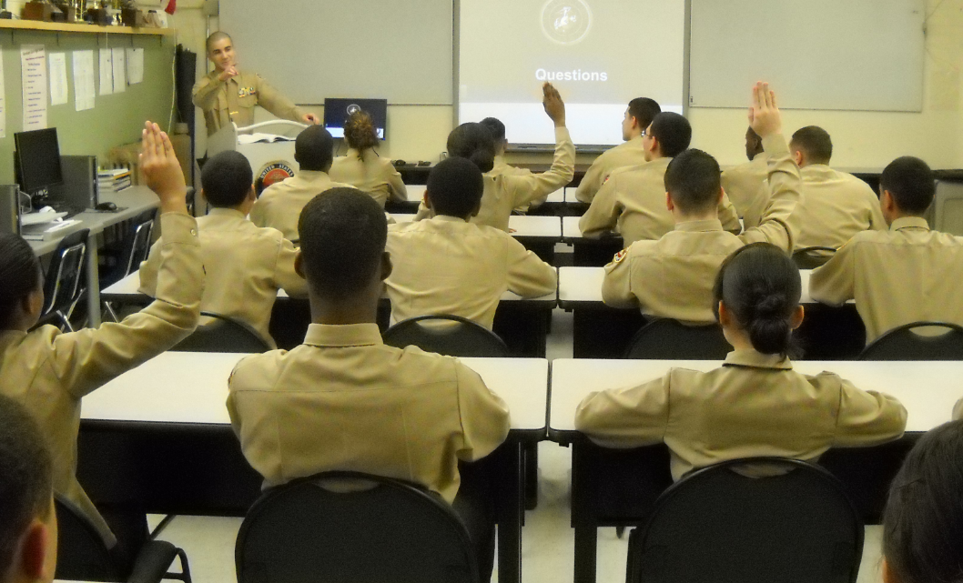
Questions

Slide 27
Copyright Information
Images in this lesson were taken from:
    Microsoft© Clip Art Gallery
    Marine Corps Combat Camera

Slide 28
Participant Leaders
Points | Participant | Points | Participant

Slide 29
Team Scores
Points | Team | Points | Team

Slide 30
Team MVP
Points | Team | Participant

Slide 31
Fastest Responders
Seconds | Participant | Seconds | Participant

Slide 32
Whiteboard

