Slide 1
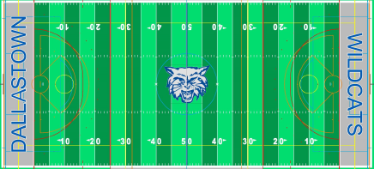

Football Pass Patterns
Pivot
10 yd Post
10 yd Dig
Fade
Comeback
Slant
Curl
Wheel

