Slide 1
Evolution

Slide 2
What is a theory?
Definition:
  “A coherent set of propositions that explain a class of phenomena that are supported by extensive factual evidence, and that may be used for prediction of future observations.”
  Numerous lines of evidence must exist
  Examples: Newton’s theory of gravity; Copernicus’s theory of the heliocentric solar system
Different than a fact
  Facts are based on direct observation or experience
    Examples: The existence of dinosaur fossils or the number of ribs a human possesses.
Notes:
http://www.gly.uga.edu/railsback/1122science7.html

Slide 3
What is evolution?
Can be a difficult term to define:
  Is a process that occurs over time
  Does NOT refer to an individual, but to a population
  It is NOT one individual changing into another
Most simply:
  “Evolution is a process that results in heritable changes in a population spread over many generations.”
  Change in allele frequency of a gene pool over generations
  Descent with modification (Darwin)

Slide 4
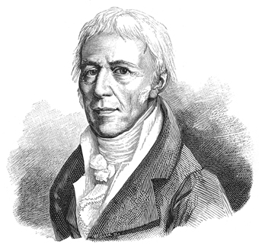
History of Evolution
Jean Baptiste Lamarck
  French biologist
  Noticed that species changed over time in response to the environment
    Evolution!
  Use and Disuse Inheritance

Slide 5
Lamarckism
Use and Disuse Inheritance (1809)
  Traits are acquired in response to the environment
  Acquired traits can be passed on to offspring
  Use:
    Organisms will develop characteristics that are useful in a given environment.
  Disuse:
    Organisms will lose characteristics that are not used in a given environment.
**Use and Disuse Inheritance is NOT supported by evidence**

Slide 6
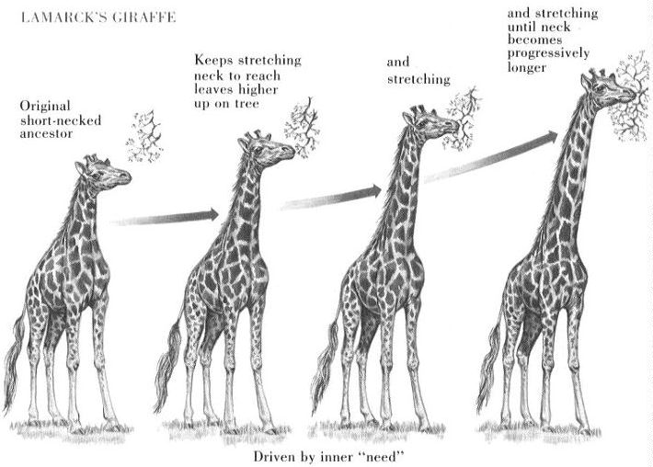
Lamarckism
Example:
  Giraffes’ long necks enable them to reach leaves on the tops of trees.
  A giraffe ancestor once had a short neck. According to Lamarck, long necks developed out of necessity, through stretching, so that giraffes could reach the progressively higher leaves. He proposed that this lengthened neck could be passed on to offspring.

Slide 7
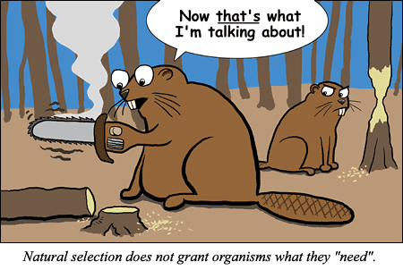

Slide 8
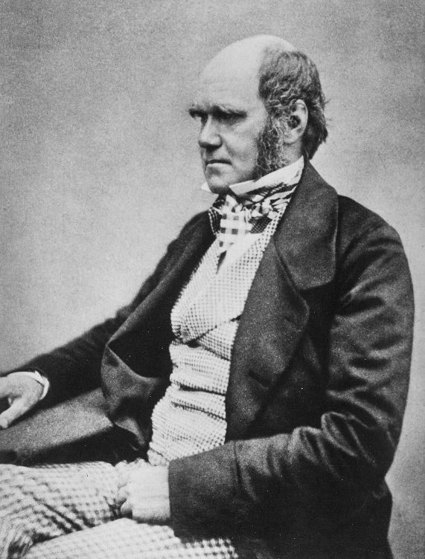
Charles Darwin
Born in 1809, to a wealthy English family
Educational history:
  Enrolled in medical school, but dropped out and became interested in theology.
  When he became interested in biology, he took a job on the HMS Beagle

Slide 9
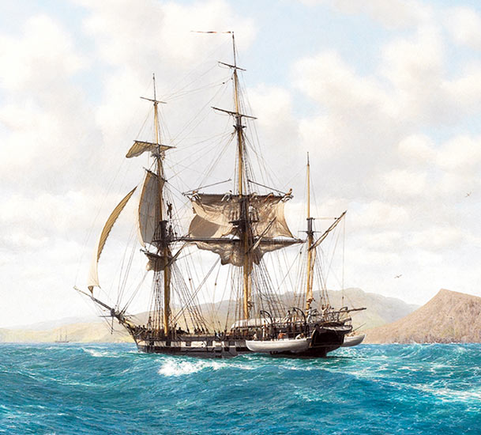
Aboard the Beagle
Purpose of the Beagle’s voyage:
  Chart the coast of South America
Darwin worked as a naturalist
  Studied the South American wildlife
    Especially on the Galapagos Islands
  Collected specimens as well as fossils
  Recorded detailed observations of many live organisms
5 year voyage

Slide 10
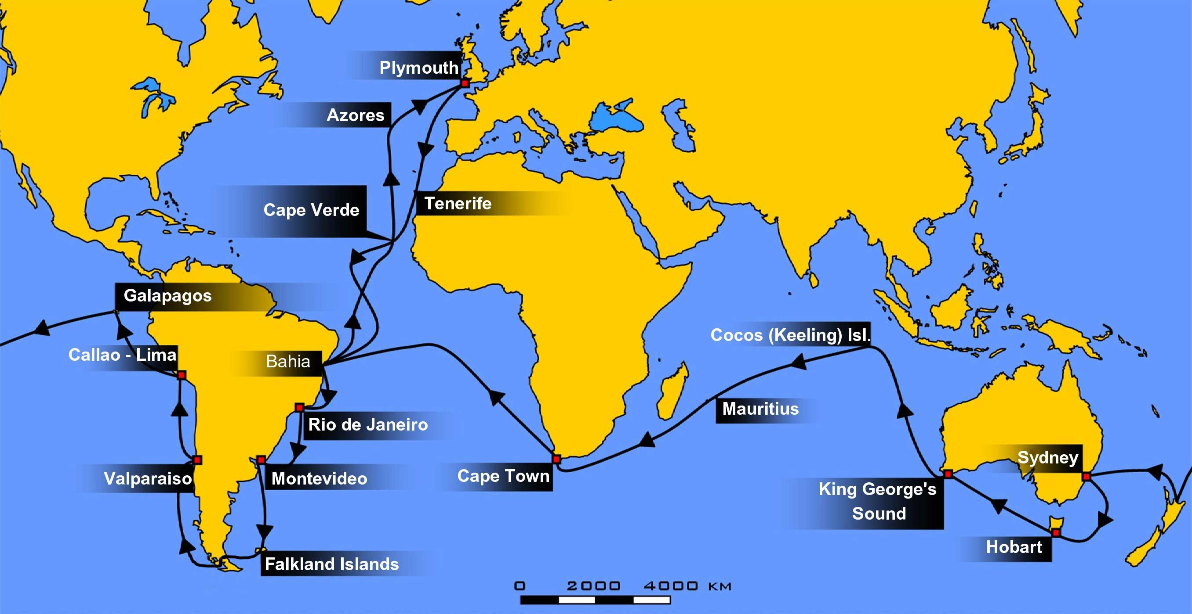
Route of the HMS Beagle

Slide 11
Darwin’s Findings
After close analysis of his data, Darwin proposed a theory:
  The Theory Evolution by Natural Selection
Findings were published in 1859
  On the Origin of Species
  Proposed that natural selection is the mechanism that drives evolution

Slide 12
On the origin of species
The process of natural selection:
  Species overproduce
    More offspring are born than the environment can sustain
  There is heritable variation in traits within a species
  Certain traits were better suited to the environmental conditions than others
  The individuals with traits best suited to the environment will have the greatest chance to survive and reproduce
    Survival of the fittest
      Those best suited to their environment will produce the most offspring

Slide 13
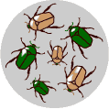
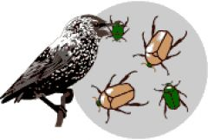
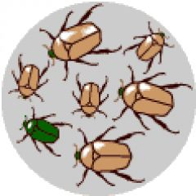
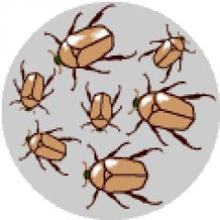
On the origin of species
Result:
  The number of individuals with a favorable trait will increase over time.
  When allele frequency changes over time, evolution has occurred!
    Allele frequency = Proportion of a particular allele of a gene in a population

Slide 14
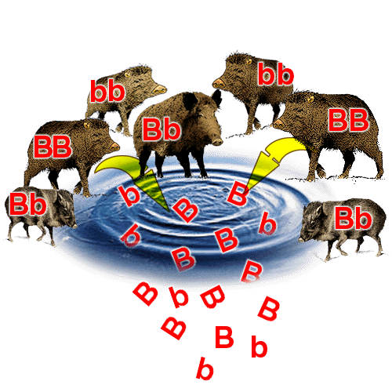
Gene mutations and allele frequency
Gene pool
  Set of all genes in a population
Mutations can create new alleles
  New alleles change the composition of gene pool by changing allele frequencies
Over time, allele frequencies will change:
  Frequency of alleles that help survival will increase
  Frequency of alleles that are detrimental to survival will decrease

Slide 15
Evidence of Evolution
Remember, evolution is a theory, so there must be extensive evidence that supports it!
Lines of evidence:
  Fossil record
  Anatomical features
  Embryology
  Biochemistry

Slide 16
Fossil Record
Show similarities between extinct organisms and organisms living today
Many types of fossils
  Bones, imprints (footprints, leaves), shells, plants, seeds, eggs, fossilized amber (insects)
Transitional Species
  Show link between groups of organisms
    Example: Archaeopteryx–Link between reptiles and birds
Shows ancestry between living and extinct species
    Example: Darwin’s giant ground sloth fossil and tree sloths alive today

Slide 17
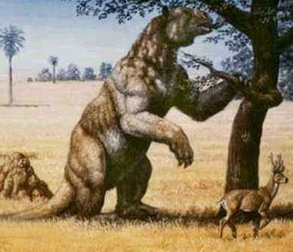
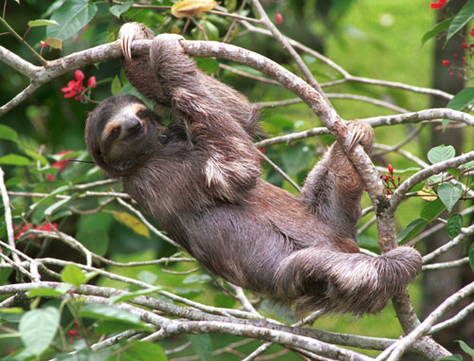
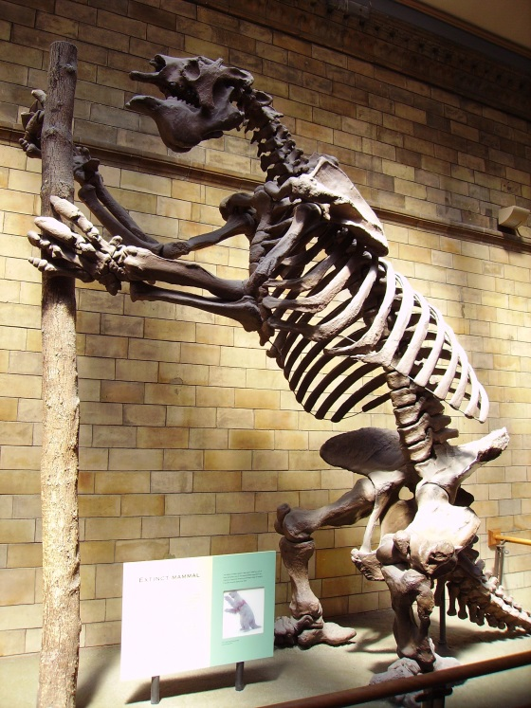
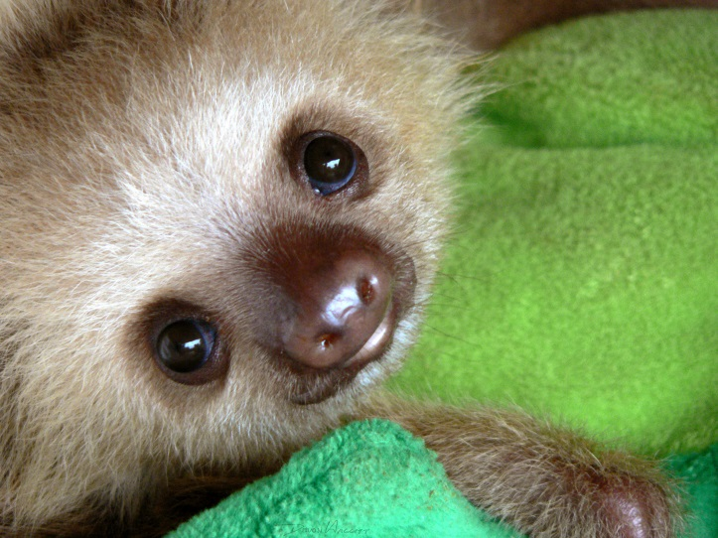
Ground Sloth (extinct) and
Tree sloth (living species)

Slide 18
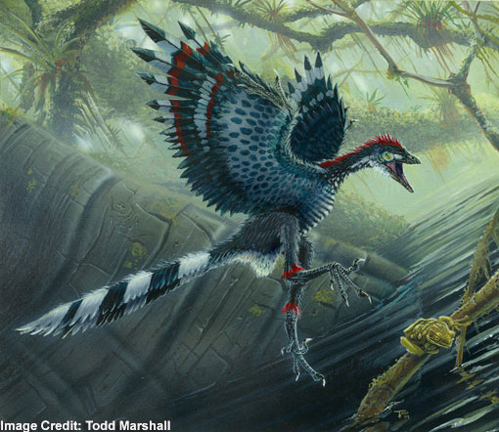
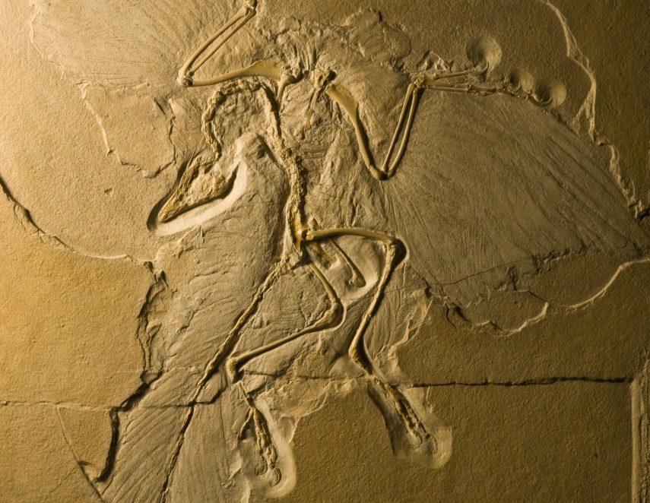
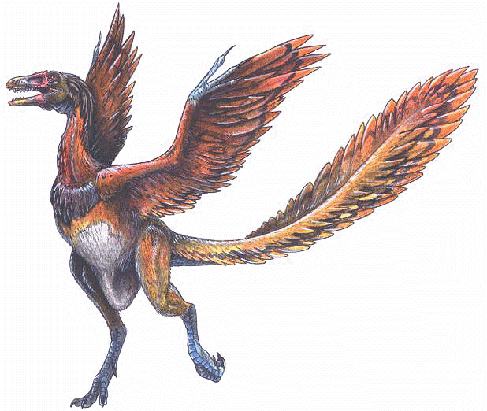
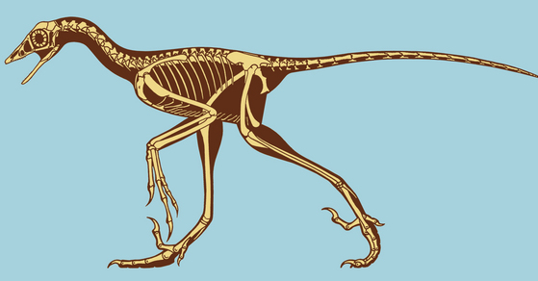
Archaeopteryx

Slide 19
Anatomical features
Similarities in anatomy suggest common descent/ancestry among organisms
  Homologous structures
  Vestigial structures

Slide 20
Homology vs. Analogy
Homology- traits inherited by two different organisms from a common ancestor (forelimbs of a dog and human arm)
Analogy- similarity due to convergent evolution not common ancestry (wings of a bird and wings of a butterfly)

Slide 21
Convergent Evolution
Convergent evolution
  Two separate organisms evolve similar characteristics independently of one another
  Happens when two species are facing similar selective pressures/same environmental pressures

Slide 22
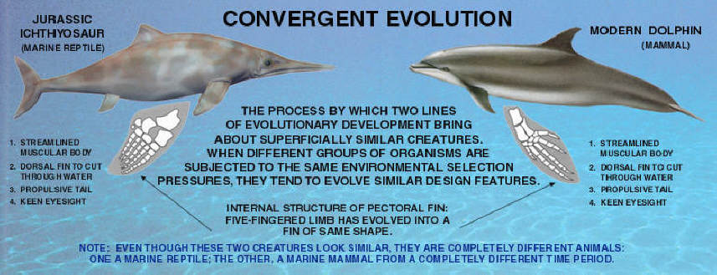

Slide 23
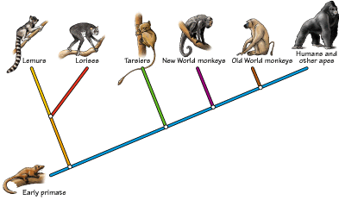
Divergent evolution
Divergent evolution is the accumulation of differences; results in different species

Slide 24
Homologous Structures
Definition:
  Bones or organs that appear in different organisms but share a common ancestry
  Same basic structure, but different functions
  Example:
    Forelimbs of vertebrates:
      Dolphin flipper
      Bat wing
      Dog front limb
      Human arm
      These bones are very similar but have very different functions

Slide 25
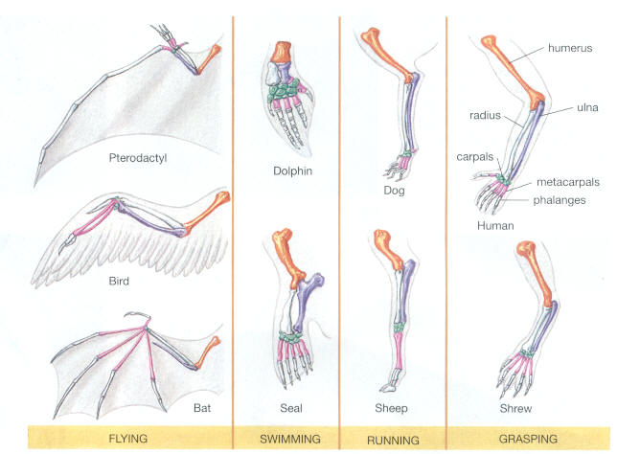
Homologous Structures

Slide 26
Vestigial Structures
Definition
  Body structure that has been reduced in size and function
  But, resembles a fully functional structure in another organism
Examples
  Tailbone (coccyx) in humans
  Appendix in humans
  Wings in flightless birds
    Related to wings used for flying
  Semilunar fold in human eye
    Remnant of nictitating membrane
  Goosebumps in humans
    Attempt to fluff up fur when cold

Slide 27
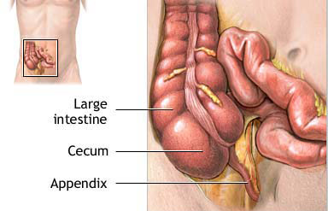
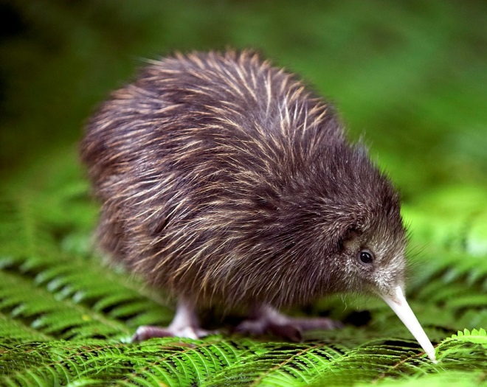
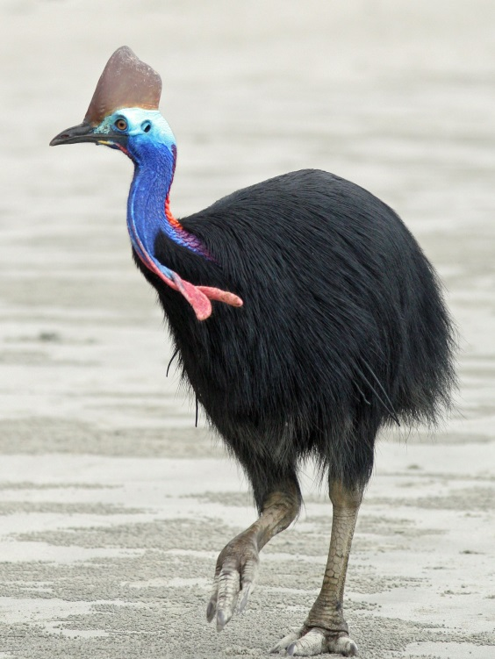
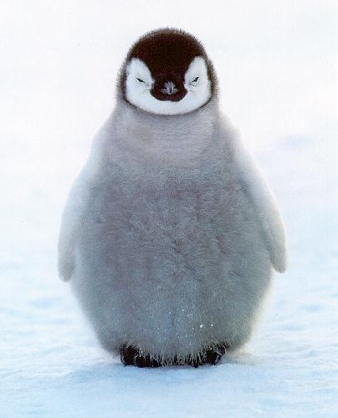
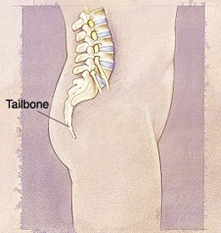
Vestigial structures

Slide 28
Embryology
Embryology Definition:
  The study of embryos and their development
Different organisms show very similar developmental patterns and structures
  Suggests common ancestry between species
Example:
  All vertebrates have gill slits and a tail at some point during development

Slide 29
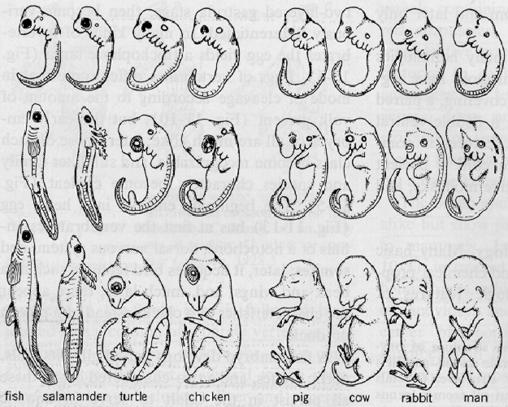
Embryology

Slide 30
Biochemistry
Nucleic acids carry genetic information in all organisms
  DNA or RNA
Universal genetic code
  Triplet code and amino acids are the same for all organisms
DNA sequences
  The more closely related organisms are, the more similar their DNA sequences
Proteins
  Vital proteins are found in all organisms
  Example: DNA polymerase, RNA polymerase
ATP
  Energy source for all organisms

Slide 31
Natural Selection at Work
Rock Pocket Mice Video (9 min)

Slide 32
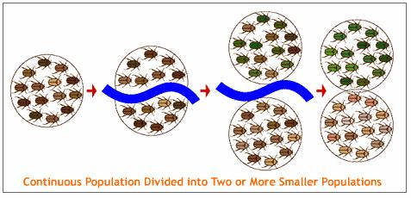
Speciation
Speciation:
  The formation of a new species
When species are geographically separated over long periods of time, new species can result
  Population is split into two or more smaller groups by a physical barrier
    Mountains, streams, ocean, desert, etc.

Slide 33
Speciation Animation (2:38)

Slide 34
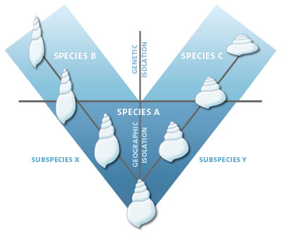
Geographic Separation
Geographic isolation animation (1:31)

Slide 35
Reproductive isolation
Over time, geographically separated species evolve separately and become reproductively isolated
Reproductive isolation:
  Members of a species cannot mate and/or produce viable offspring
  When reproductive isolation occurs:
  →New species!

Slide 36
Reproductive isolation
Many reproductive isolating mechanisms:
  Temporal
  Ecological
  Behavioral
  Mechanical
  Post-mating Mechanisms

Slide 37
Reproductive Isolating mechanisms
Temporal
  Species have different mating seasons, periods of fertility, or periods of activity (morning vs. night)
Ecological
  Species only mate in their preferred habitat, which is not shared by a different species
Behavioral
  Species have different mating rituals (calls, dances, etc.)
Mechanical
  Physical, morphological differences prevent mating

Slide 38
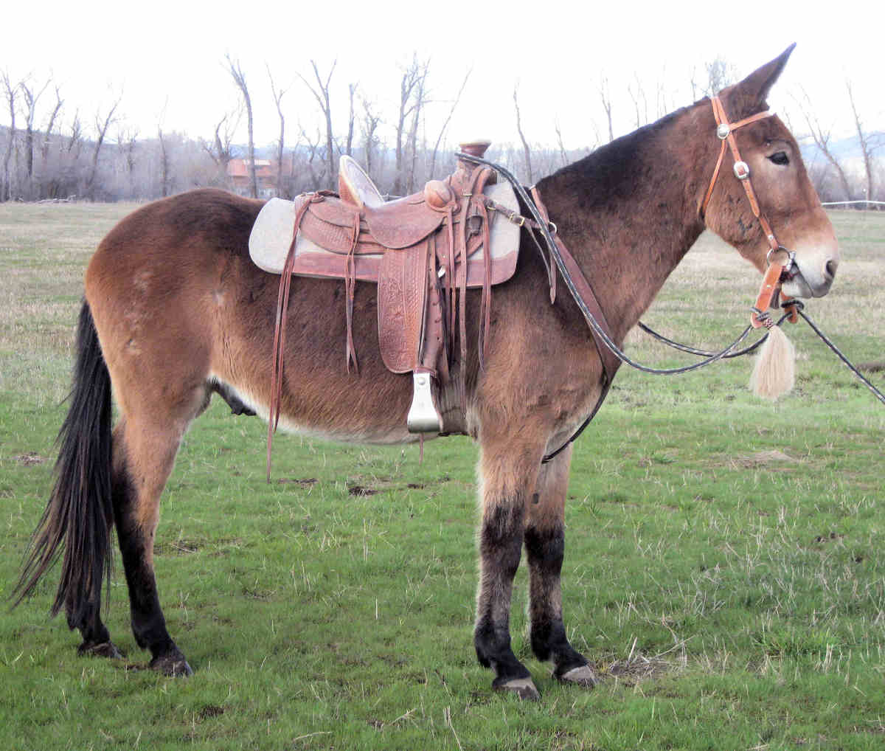
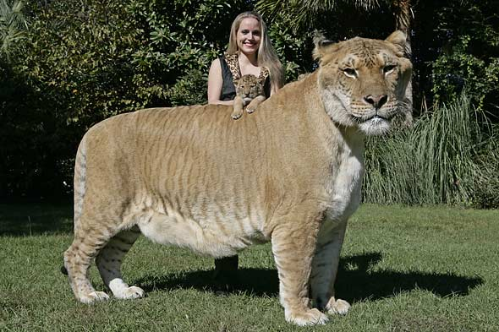
Reproductive Isolating mechanisms
5. Post-mating Mechanisms
  Mating takes place, but:
    Fertilization does not occur
    (gametic isolation),
    Zygote or embryo dies
    (hybrid inviability),
    Or, offspring is sterile (hybrid sterility)
  Examples:
    Mule:
      Sterile hybrid of horse and donkey
    Liger:
      Sterile hybrid of lion and tiger

Slide 39
Gradualism vs. Punctuated Equilibrium
Two hypotheses about how evolution occurs:
  Gradualism
    Genetic changes are slowly but steadily occurring
    Over time, small changes add up to the formation of a new species
  Punctuated Equilibrium
    Periods of little to no change, followed by a rapid change
    Mutation occurs that causes a huge change in a small number of individuals
      If the change is advantageous , these individuals will have high fitness and pass the trait along

Slide 40
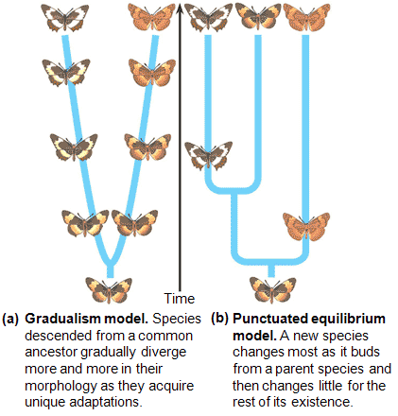
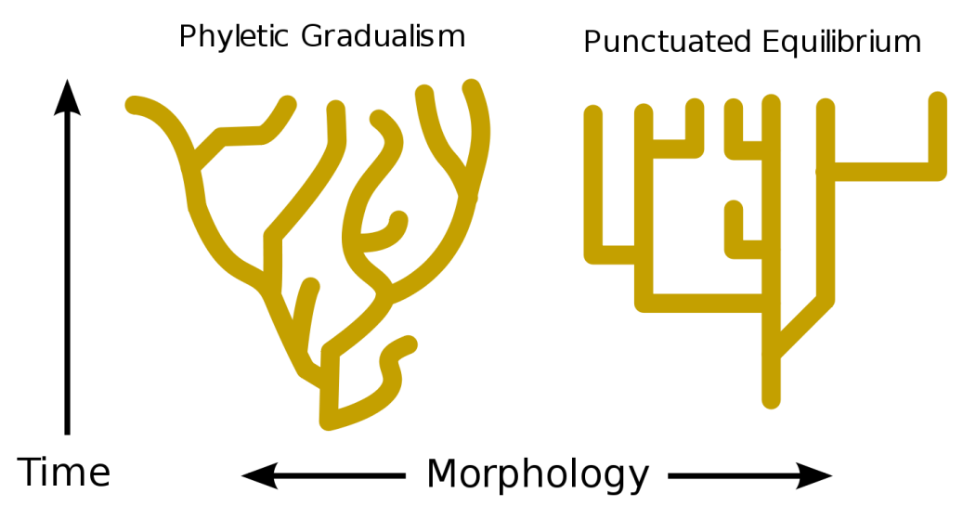
Gradualism Vs. Punctuated equilibrium
Animation

Slide 41
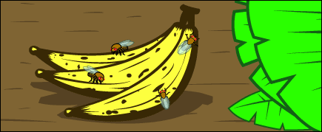
The scene: a population of wild fruit flies
minding its own business on several bunches
of rotting bananas, cheerfully laying their eggs
in the mushy fruit...

Slide 42
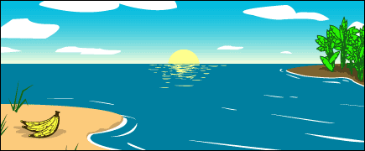
Disaster strikes: A hurricane washes the
bananas and the immature fruit flies they
contain out to sea. The banana bunch eventually
washes up on an island off the coast of the
mainland. The fruit flies mature and emerge
from their slimy nursery onto the lonely island.
The two portions of the population, mainland and island, are
now too far apart for gene flow to unite them. At this point,
speciation has not occurred—any fruit flies that got back to
the mainland could mate and produce healthy
offspring with the mainland flies.

Slide 43
The populations diverge: Ecological conditions are slightly different on the island, and the island population evolves under different selective pressures and experiences different random events than the mainland population does. Morphology, food preferences, and courtship displays change over the course of many generations of natural selection.

Slide 44
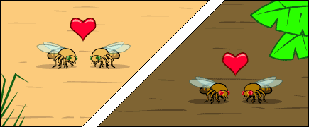

Slide 45
So we meet again: When another storm reintroduces the island flies to the mainland, they will not readily mate with the mainland flies since they’ve evolved different courtship behaviors. The few that do mate with the mainland flies, produce inviable eggs because of other genetic differences between the two populations. The lineage has split now that genes cannot flow between the populations.

Slide 46
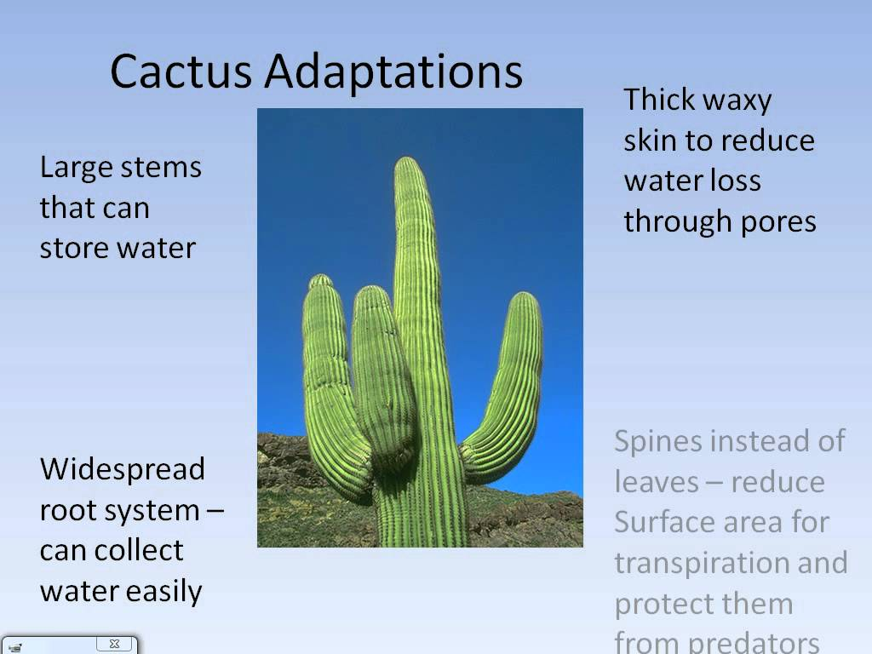
Natural Selection:
Adaptation = any trait that aids the chances of survival and reproduction of an organism.

Slide 47
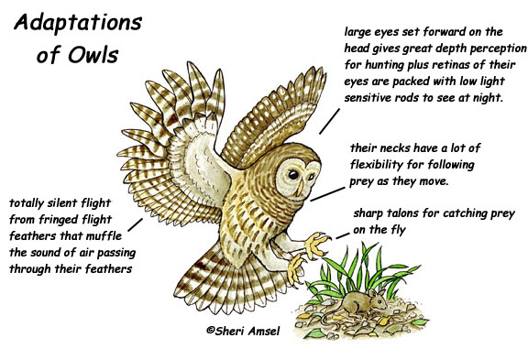
Natural Selection:
Two Types: Structural and Physiological
STRUCTURAL ADAPTATIONS arise over many generations:

Slide 48
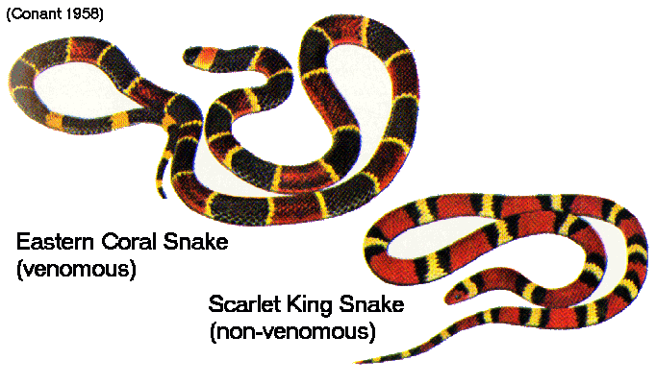
Types of Structural Adaptations
Mimicry = provides protection for an organism by enabling it to copy the appearance of another dangerous species.

Slide 49
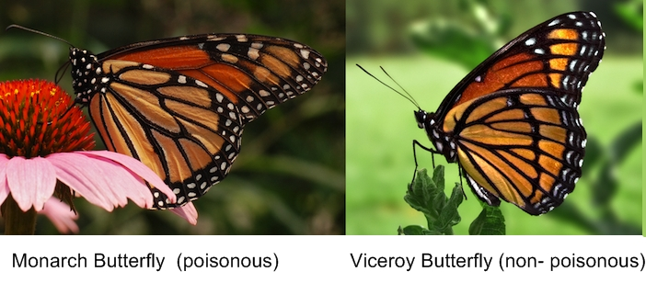
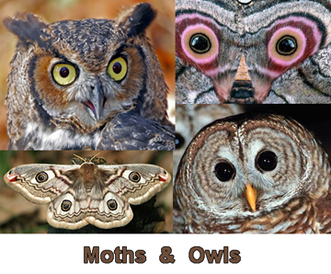
Mimicry:

Slide 50
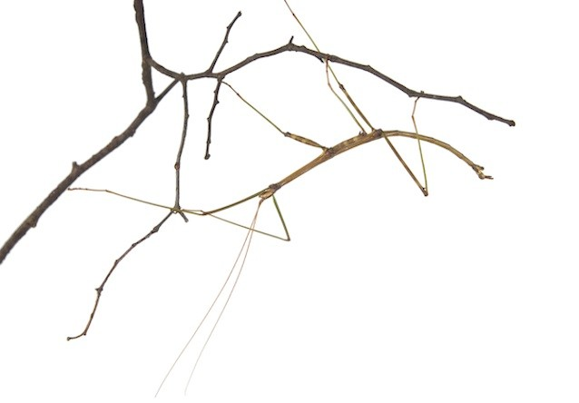
Mimicry:

Slide 51
Structural Adaptations:
Camouflage = enables an organism top blend in with its surroundings
  More likely to escape predators and survive to reproduce

Slide 52
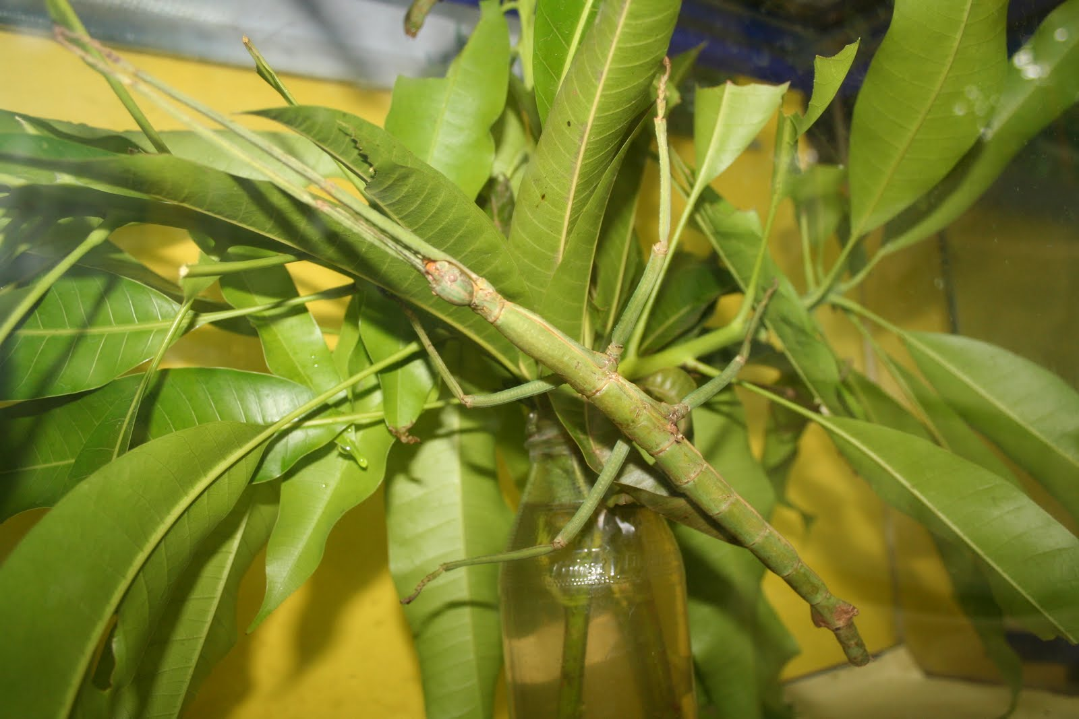
Camouflage:
Walking Stick

Slide 53
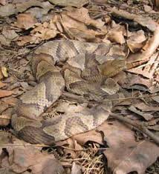
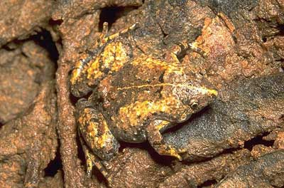
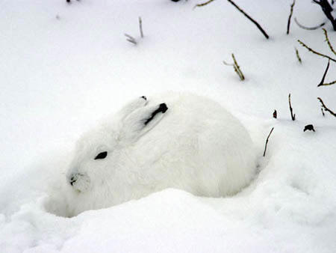
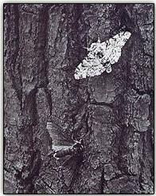
Camouflage
Video Clip

Slide 54
Example of Natural Selection
Lighter colored pepper moths less noticeable on lichen covered trees

Slide 55
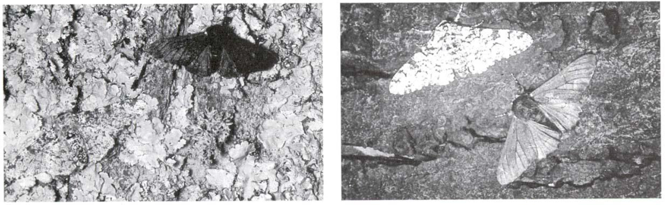
Pollution kills lichens and uncovers darker tree trunks

Slide 56
Frequency of color moths has changed over time in response to pollution

Slide 57
Natural Selection:
PHYSIOLOGICAL ADAPTATIONS can develop rapidly
  Changes in an organism’s metabolic processes

Slide 58
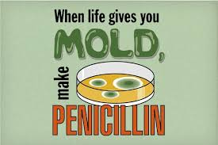
Physiological Adaptations
Ex: Penicillin – was discovered 50 years ago as a wonder drug because it could kill many types of disease-causing bacteria
Now penicillin is not as effective as it used to be because many species of bacteria have evolved physiological adaptations that make them resistant to penicillin.

Slide 59

Physiological Adaptations:
Ex: insects/ weeds have been selected for physiological resistance to chemicals used in pesticides

Slide 60
Mechanisms of Evolution
  Natural Selection
    Survival of the fittest
  Mutation
    Changes allele frequency of populations
  Genetic drift
  Migration

Slide 61
Genetic Drift
Definition
  Change in allele frequency of a population due to chance
  Small populations are more susceptible
In a population, some individuals will produce more offspring, and pass on more of their genes
Result:
  Over time, only one allele for a trait may remain in a population (Fixation)
    Reduce in genetic diversity

Slide 62

Genetic Drift
Genetic Drift Animation (2:09)

Slide 63

Migration
Definition:
  Movement of individuals from one population to a new population
Movement of individuals between populations can change allele frequency
Founder effect
  A colony is founded by members of an existing population
  Small colony population may have:
    Lower genetic diversity
    A non-representative collection of
    genes from the original population
  Grants Research of Darwin’s Finches
  (16:08)

Slide 64


Founder effect in the Amish
Live in Lancaster, PA
Founded by 200 German immigrants
These immigrants had a high proportion of the recessive alleles that cause Ellis-van Creveld syndrome
  Symptoms: Dwarfism, polydactyly, holes in heart chambers, malformed nails and teeth
Closed gene pool keeps the disease alleles in
the population

Slide 65

Population bottleneck
Definition:
  A populations size is greatly reduced for at least one generation
Genetic diversity is greatly reduced
If population increases again, the genetic diversity will be extremely low

Slide 66



Bottleneck Examples
Elephant seals
  Almost hunted to extinction in the 1890s
  Population dwindled to 20-60 seals
  Once the species was protected, it was able to rebound
  Today, population is 30,000
Cheetahs
  Near extinction 10,000 years ago
    End of last ice age
  Population further reduced due to poaching
  Today, all cheetahs have almost identical DNA
    Reduced health, fertility, and fitness

Slide 67


Lego Animation
Founder effect, bottlenecking, and genetic drift (2:55)

Slide 68
Mutation
A change in the genetic code that can be neutral, lethal, or beneficial to the organism.
If a mutation is beneficial to the organisms in its environment, it can lead to an adaptation.
Read Article: The Evolution of Antibiotic Resistance in Bacteria

Slide 69
Evolution in the Influenza Virus
1. Each season, mutations occur in the influenza virus. Those vaccinated against the flu would not have antibodies against the mutated version. A new vaccine would need to be produced to account for the mutation.

Slide 70
Evolution in the Influenza Virus
2. Antibodies produced by the human immune system would not recognize the mutated version of the flu. The mutated viruses would then be able to avoid the antibodies and continue to infect. These survivors would evolve into a new strain of the flu.

Slide 71
Evolution in the Influenza Virus
Using Darwin’s 4 major points on how Evolution by Natural Selection occurs:
Many flu viruses produced in each generation. Not all will be able to avoid the immune system. (over reproduction)
Mutations in the virus = variations
Those with a mutation that enables them to avoid the human antibodies will survive and reproduce. (Increased reproductive success)
The # of flu viruses with the mutation will increase and the virus will evolve. (Increased allele frequency)

