Slide 1

Introduction to Law
Chapter 7 Notes
“Crime in America”

Slide 2
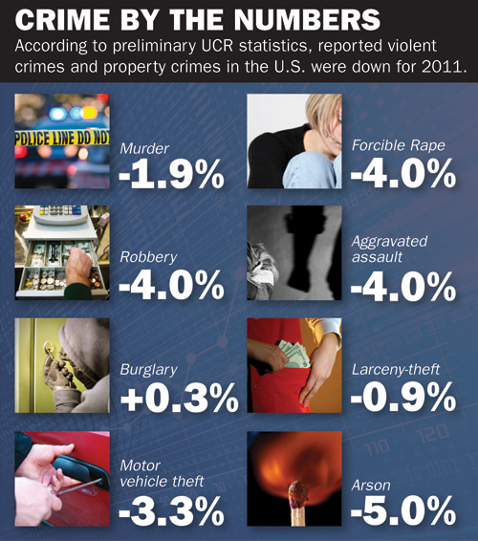
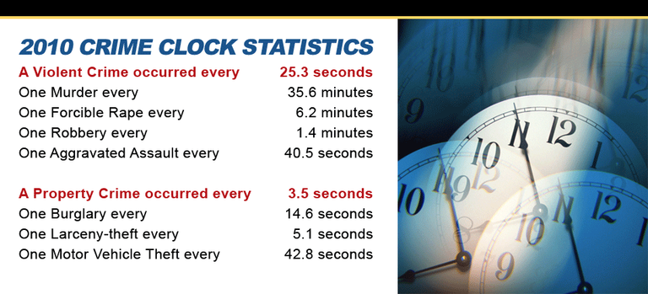
An act which the government has deemed contrary to the public good: a wrong which the government has determined injurious to the public
Crime -
Types of Crimes
- crimes against people => murder, battery, assault, rape
- crimes against property => burglary, embezzlement, and receiving stolen goods
- crimes against the public => hate crimes, vagrancy, and disorderly conduct

Slide 3
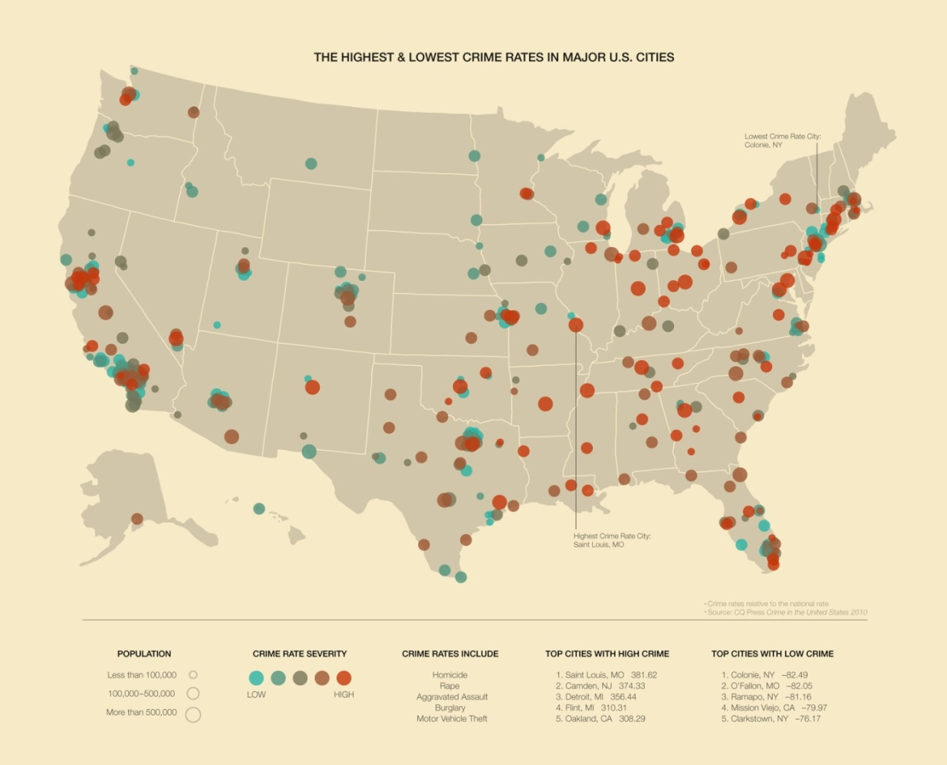
Crime rates are influenced by many factors:
=> Location – violent crime rate in urban areas is about 70% higher than the rural rate and 35% higher than the suburban rate
=> Age – 15 – 24 year olds commit most violent crimes
=> Gender – males are 4X as likely to commit a crime than females
- One way in which crime affects us all is that it monetarily…the total amount of government expenditures on crime is approximately $150 billion
- a family of four pays an average of more than $1,500 in taxes relating to crime

Slide 4
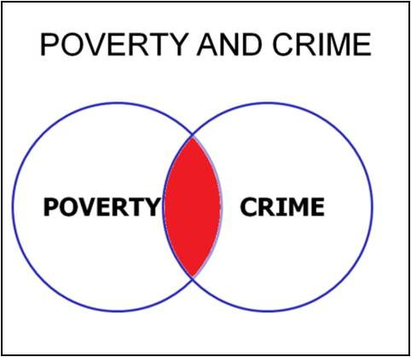
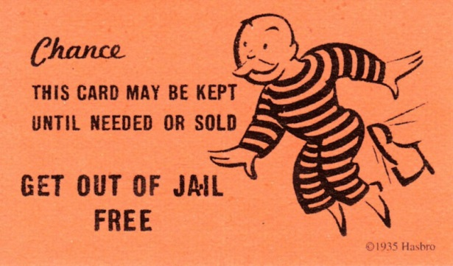
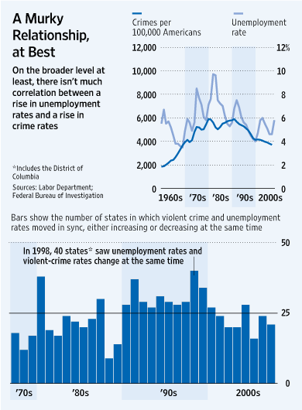
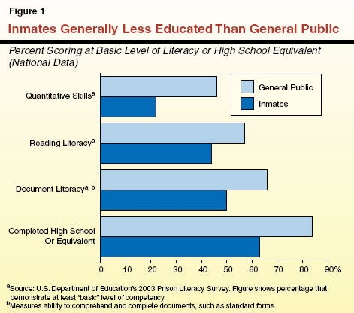
Reasons suggested for high crime rates:
1. poverty
2. permissive courts
3. unemployment
4. lack of education

Slide 5
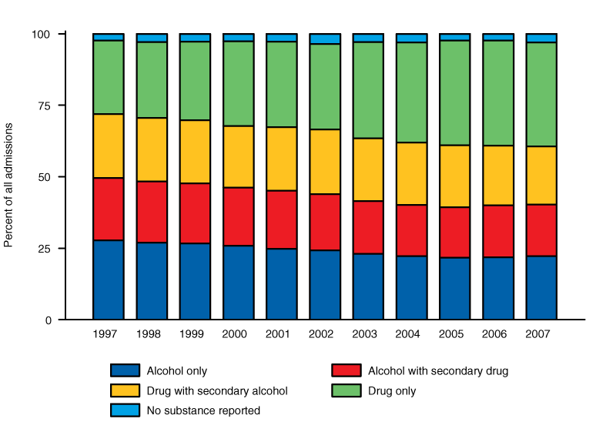
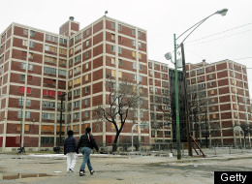
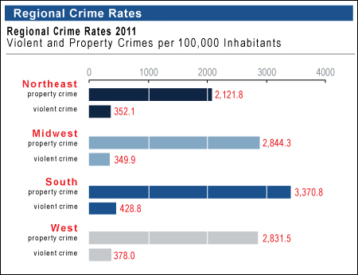

5. abuse of alcohol/drugs
6. inadequate police protection
7. rising population
8. lack of parental guidance

Slide 6
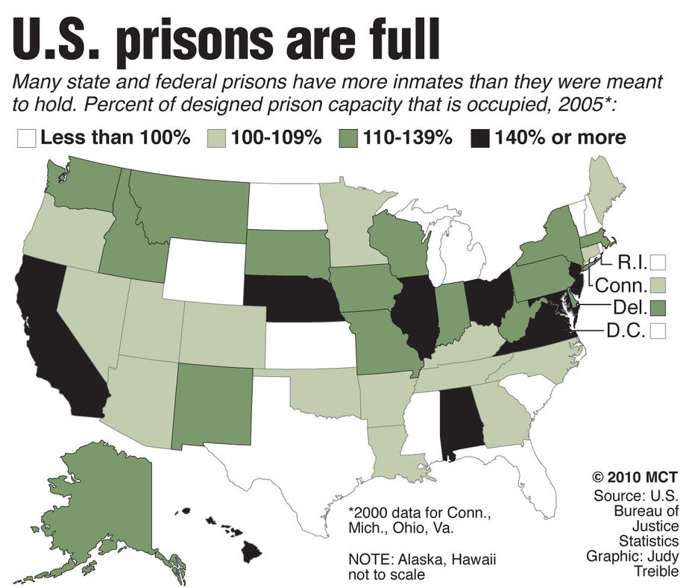
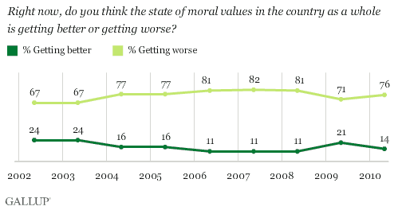
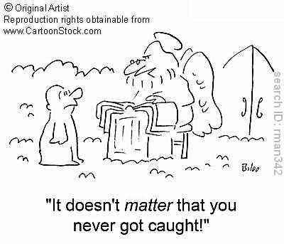

9. a breakdown on morals
10. ineffective correctional system
11. little chance of being caught
12. influence of movies, television, and video games

Slide 7
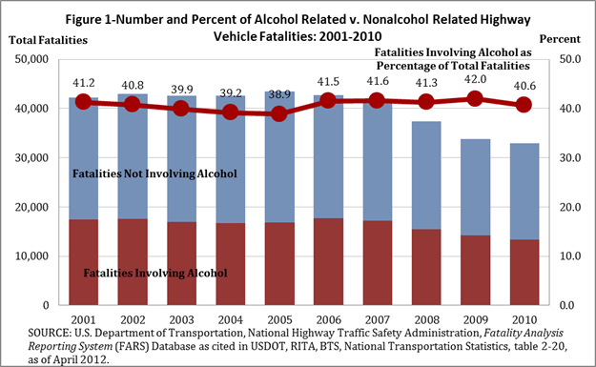
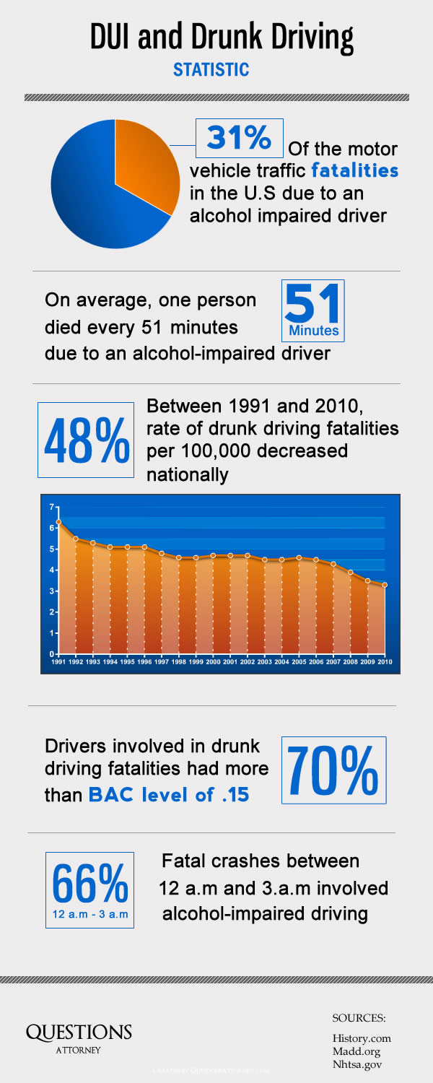
Substance Abuse and Crime
- according to the Dept. of Justice, alcohol was a factor in 35% of violent crimes committed in the U.S. in 2010; 2/3 of the victims who suffered violence by a spouse, former spouse, boyfriend, or girlfriend report that alcohol had been a factor
DUI….DWI…BAC
- every year over 1 million are arrested for driving under the influence of alcohol
Implied consent law - driver agrees to submit to a BAC test in exchange for the privilege of driving

Slide 8
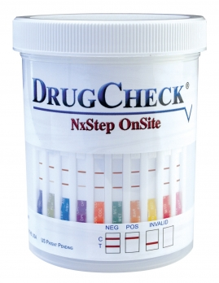
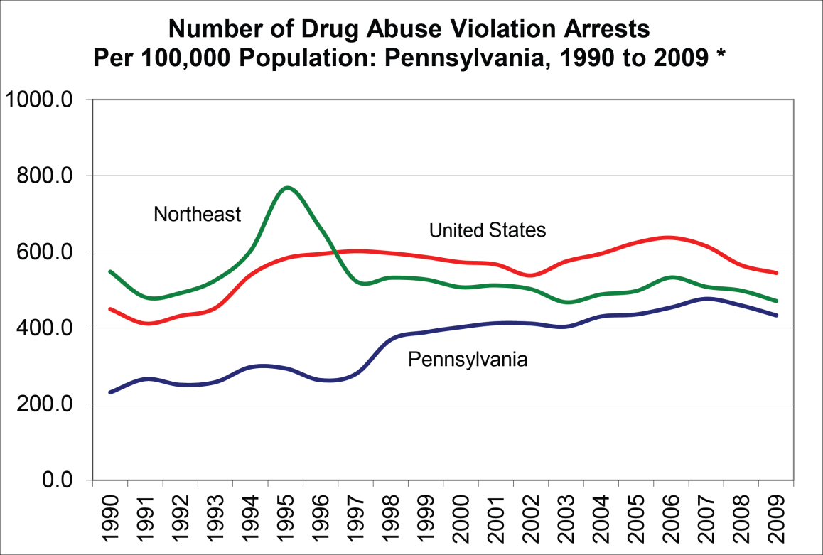
- between 50% and 75% of persons who enter the criminal justice system test positive for one or more drugs at the time of their arrest
- possession, distribution, or the sale of certain drugs is a crime that may violate federal law, state law, or both
- federal and most state laws now carry harsher penalties for drug offenders than they once did
- Mandatory jail sentences, “life without parole”, or federal crime classification, and forfeiture laws are all examples

Slide 9
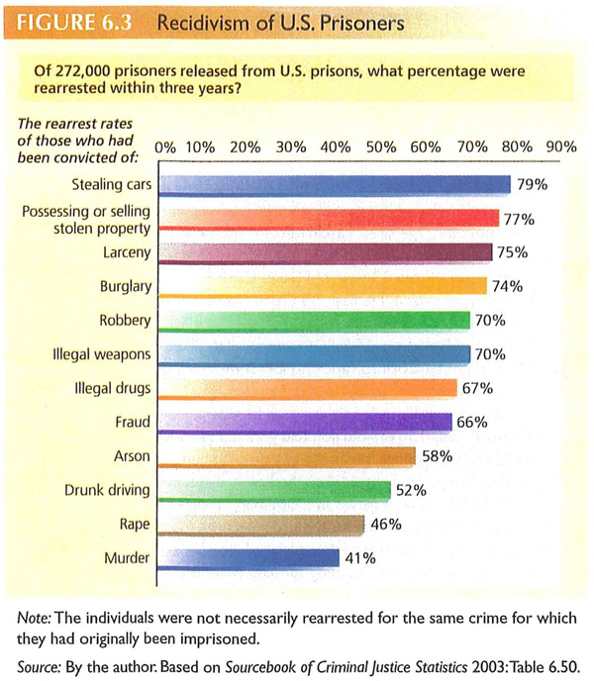
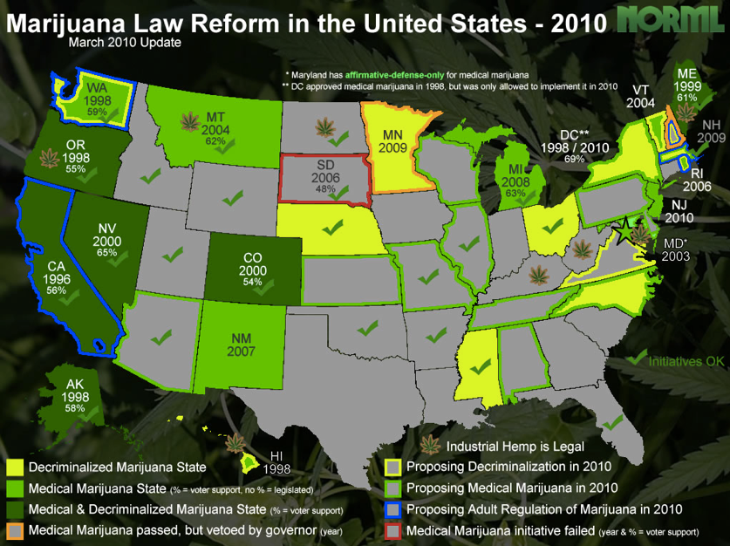
- more than 40 states have some type of recidivist law that require longer sentences for people who are repeat offenders
- the debate continues over the legalization of drugs, or certain types of drugs

Slide 10

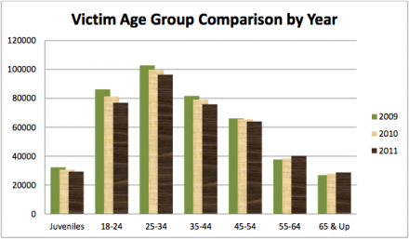
Victims of Crime
- Crime affects all segments of society…each year more than 24 million Americans aged 12 or older are victims of crime
- those aged 12 to 24 were victims of violent crimes most frequently
- gender, socio-economic status, race, and location are all factors influencing a person’s likelihood of becoming a victim

