Slide 1

Introduction to Law
Chapter 8 Notes – Criminal Law

Slide 2

Criminal Law – law created by the legislature (statutory) for the health, welfare, safety, and general goods of the public
Purposes of Criminal Law
1. Protection of society
2. Deterrence
3. Rehabilitation
4. Incapacitation
5. Retribution

Slide 3


Ex post facto law (Article 1, Section 9) – an individual cannot be punished for committing an act that was legal at the time but has recently been changed to illegal
Strict liability law – crimes that do not require a guilty state of mind; the act itself is criminal, regardless of the knowledge or intent of the person committing the act

Slide 4
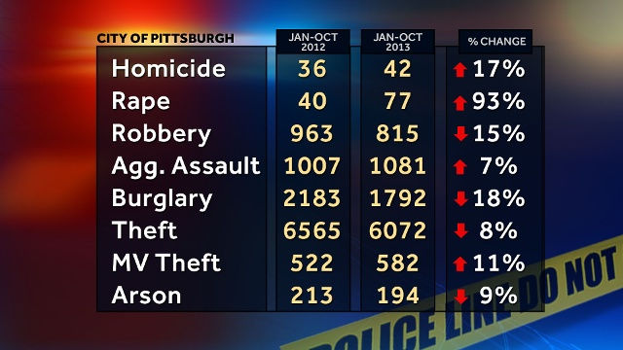
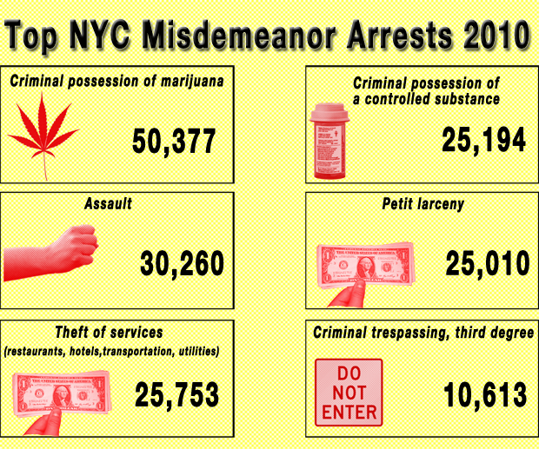
Model Penal Code => a collection of criminal statutes; it was created for the states to adopt in whole or in part, and has helped create uniformity in criminal law
Felony => any offense punishable by death or imprisonment exceeding one year
Misdemeanor => crime punishable by a fine or by detention of one year or less in a jail or an institution other than a penitentiary

Slide 5
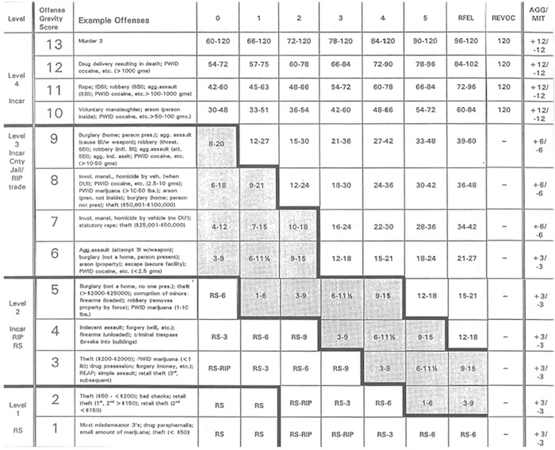

- felonies and misdemeanors are often then divided into subclasses for sentencing
- the judge s responsible for imposing the sentence; the sentences are mandatory for certain charges, while others may give a range of years
- in criminal law, the government prosecutes the offender to punish the person who caused the injuries

Slide 6
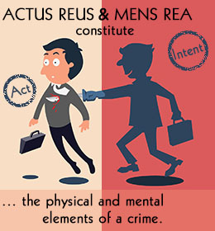
Two basic elements are included in all crimes:
1. actus reus (“wrongful act”) => the element of physical conduct necessary to commit a criminal act
2. mens rea (“guilty mind”) => the mental state required as an element to convict one of criminal conduct
Concurrence – when both the physical and metal elements of the crime are present

Slide 7


Two Basic Subtypes:
A. Specific Intent – requires that the actor formed the actual intent to achieve the result of the crime
B. General Intent – requires only knowledge of the likelihood of the result of the act

Slide 8
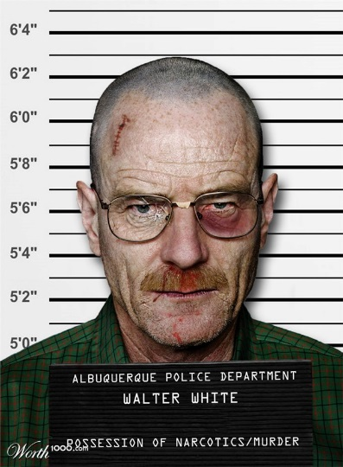
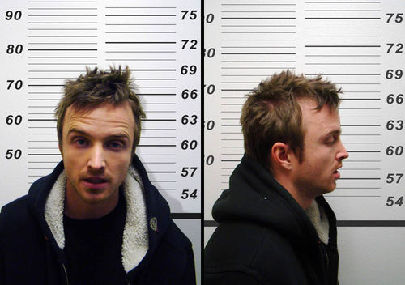
Parties to Crimes
1. Principal – the person who commits the crime
2. Accomplice – someone who helps the principal commit the crime
Accessory Before the Fact – help to plan the commission of the crime; this person can usually be charged with the same crime and can receive the same punishment as the principal
Accessory After the Fact – person who, knowing a crime has been committed, helps the principal or an accomplice avoid capture or helps them escape

