Slide 1
The Characteristics of life
What characteristics are
common to ALL
living things?

Slide 2
All living things…
Have at Least one Cell
  All cells have DNA inside as the genetic blueprint for life.

Slide 3
  Cell Types
    If the DNA is NOT in a separate structure (nucleus), the cell is prokaryotic.
    If the DNA is in a nucleus, the cell is eukaryotic.

Slide 4
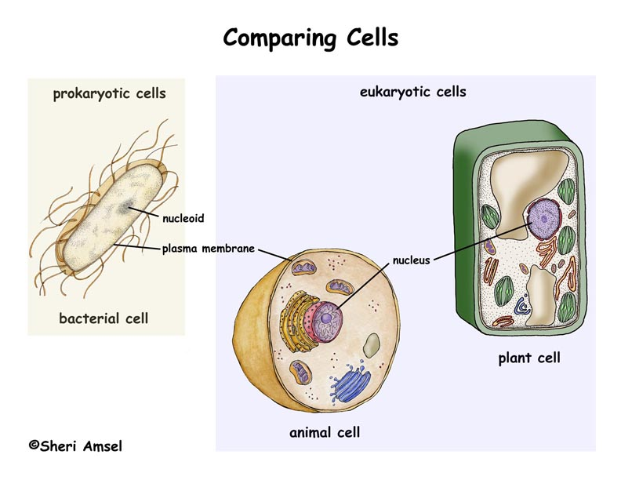
A Prokaryotic cell
(bacteria only)
A Eukaryotic cell
(animal, plant, fungi, protist)
Cell wall
DNA
Cell membrane
nucleus

Slide 5
Cell Number
  An organism that has only one cell is said to be unicellular.
    Examples = bacteria, most protists, one fungus (yeast)
  An organism that has more than one cell is said to be multicellular.
    Examples = all plants, all animals, most fungi, and some protists

Slide 6
All Living things…
Have a Lifespan
  Grow – get larger
    In cell size
    In cell number
  Develop =
    Into a mature organism that can reproduce
  Die
    Reach the end of its lifespan

Slide 7
All living things…
Reproduce
  Have the ability to create offspring like themselves
  Types of reproduction
    If one organism creates an exact copy (clone) of itself to become 2 organisms, it is asexual reproduction
    If egg and sperm unite to create a genetically different individual, it is sexual reproduction
      Creates new gene combinations in a species.

Slide 8
All living things…
Obtain food which is used to produce energy
  Ways Organisms Obtain Food = make it or eat it
    Autotrophs = make food in their cells
      Called the producers
      Usually involves the process of photosynthesis
      Examples = plants, algae and some bacteria and protists

Slide 9
All living things…
  Heterotrophs = must eat other organisms to get food (glucose) to their cells.
    Called the consumers
    Examples = all animals, most fungi, some bacteria, some protists

Slide 10
Produce Energy during the process of Respiration
  A chemical process performed by the cells of all living things to change food energy into energy that the cell can use to do work and carry out life processes.
  Types of respiration
    Respiration that uses oxygen is called aerobic respiration.
    Respiration that does not use oxygen is called anaerobic respiration
  ***After obtaining food and producing/using energy, all living things produce waste.***

Slide 11
All living things…
Respond to changes in the environment
  React to stay alive = maintaining homeostasis = balance
  Examples = shivering to produce heat, sweating to cool off, plants bend toward windows to get sunlight

Slide 12
All living things…
Adapt to changes in the environment
  Involves genetic change that occurs over generations to help a species survive. (evolution)
  Examples = a new gene creates a new color that is better camouflaged (hidden) in environment.

