Slide 1
Using Introspection to Develop Leadership Traits

Slide 2
Lesson Purpose
This lesson explains how to develop the traits and qualities necessary to become an effective leader.

Slide 3

Lesson Objectives
Define introspection.
List the various methods of introspection.
Identify the appropriate questions used during an introspection activity.

Slide 4

Team Assignment
Alpha
Bravo
Charlie
Delta

Slide 5

Which type of introspection do you most identify with?
(LE1-C1S3T1:LQ1)
Prayer
Reflection
Meditation
Moment of peace and quiet
Other

Slide 6

Socrates said,
"The ____________ life is not worth living."
(LE1-C1S3T1:LQ2)
lazy
introspective
unexamined

Slide 7
Key Words
Introspection
Dedicated
Alternatives
Attitude
___________ - examining your own thoughts, ideas, and feelings
_________ - being loyal and whole-hearted in support of other people, activities, or beliefs
__________ - options and/or choices that can be taken in a particular instance
_______ - the way that you think, feel, and display your behavior

Slide 8
Key Word Question Slide Index
Introspection
Situation #1
Being loyal and whole-hearted in support
“Attitudes" are to "feelings" as...

Slide 9

Introspection
(LE1-C1S3T1:KW1)
The way that you think, feel, and display your behavior
Options and/or choices that can be taken in a particular instance
Being loyal and whole-hearted in support of other people, activities, or beliefs
Examining your own thoughts, ideas, and feelings

Slide 10

Cadet Eadon had several _________. He could either cheat on the test, study to try and make a good grade, or blow it off.
(LE1-C1S3T1:KW2)
introspections
dedications
alternatives
attitudes

Slide 11
Being loyal and whole-hearted in support of other people, activities, or beliefs
(LE1-C1S3T1:KW2)
Introspection
Dedicated
Alternatives
Attitude

Slide 12

“Attitudes" are to "feelings" as...
(LE1-C1S3T1:KW4)
"Choices" are to "decisions"
"Choices" are to "problems"
"Problems" are to "solutions"

Slide 13
Opening Question
List 2-3 examples of what you might discover about yourself if you practiced regular introspection.
Note to Instructors:
Click the Show/Hide Response Display Button

Slide 14

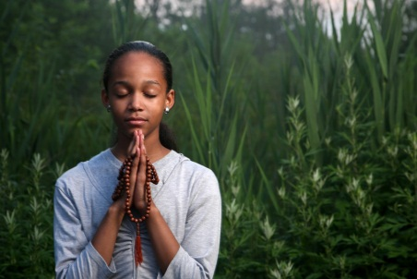
Methods of Introspection
People have different ways of conducting personal assessments, sometimes called “introspection.”
Take a few moments each day to take stock of your attitudes and actions that day.
Prayer, reflection, or meditation
Take time for complementation and reflection.

Slide 15
Getting Started
When you begin to practice introspection, follow these guidelines:
No perfect leader: Do not expect to become a perfect leader on the first day. Brainstorm __________ for how you could better handle situations.
alternatives
Learn from Mistakes: Do not be too hard on yourself for making mistakes in areas where you are trying to improve. Self-improvement takes _____________.
time and effort

Slide 16
Questions for Introspection
When exercising self-assessment, ask yourself the following questions:
Have I been honest with my teachers, peers, parents, and family?
Have I been kind in my dealings with people?
Have I been firm in my decisions?

Slide 17

Positive Attitude
When practicing introspection it is best to have a _______ attitude?
positive
Concentrate on what you can do to improve yourself, rather than trying to control factors out of your control

Slide 18

Which of the following should you do when practicing introspection or self-assessment?
(LE1-C1S3T1:LQ3)
Focus on the negative aspects of your behavior.
Try to make yourself into the perfect leader.
Think about the mistakes that others have made.
None of the above

Slide 19

Which of the following is the BEST type of question to ask yourself when practicing introspection?
(LE1-C1S3T1:LQ4)
Why is he/she always so mean?
Why am I such a jerk?
Why is the world so unfair?
What can I do next time?

Slide 20
Closing Question
List 2-3 things that you could “improve” about your behavior or attitude. Remember to “Stay Positive.”
Note to Instructors:
Click the Show/Hide Response Display Button

Slide 21
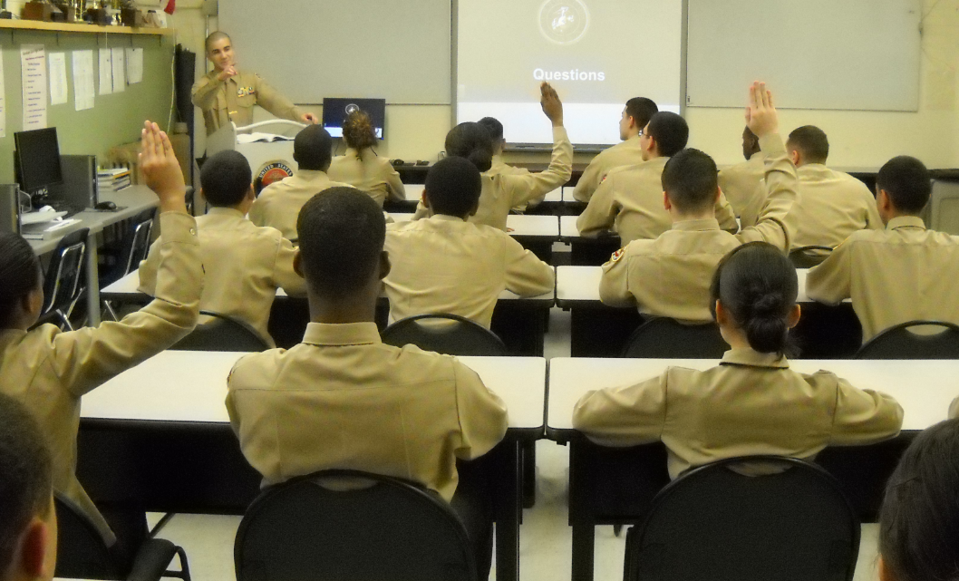
Questions

Slide 22
Copyright Information
Images in this lesson were taken from:
    Microsoft© Clip Art Gallery
    Marine Corps Combat Camera

Slide 23
Participant Leaders
Points | Participant | Points | Participant

Slide 24
Team Scores
Points | Team | Points | Team

Slide 25
Team MVP
Points | Team | Participant

Slide 26
Fastest Responders
Seconds | Participant | Seconds | Participant

Slide 27
Whiteboard

