Slide 1
The Leader Within

Slide 2
Lesson Purpose
This lesson will help you develop your own personal definition of leadership by evaluating yourself, identifying behaviors that you desire most, and developing a plan for improvement.

Slide 3
Lesson Objectives
Identify leadership behaviors that cadets currently exhibit.
Develop a plan for improvement of personal leadership behaviors.
Apply a personal definition of leadership to cadets’ everyday lives.
Game

Slide 4
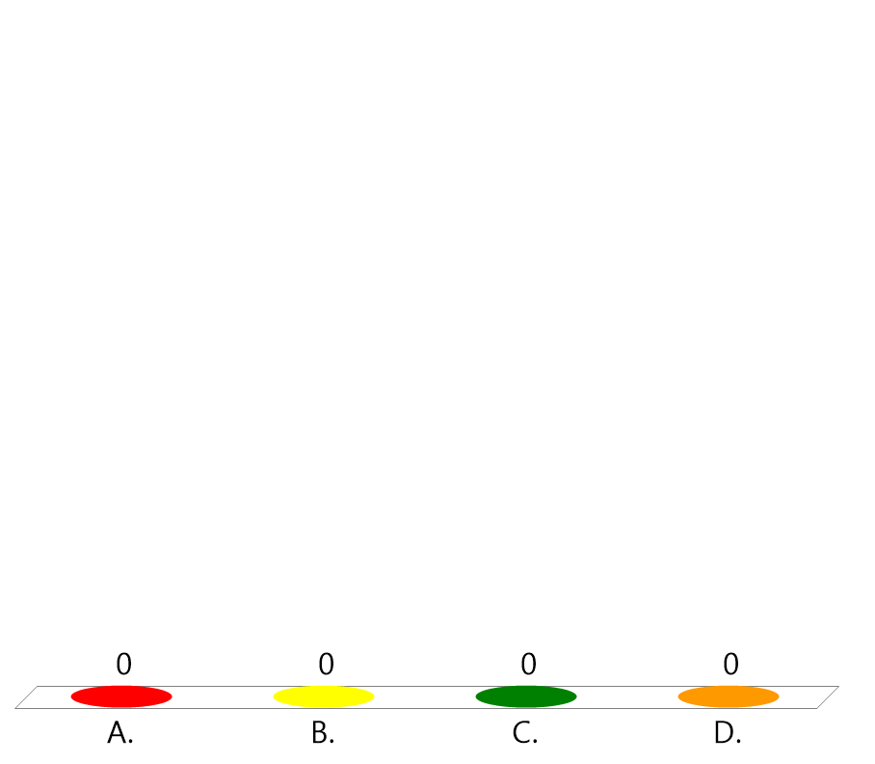
Team Assignment
Alpha
Bravo
Charlie
Delta

Slide 5


How confident are you in your current leadership abilities?
(LE1-C1S1T2:LQ1)
Very confident - I have already developed many leadership skills.
Confident - I have some skills, but need to learn more.
Unsure - I am not sure how I will perform as a leader.
Nervous - I will need support and practice to learn to be an effective leader.

Slide 6

The topic of leadership...
(LE1-C1S1T2:LQ2)
is a relatively new field of study.
has been studied for many, many years.

Slide 7
Opening Question
If someone asked you to describe yourself as a leader, how would you respond?
Note to Instructors:
Click the Show/Hide Response Display Button

Slide 8
The Study of Leadership
There have been a number of studies over the years directed at understanding effective leadership.
The more you understand the behaviors that create the desire to follow, the more you will be able to determine the leadership behaviors that will work best for you, and, even more important, the ones that will not.

Slide 9

What Guides Your Behaviors?
Beliefs, values, and norms guide the actions of individuals and groups.
They are like the traffic control system; signals that give direction, meaning, and purpose to our lives.
Mutual respect
_____________ between you and your team members will motivate them to follow orders.

Slide 10

What motivates your team members to follow your orders?
(LE1-C1S1T2:LQ3)
Being strict
Throwing parties
Fear of punishment
Mutual respect

Slide 11
What is Your Self-Image?
Self-image is how you see yourself; what you think about your characteristics, your body, your values, your goals, and your dreams.
When you become a leader, you need to constantly be aware of how you see yourself.
Be honest and try not to have illusions about who you are or who you would like to be.

Slide 12
What is Your Self-Image?
Focus on the Positive:
  What do you like MOST about yourself?
  How can you do MORE of what you like most?
Self-disclosure:
  What do others like MOST about you?
  How can you do MORE of what they like most about you?

Slide 13
Making the Change
Once you identify the behaviors you wish to have, think of ways to include those behaviors into your daily life.
To change a negative behavior into a positive one:
    Realize the need for change
    Have a positive attitude toward the change
    Follow through

Slide 14

Self image is…
(LE1-C1S1T2:LQ4)
how others see you.
how you see yourself.

Slide 15
Opening Question
List 2-3 new leadership behaviors you would like to develop in the next few months.
Note to Instructors:
Click the Show/Hide Response Display Button

Slide 16

Questions

Slide 17
Copyright Information
Images in this lesson were taken from:
    Microsoft© Clip Art Gallery
    Marine Corps Combat Camera

Slide 18
Participant Leaders
Points | Participant | Points | Participant

Slide 19
Team Scores
Points | Team | Points | Team

Slide 20
Team MVP
Points | Team | Participant

Slide 21
Fastest Responders
Seconds | Participant | Seconds | Participant

Slide 22
Whiteboard

