Slide 1
The Benefits for Successful Completion of MCJROTC

Slide 2
This lesson identifies the benefits of successful completion of the MCJROTC program.

Slide 3

Lesson Objectives
Describe promotion potential in the Military.
Describe advance placement in Senior ROTC.
Describe the potential for early application to Marine Corps Platoon Leaders Class.

Slide 4
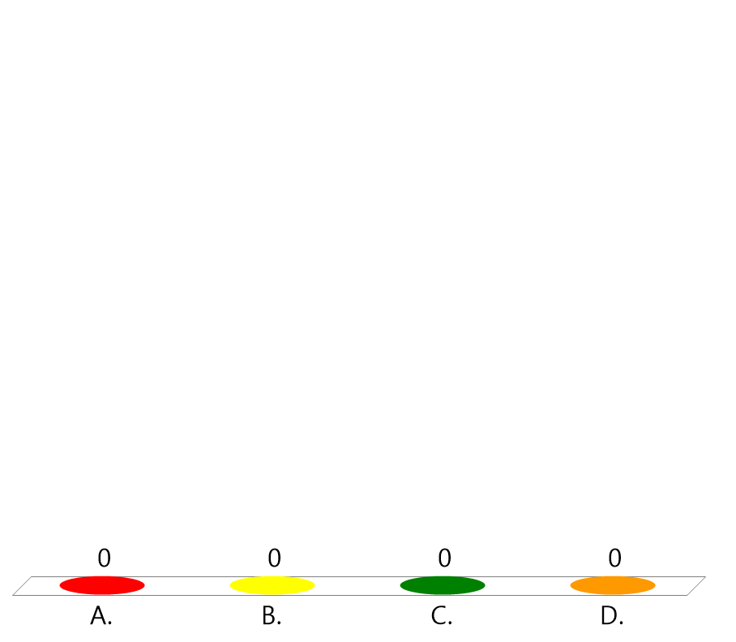
Team Assignment
Alpha
Bravo
Charlie
Delta

Slide 5

How ready are you to learn today?
(LE1-C3S1T4:LQ1)
Not very ready.... my mind is distracted by other things.
A little slow to get going... but starting to wake up.
Good to go.... bring on the lesson.
I am focused, alert, and ready to learn!

Slide 6
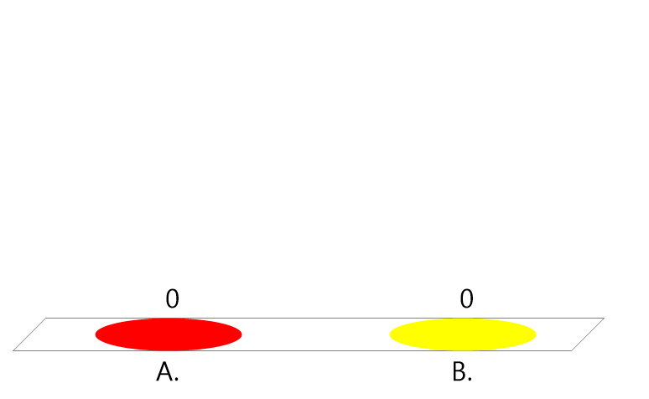
True or False:
The only benefit of participating in the MCJROTC program is learning to be a leader.
(LE1-C3S1T4:LQ2)
True
False

Slide 7
Opening Question
Think about the benefits of having a high school education.
List 2-3 of these benefits.
Note to Instructors:
Click the Show/Hide Response Display Button

Slide 8
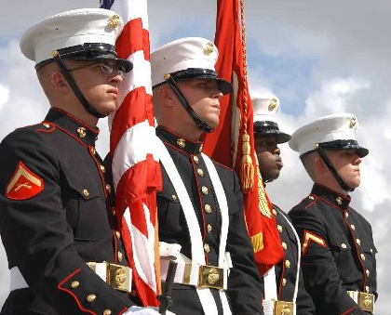
Introduction
There are more benefits to MCJROTC than just the things you learn participating in the program.
The key to being eligible for these benefits is the time you spend as a member of the MCJORTC.

Slide 9
Promotion Potential in the Military
A student that has completed at least two academic years of JROTC is entitled to advance promotion to a grade of no less than E-2 on initial enlistment.
At their discretion, the Military Department may promote a student to a grade of E-3 for successful completion of three or more academic years.

Slide 10
Advance Placement in Senior ROTC
The Reserve Officers’ Training Corps is a course that you can take in college.
You may be eligible for military scholarship or financial aid while participating in ROTC.
Upon graduation and successful completion of ROTC, you may become a commissioned officer.

Slide 11
True or False:
Successfully completing an ROTC program has no affect on advanced military promotion.
(LE1-C3S1T4:LQ3)
True
False

Slide 12

Which of the following benefits of successfully completing MCJROTC is most motivating to you right now? Why?
(LE1-C5S1T4:LQ4)
Improving your leadership abilities for your future career
Teaching you how to be a more capable and knowledgeable friend, family member, and citizen
Increasing your promotion potential in a military career
Providing advance placement in Senior Reserve Officers Training Corps (ROTC)
Giving you the opportunity for early application to the Marine Corps Platoon Leader Class
Other

Slide 13
Marine Corps Platoon Leaders Class (PLC)
Upon acceptance to a college, a cadet who has successfully completed the JROTC program may apply for the Marine PLC.
PLC lets you complete your academic career uninterrupted at the college of your choice.
All PLC training takes place during the summer.

Slide 14
True or False:
All PLC training takes place in the summer.
(LE1-C3S1T4:LQ5)
True
False

Slide 15

You have just enrolled in MCJROTC. One of your buddies asks you why you did this. Which of the following responses would NOT be accurate?
(LE1-C5S1T4:LQ6)
MCJROTC has lots of great activities like drill, camps, and marksmanship that will teach me important lessons about leadership and discipline.
MCJROTC participation will guarantee me acceptance to a 4-year college through the ROTC.
MCJROTC increases my ability to receive an advanced placement into ROTC.
MCJROTC will allow me to enlist as an E-2, and possibly even an E-3 if I decide to join the Marine Corps.

Slide 16

Successful completion of MCJROTC opens many doors for you. Why do you think colleges, ROTC admissions staff, employers, and the Marine Corps would provide preference or give extra benefits to students who complete MCJROTC?
(LE1-C5S1T4:LQ7)
It is a legal requirement for colleges and employers to give preference to those who have completed MCJROTC.
Students who demonstrate the ability to complete a program as challenging as MCJROTC are generally more likely to succeed in other organizations as well.
Completion of MCJROC demonstrates to college admissions staff that you have the support of your family to continue your education.
Students who complete the MCJROTC program typically have more financial resources than those who do not.

Slide 17
Closing Question
List the 2-3 most important things you learned in this lesson.
Why are they important to you?
Note to Instructors:
Click the Show/Hide Response Display Button

Slide 18

Questions

Slide 19
Copyright Information
Images in this lesson were taken from:
    Microsoft© Clip Art Gallery
    Marine Corps Combat Camera

Slide 20
Participant Leaders
Points | Participant | Points | Participant

Slide 21
Team Scores
Points | Team | Points | Team

Slide 22
Team MVP
Points | Team | Participant

Slide 23
Fastest Responders
Seconds | Participant | Seconds | Participant

Slide 24
Whiteboard

