Slide 1
Codes of Conduct

Slide 2
This lesson provides the basic requirements of conduct in school and conduct as a MCJROTC cadet.

Slide 3

Lesson Objectives
Explain code of conduct.
Describe school codes of conduct.
Describe MCJROTC codes of conduct.

Slide 4

Team Assignment
Alpha
Bravo
Charlie
Delta

Slide 5

How confident are you in your ability to follow the MCJROTC code of conduct?
(LE1-C5S1T7:LQ1)
Extremely - It has always been easy for me to remember and follow rules.
Very - I am ready to follow the code, but need to learn more first.
Somewhat - I have been in some trouble before, so this might be a bit of a challenge for me.
Low - I am kind of known as a trouble maker. I may need a lot of help in this area!

Slide 6

You should follow the school and MCJROTC code of conduct for which of the following reasons?
(LE1-C5S1T7:LQ2)
To honor yourself
To honor your cadets
To honor MCJROTC
All of the above

Slide 7
Key Words
Conduct
Codes of conduct
Accountability
_______ - the way someone behaves
_______________ - a system of principles or
rules that govern conduct, provide specific
rules for appropriate behavior, and explain the
consequence for violating them
_____________ - an obligation or willingness to
accept responsibility

Slide 8
Key Word Question Slide Index
An obligation or willingness to accept responsibility
Provides specific expectations or rules for appropriate behavior and the consequences for violating them
The way someone behaves

Slide 9

An obligation or willingness to accept responsibility
(LE1-C5S1T7:KW1)
Conduct
Codes of conduct
Accountability

Slide 10
Provides specific expectations or rules for appropriate behavior and the consequences for violating them
(LE1-C5S1T7:KW2)
Conduct
Codes of conduct
Accountability

Slide 11
The way someone behaves
(LE1-C5S1T7:KW3)
Conduct
Codes of conduct
Accountability

Slide 12
Opening Question
List 2-3 rules you might find at your local swimming pool.
What are the reasons for each rule?
Note to Instructors:
Click the Show/Hide Response Display Button

Slide 13
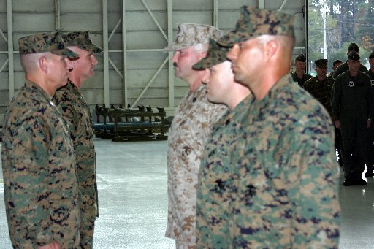
Introduction
Rules establish standards of personal behavior, also known as a code of conduct.

Slide 14
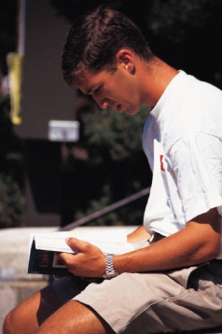
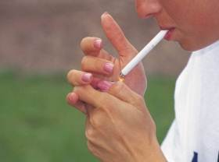
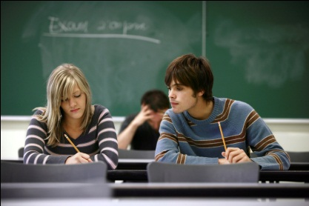


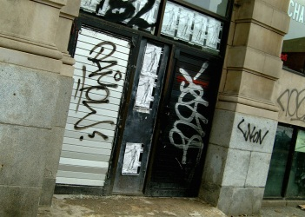
School Codes of Conduct
School codes of conduct include the following policies:
Attendance
Integrity
Substance abuse
Transportation
Vandalism
Technology and the Internet

Slide 15
School Codes of Conduct
Schools typically provide students with the school codes of conduct at the beginning of the school year.
Students may be required to read and sign the school’s code of conduct.
School codes of conduct generally apply to students on school property, on school buses, at school bus stops, and when attending school sponsored activities.

Slide 16

When are students required to follow their school's code of conduct?
(LE1-C5S1T7:LQ3)
Never
At home
On school property
At church

Slide 17
MCJROTC Codes of Conduct
As a MCJROTC cadet you must set an example by displaying honor, courage, and commitment.
Honor is the quality that guides ethical and moral behavior.
Courage is the mental quality that recognizes fear of danger or criticism but enables a leader to proceed calmly.
Commitment is an agreement or pledge to do something.

Slide 18
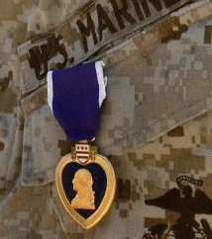
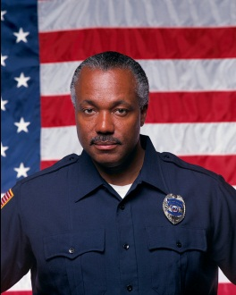
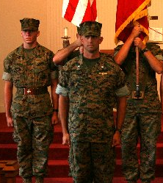
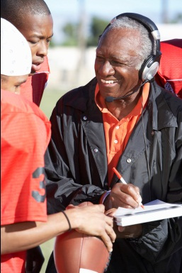
MCJROTC Codes of Conduct
The following are some of the MCJROTC codes of conduct you should live by:
Obey the law
Lead by example
Maintain a high standard of integrity
Place faith and honor above all else

Slide 19

A cadet cheated on a test. He says he is afraid of admitting it because he will get kicked out of MCJROTC. You encourage him to live up to the code of conduct by having the _______ to do the right thing.
(LE1-C5S1T7:LQ4)
honor
courage
commitment

Slide 20
Note to instructors…
The following survey is designed to be delivered in “Anonymous Mode”.
Make sure to tell the cadets that their clicker numbers will not be recorded for this session.
It is important that cadets know and BELIEVE that their responses will be anonymous for this activity to work effectively.

Slide 21
Optional Situational Questions
The following survey asks you to consider how you might respond to an ethical situation given various conditions.
None of us know how we would DEFINITELY respond until we are actually faced with the situation.
However, we ask you to consider each scenario and give your best and HONEST answer.

Slide 22
Optional Situational Questions
For each situation and action you will be given the choices:
  Definitely (100% sure)
  Probably (75% sure)
  Maybe (50%)
  Probably not (25%)
  Definitely not (0%)

Slide 23
Optional Situational Questions
The conditions of the scenario will be slightly changed for each question to see how it might affect your response.
The scenarios are written with no intended “right answer”.
The goal is conversation.

Slide 24
Optional Situational Questions
Your answers to this survey are CONFIDENTIAL.
Neither your MCJROTC instructor nor your fellow cadets will know what you entered…. so please BE HONEST.
After the survey is completed, your class will have the opportunity to see how many students (but not which students) chose each response.
You will then have the chance to discuss the results.

Slide 25
Core Scenario
Situational Questions (1-5)
You are waiting at a bus stop in a major city. A woman is sitting next to you. A bus pulls up and she gets on. As you are waiting for your bus to come you notice that there is small purse sitting on the ground. You check the purse for identification but all you find is makeup and a money clip with about $50. You might be able to run the bus down and return the money, but it is pretty far away at this point.
Would you run after the bus?
Assume that the only alternative is to pocket the money and return it to her in the future, which is not likely because you have never seen her before.

Slide 26

Condition 1: It is sunny, you are wearing sneakers, and do not have to be anywhere soon.
Would you try to chase the bus down and return the money?
(LE1-C5S1T7:SQ1)
Definitely (100% chance I would do this)
Probably (75% chance I would do this)
Maybe (50% chance I would do this)
Probably not (25% chance I would do this)
Definitely not (0% chance I would do this)

Slide 27

Condition 2 Change: It is raining heavily. You do not have an umbrella and have a meeting soon.
Would you try to chase the bus down and return the money?
(LE1-C5S1T7:SQ2)
Definitely (100% chance I would do this)
Probably (75% chance I would do this)
Maybe (50% chance I would do this)
Probably not (25% chance I would do this)
Definitely not (0% chance I would do this)

Slide 28
Condition 3:Before her bus arrived, you noticed she was the teacher at your school who failed your little brother which caused him to be set back a grade This has had a tremendous negative impact on your little brother in terms of his self-esteem.
Would you try to chase the bus down and return the money?
(LE1-C5S1T7:SQ3)
Definitely (100% chance I would do this)
Probably (75% chance I would do this)
Maybe (50% chance I would do this)
Probably not (25% chance I would do this)
Definitely not (0% chance I would do this)

Slide 29
Condition 4: Before her bus arrived, you started up a conversation with the woman. She mentioned that she was visiting her son at Children’s Hospital today.
Would you try to chase the bus down and return the money?
(LE1-C5S1T7:SQ4)
Definitely(100% chance I would do this)
Probably (75% chance I would do this)
Maybe (50% chance I would do this)
Probably not (25% chance I would do this)
Definitely not (0% chance I would do this)

Slide 30
Condition 5: Before her bus arrived, you tried to start up a conversation with the woman. She gave you a strange look and then called you a racial slur.
Would you try to chase the bus down and return the money?
(LE1-C5S1T7:SQ5)
Definitely (100% chance I would do this)
Probably(75% chance I would do this)
Maybe (50% chance I would do this)
Probably not (25% chance I would do this)
Definitely not (0% chance I would do this)

Slide 31
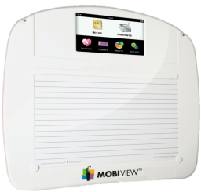
Closing Question
Describe a situation where it would be difficult for you to live up to the code of conduct. See if other cadets can help you think of how to handle the situation.
Note to Instructors:
Click the Show/Hide Response Display Button

Slide 32

Questions

Slide 33
Copyright Information
Images in this lesson were taken from:
    Microsoft© Clip Art Gallery
    Marine Corps Combat Camera

Slide 34
Participant Leaders
Points | Participant | Points | Participant

Slide 35
Team Scores
Points | Team | Points | Team

Slide 36
Team MVP
Points | Team | Participant

Slide 37
Fastest Responders
Seconds | Participant | Seconds | Participant

Slide 38
Whiteboard

