Slide 1
Requirements for MCJROTC Participants

Slide 2
Lesson Purpose
This lesson identifies the requirements for participation in the MCJROTC program.

Slide 3

Lesson Objectives
Explain high school enrollment requirements.
Explain citizenship requirements.
Explain physical fitness requirements.

Slide 4

Team Assignment
Alpha
Bravo
Charlie
Delta

Slide 5

How much do you already know about the MCJROTC requirements?
(LE1-C5S1T3:LQ1)
Expert - I have done a lot of learning in this area already.
Above average - I have learned some advanced information about freedom documents.
Moderate - I know a little about this topic.
Rookie - I am a blank slate... but ready to learn!

Slide 6

Which of the following is NOT one of the "requirements" for MCJROTC participation?
(LE1-C5S1T3:LQ2)
Military service
High school enrollment
Citizenship
Physical fitness

Slide 7
Key Words
Citizen
National
______ – a person who is born in a country or
who chooses to become a member of a
country according to its laws
________ – a person who is a citizen of a
nation, but lives abroad

Slide 8
Key Words
Alien
Naturalization
_____ - person who is born in a country or
who chooses to become a member of a
country according to its laws
____________ – when the government of
a country allows a person who was not
born in that country to become a citizen
of it

Slide 9
Key Word Question Slide Index
A person who is a citizen of a nation, but lives abroad
A foreign-born resident who has not been naturalized and is still a subject or citizen of a foreign country
When the government of a country allows a person who was not born in that country to become a citizen
A person who is born in a country or who chooses to become a member of a country according to its laws

Slide 10

A person who is a citizen of a nation, but lives abroad
(LE1-C5S1T3:KW1)
Citizen
National
Alien
Naturalization

Slide 11
A(n) _______ is a foreign-born resident who has not been naturalized and is still a subject or citizen of a foreign country.
(LE1-C5S1T3:KW2)
citizen
national
alien
naturalization

Slide 12
When the government of a country allows a person who was not born in that country to become a citizen, it is called _____________.
(LE1-C5S1T3:KW3)
citizen
national
alien
naturalization

Slide 13
A ______ is a person who is born in a country or who chooses to become a member of a country according to its laws.
(LE1-C5S1T3:KW4)
citizen
national
alien
naturalization

Slide 14
Opening Question
Think about the rules your school sets for you.
List 2-3 reasons why these rules are in place.
Note to Instructors:
Click the Show/Hide Response Display Button

Slide 15
Background
Congress established the Junior ROTC under the National Defense Act of 1916.
The three requirements that determine your MCJROTC participation are:
        High school enrollment
        Citizenship
        Physical fitness

Slide 16
High School Enrollment
To participate in MCJROTC, you must be enrolled in high school.
You cannot be attending one high school while participating in MCJROTC in another high school.
You must be in grades ninth through twelfth to participate.

Slide 17

To participate in the MCJROTC program, what requirements must you meet?
(LE1-C5S1T3:LQ3)
Be in 9th - 12th grade
Be enrolled in high school
Both A and B are correct
None of the above

Slide 18
Citizenship
      Students in the MCJROTC program must fall into one of these citizenship categories:
        Citizens of the United States
        Nationals of the United States
        Aliens lawfully admitted to the United States for permanent residence

Slide 19
Physical Fitness
Cadets must have current school physical evaluations certifying that they are physically fit.
The Semper Fi Fitness program focuses on physical fitness training as well as good nutrition and stress reduction.

Slide 20
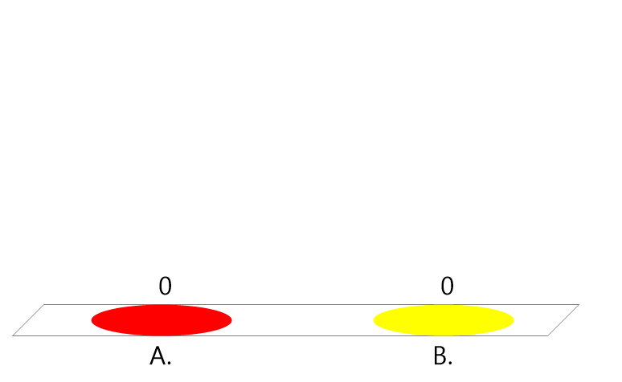
True or False:
To participate in the MCJROTC program, you need to be a citizen of the United States.
(LE1-C5S1T3:LQ4)
True
False

Slide 21
Closing Question
List 2-3 questions you have or things that are still unclear to you from this lesson.
Note to Instructors:
Click the Show/Hide Response Display Button

Slide 22

Questions

Slide 23
Copyright Information
Images in this lesson were taken from:
    Microsoft© Clip Art Gallery
    Marine Corps Combat Camera

Slide 24
Participant Leaders
Points | Participant | Points | Participant

Slide 25
Team Scores
Points | Team | Points | Team

Slide 26
Team MVP
Points | Team | Participant

Slide 27
Fastest Responders
Seconds | Participant | Seconds | Participant

Slide 28
Whiteboard

