Slide 1
Introduction to MCJROTC Leadership Education

Slide 2
Lesson Purpose
This lesson identifies the requirements for successful completion of the MCJROTC leadership education course.

Slide 3

Lesson Objectives
Identify seven objectives of MCJROTC Leadership Education.
Identify five subject areas presented in MCJROTC Leadership Education.
Explain what is expected of an individual during each of the Leadership Education courses.
Explain the benefits from each of the five courses.

Slide 4
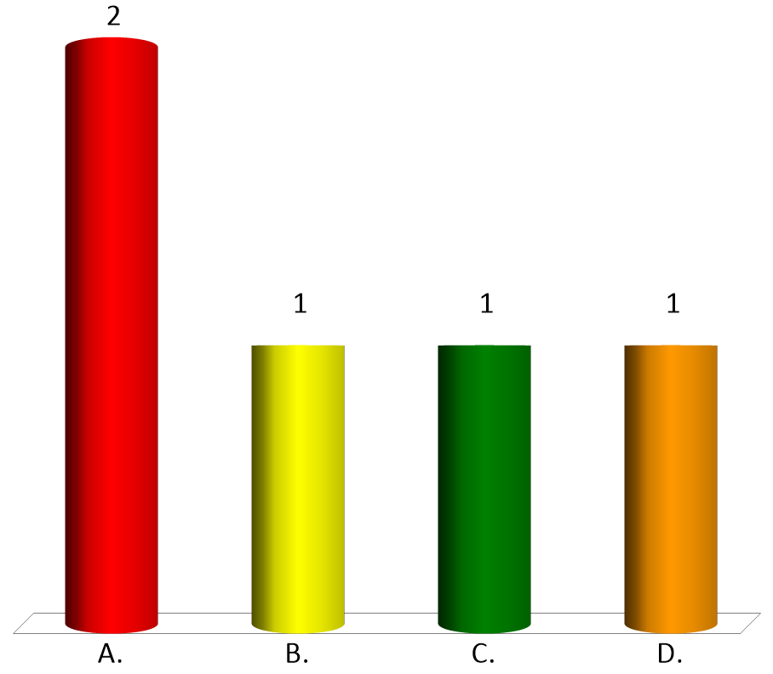
Team Assignment
Alpha
Bravo
Charlie
Delta

Slide 5

How ready are you to learn today?
(LE1-C5S1T1:LQ1)
Not very ready.... my mind is distracted by other things.
A little slow to get going... but starting to wake up.
Good to go.... bring on the lesson.
I am focused, alert, and ready to learn!

Slide 6
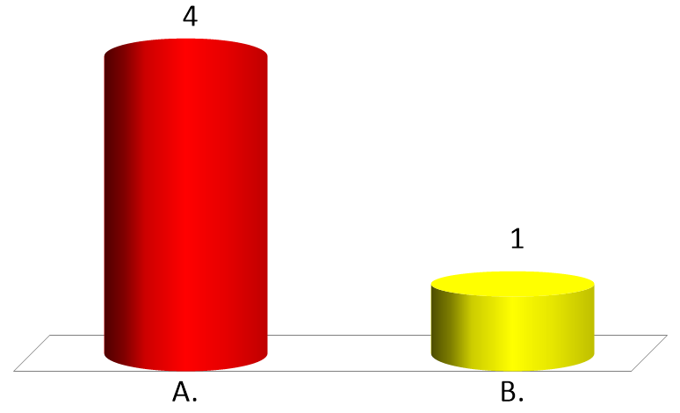
True or False:
The United States formed its first "reserve" forces under the Militia Act of 1792.
(LE1-C5S1T1:LQ2)
True
False

Slide 7
Opening Question
List 2-3 things you know about the history of MCJROTC.
Note to Instructors:
Click the Show/Hide Response Display Button

Slide 8
History of the MCROTC
In 1783, the honorable George Clinton introduced an idea that called for the inclusion of military instruction in a civilian college.
Those who completed this instruction would serve a short stint of active military service. When returning to civilian life, these students would form a trained officer corps and be held on reserve.

Slide 9
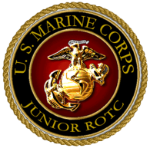
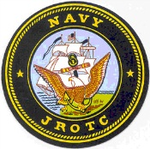

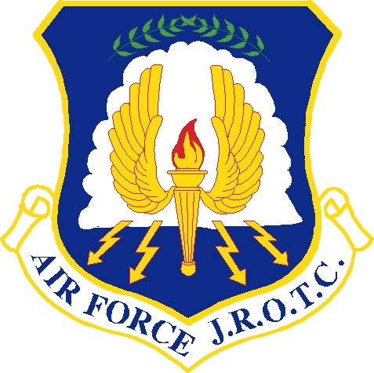
History of the MCJROTC
In 1916, Congress passed the National Defense Act authorizing the War Department to establish _______________________________.
The JROTC also came into being with the signing of the National Defense Act.
Reserve Officers Training Corps (ROTC)

Slide 10
History of the MCJROTC
In 1961, the Secretary of Defense, attempted to convert JROTC units into NDCC units, due to what he thought was excessive spending.
He failed to realize the number of supporters of the JROTC and was flooded with letters that insisted the JROTC was a national asset.
On October 13, 1963, President Kennedy signed the ROTC Vitalization Act, increasing the number of JROTC units.

Slide 11

What Act in 1916 authorized the War Department to establish ROTC units in schools?
(LE1-C5S1T1:LQ3)
Morrill Act
ROTC Vitalization Act
National Defense Act
None of the above

Slide 12
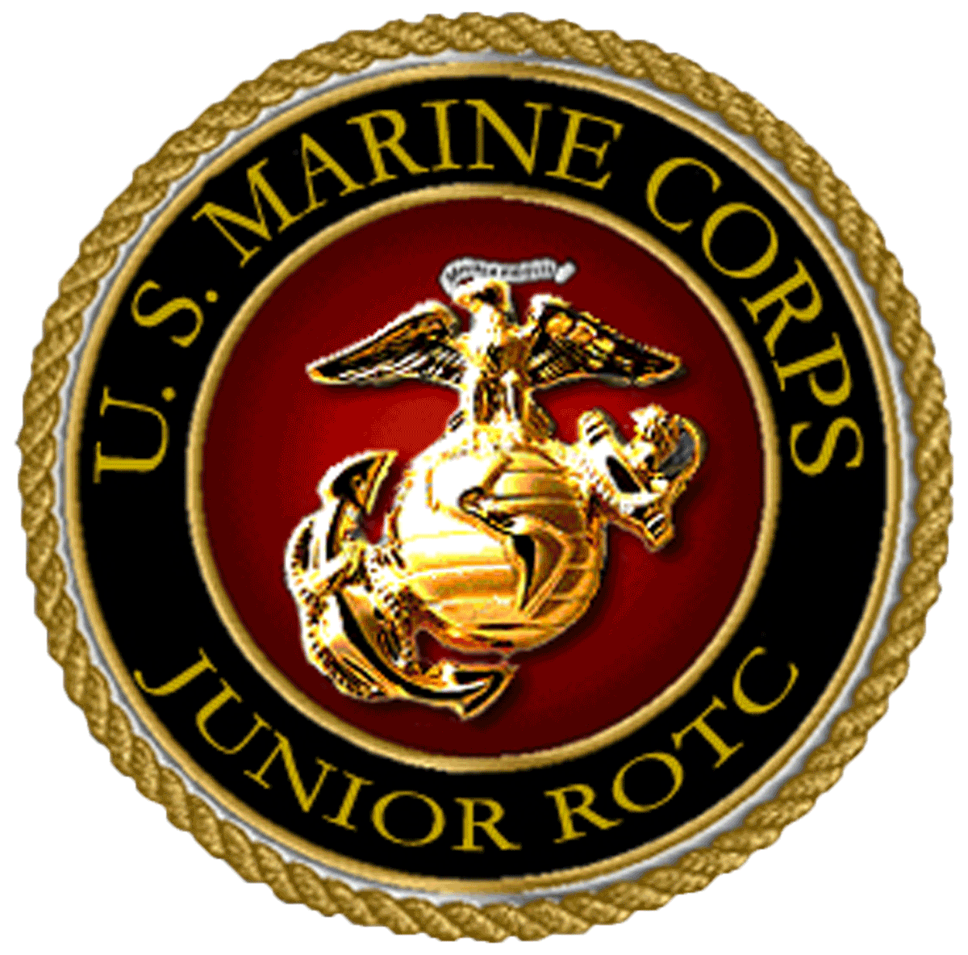

Purpose of MCJROTC
To instill values of citizenship, service to the United States, personal responsibility, and a sense of accomplishment.
MCJROTC is funded and sponsored through the Office of the Secretary of the Navy.
Notes:
Not sure if we should bold and underline the rest of the text…..

Slide 13
The Seven Objectives of MCJROTC
Aims at developing informed and responsible citizens.
Helps develop leadership.
Helps build character through leadership development.
The program is designed to teach you about the elements and requirements for national security.

Slide 14
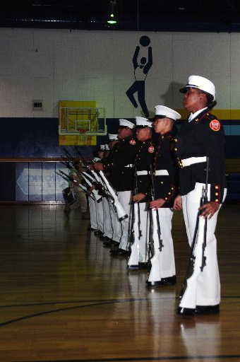
The Seven Objectives of MCJROTC
Discipline is stressed.
Learning respect for authority, your peers, superiors, and subordinates.
Enlighten you to possible career and educational choices.

Slide 15
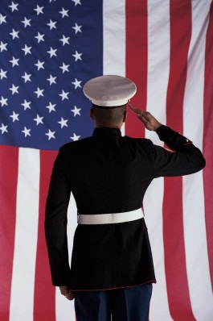

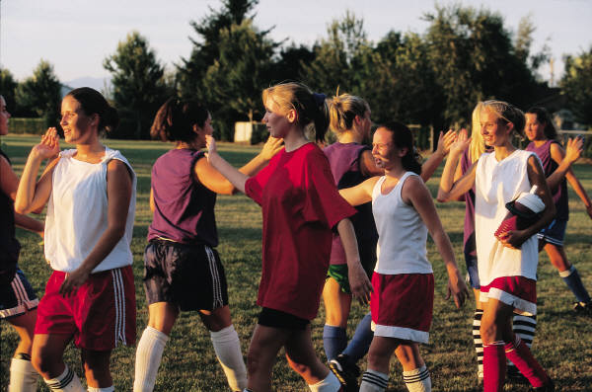
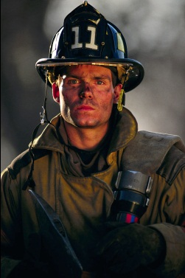

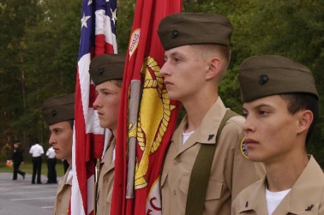
The MCJROTC Curriculum
The five courses in MCJROTC are:
Leadership
Citizenship
Personal Growth and Responsibility
Career Exploration and Public Service
General Military Subjects

Slide 16

Which of the following are courses of the MCJROTC Curriculum?
(LE1-C5S1T1:LQ4)
Leadership
Gun safety
Citizenship
Both A and C

Slide 17
Closing Question
List 2-3 things you learned about MCJROTC that you learned in this lesson that you did not already know.
Note to Instructors:
Click the Show/Hide Response Display Button

Slide 18

Questions

Slide 19
Copyright Information
Images in this lesson were taken from:
    Microsoft© Clip Art Gallery
    Marine Corps Combat Camera

Slide 20
Participant Leaders
Points | Participant | Points | Participant
30 | CB51CD
20 | CB51C8
20 | CB5346
20 | CB5395
10 | CB5383

Slide 21
Team Scores
Points | Team | Points | Team
25 | Alpha
25 | Alpha(1)
20 | Charlie
20 | Charlie(1)
20 | Delta
20 | Delta(1)
10 | Bravo
10 | Bravo(1)

Slide 22
Team MVP
Points | Team | Participant
20 | Alpha | CB51CD
20 | Alpha(1) | CB51CD
10 | Charlie | CB5346
10 | Charlie(1) | CB5346
10 | Bravo | CB5383
10 | Bravo(1) | CB5383
10 | Delta | CB5395
10 | Delta(1) | CB5395

Slide 23
Fastest Responders
Seconds | Participant | Seconds | Participant
4.407 | CB51C8
9.575 | CB51CD
12.701 | CB5346
15.361 | CB5395

Slide 24
Whiteboard

