Slide 1
Cell Membrane Structure
Processes that Transport molecules into/out of cells

Slide 2
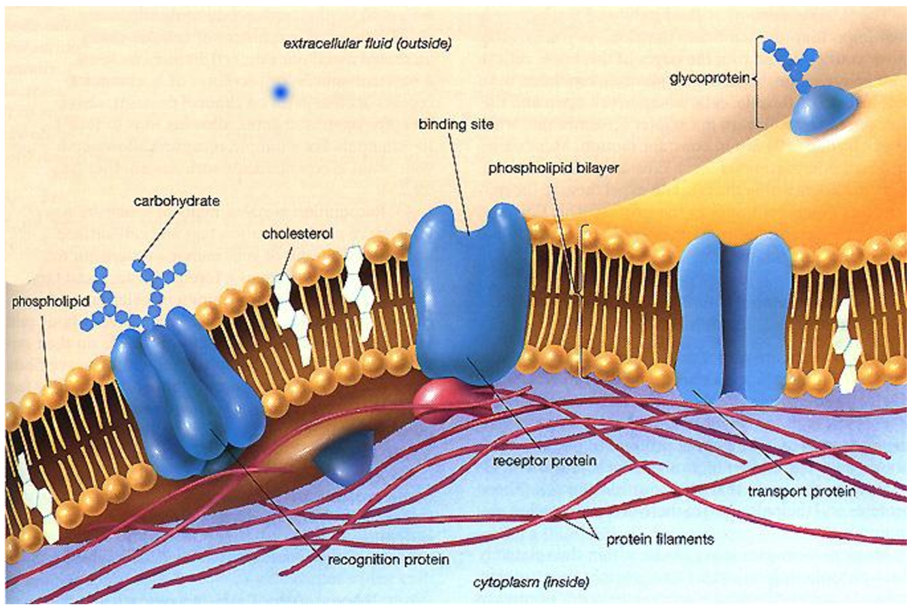
The Structure of the Cell Membrane
C.
B.
A.
D.

Slide 3
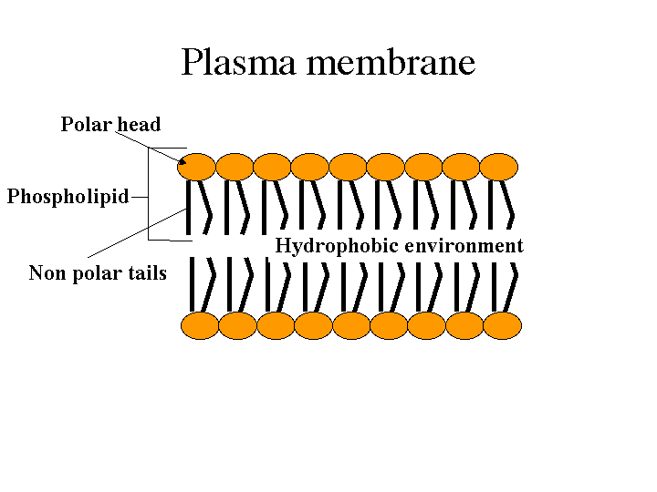
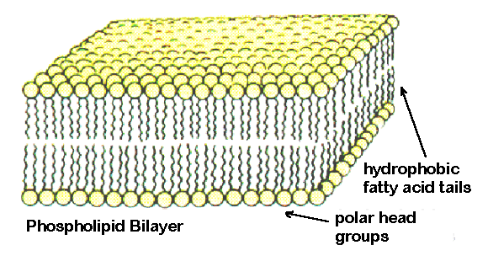
Letter A = The Phospholipid Bilayer
  Most common material in the cell membrane
  Two layers thick
    Each layer has a rounded head end (hydrophilic = loves water) that always faces the water based solution (either the cell’s environment or the cell’s cytoplasm.
    Each phospholipid has two tails on one end (hydrophobic = fears water) that always face away from the water-based solutions.

Slide 4
Round ends of the phospholipids don’t fit tightly together which creates tiny spaces, called pores, in the cell membrane.
Small molecules like water, carbon dioxide, and oxygen can pass through these pores.
The membrane is permeable to these materials.

Slide 5
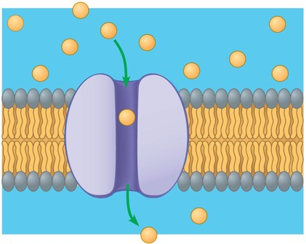
Letter B = transport proteins (also called Channel or Carrier proteins)
  Protein molecules in the phospholipid bilayer.
  Open up to help large molecules go across the cell membrane to move into or out of the cell.
Transport Protein

Slide 6
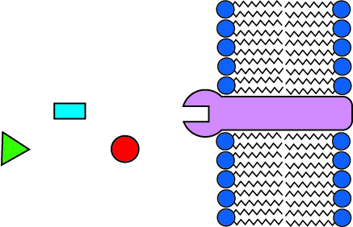
Letter C = Receptor Proteins
  A place where chemicals can attach to the cell membrane

Slide 7
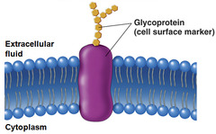
Letter D = recognition proteins
  Help to identify cell type (mammal, human, liver, lung, etc.)
  Like an id tag!
  Helps cells stick together to form tissues
  Also called glycoproteins

Slide 8
Model of Cell Membrane
Called fluid mosaic model
  Fluid = flexible, flowing
  Mosaic = made of a variety of different pieces

Slide 9
Lay your paper in landscape on your desk. Name on top right.
Title it “Cell Membrane Structure”
Draw a phospholipid bilayer. (Leave three spaces)Label the inside and outside of the cell.
Draw a transport protein.
Label and explain the role of a transport protein.
Draw a receptor protein.
Label and explain the role of a receptor protein.
Draw a recognition protein.
Label and explain the role of a recognition protein.
Make a large box and label it “Fluid Mosaic Model”.
In the box, explain why WE describe the cell membrane as the fluid mosaic model.

