Slide 1
BIOTECHNOLOGY

Slide 2
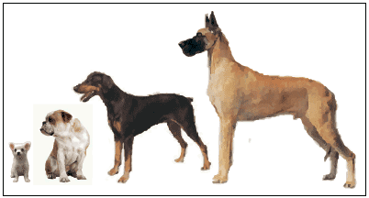
I. Selective Breeding
1.) Selective breeding = The process by which desired traits of certain plants and animals are selected and passed on to their future generations.
  Breed only those plants or animals with desirable traits
2.) People have been using selective breeding for 1000’s of years with farm crops and domesticated animals.

Slide 3

II. Human Genome Project (HGP)
1.) HGP = Map of all 30,000 genes on the 46 human chromosomes (1988-2003)
  Information has led to many advances in the fields of medicine, agriculture, bio-engineering
2.) An organism’s genome is the total DNA in the nucleus of each cell

Slide 4

III. Genetic Engineering
1.) Biotechnology refers to technology used to manipulate DNA.
2.) The procedures are often referred to as genetic engineering.

Slide 5
III. Genetic Engineering
3.) DNA is the genetic material of all living organisms.
  All organisms use the same genetic code (A, T, C, G).

Slide 6
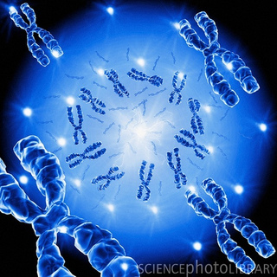
Creating Recombinant DNA

Slide 7
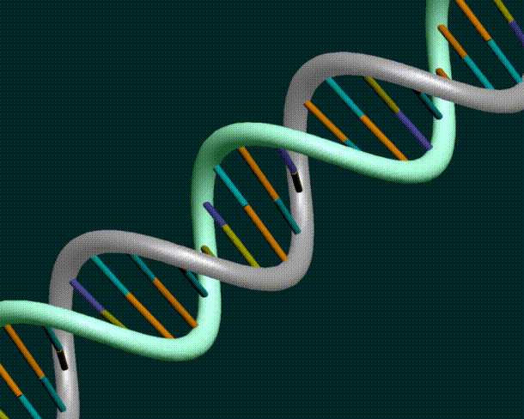
IV. Recombinant DNA
1.) Recombinant DNA refers to the DNA from the two different organisms.
  Can be used for creating transgenic organisms, gene therapy, and cloning.

Slide 8
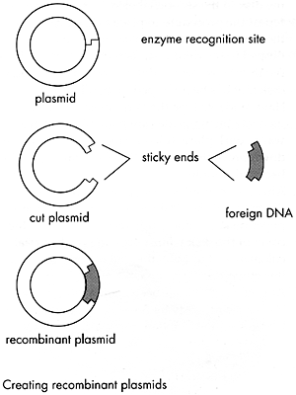
IV. RECOMBINANT DNA
2.) Recombinant DNA technology was first used in the 1970’s with bacteria.
3.) A plasmid is small ring of DNA in a bacterium

Slide 9
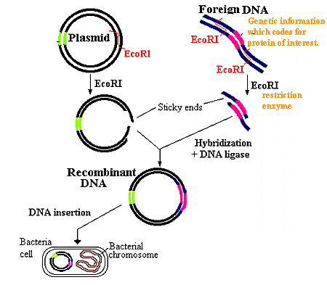
4.) Making Recombinant Bacteria
a.) Remove bacterial DNA (plasmid).
b.) Cut the Bacterial DNA with “restriction enzymes (RE)”.
  Restriction enzymes were discovered in bacteria.
    Bacteria use them as a defense mechanism to cut up the DNA of viruses or other bacteria

Slide 10
4.) Making Recombinant Bacteria
  Hundreds of different restriction enzymes have been isolated
  Each restriction enzyme or RE cuts DNA at a specific base sequence.

Slide 11

4.) Making Recombinant Bacteria
For example, EcoRI always cuts DNA at GAATTC as indicated below

Slide 12
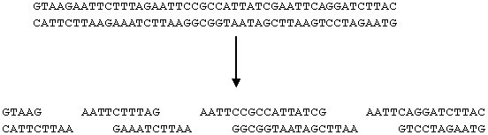
  The sequence GAATTC appear three time in the below strand of DNA, so it is cut into four pieces.

Slide 13
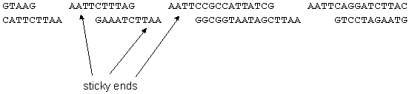
Fragments of DNA that has been cut with restriction enzymes have unpaired nucleotides at the ends called sticky ends. Sticky ends have complimentary bases, so they could rejoin.

Slide 14
4.) Making Recombinant Bacteria
c.) Cut the gene of interest from the organism’s DNA with same “restriction enzyme” (RE).

Slide 15
4.) Making Recombinant Bacteria
d.) Combine the “sticky ends” of the two DNA pieces together with DNA ligase (enzyme) – also known as gene splicing.
  This creates a vector = a DNA molecule used to carry a gene of interest from one organism to another.

Slide 16
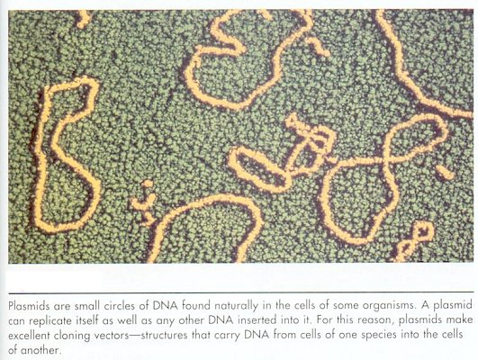
Plasmids & viruses are the most commonly used vectors

Slide 17
4.) Making Recombinant Bacteria
e.) Insert vector into bacteria.
f.) The bacteria can now reproduce the recombinant DNA.
g.) The foreign genes will be expressed in the bacteria.

Slide 18
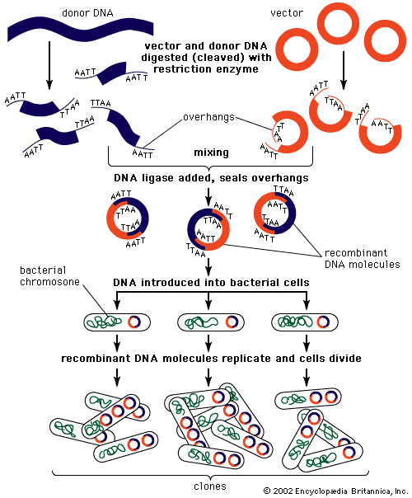

Slide 19
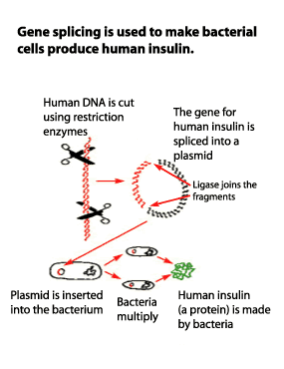
5.) Benefits of Recombinant Bacteria
Bacteria can make human insulin or human growth hormone.

Slide 20
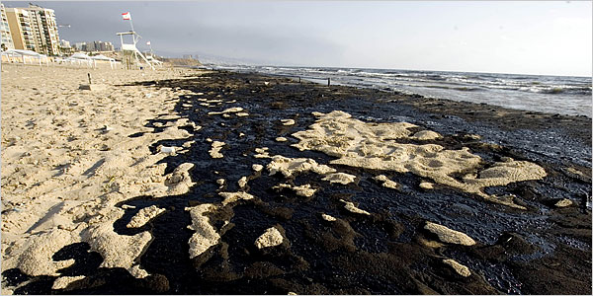
5.) Benefits of Recombinant Bacteria
Bacteria can be engineered to “eat” oil spills.

Slide 21
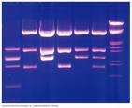
V. GENETIC ENGINEERING: What Can We Do With Genes?
1. DNA fingerprinting - Recombinant DNA techniques are used in DNA fingerprinting

Slide 22
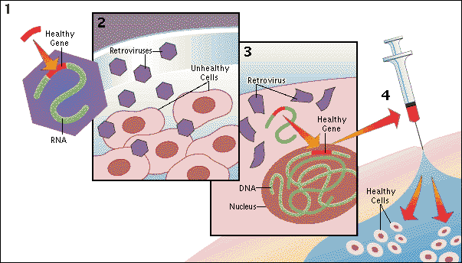
V. GENETIC ENGINEERING: What Can We Do With Genes?
2. Gene therapy: A "normal" gene is inserted into the genome to replace an "abnormal," disease-causing gene.

Slide 23
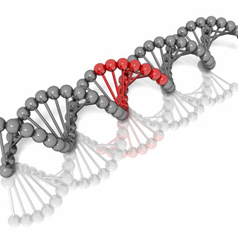
Gene Therapy
In the future, may be used treat a disorder by inserting a gene into a patient’s cells instead of using drugs or surgery.
Types of gene therapy:
      Replacing a mutated gene that causes disease with a healthy copy of the gene
      Inactivating, or “knocking out,” a mutated gene that is functioning improperly.
      Introducing a new gene into the body to help fight a disease.

Slide 24

Gene Therapy
Currently, the only way for you to receive gene therapy is to participate in a clinical trial.
  Clinical trials are research studies that help doctors determine whether a gene therapy approach is safe for people.

Slide 25

Gene Therapy
The Food and Drug Administration (FDA) has not yet approved any human gene therapy product for sale.

Slide 26
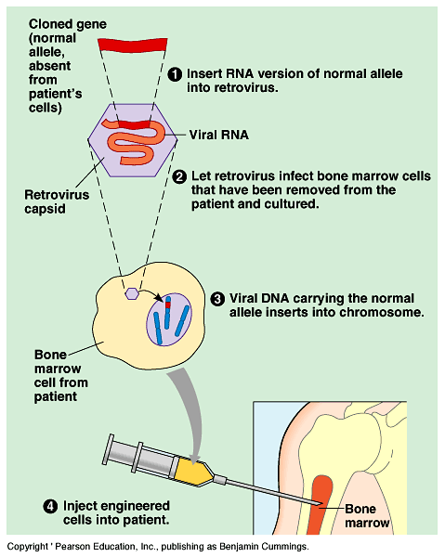
APPLICATIONS
One type of gene therapy procedure
Notes:
26

Slide 27
Making of Insulin http://www.youtube.com/watch?v=AEINuCL-5wc&feature=related
Gene Therapy
http://www.youtube.com/watch?v=EfXK50Bxod8&feature=PlayList&p=75527107C0AFBA9F&playnext=1&playnext_from=PL&index=43
Blindness http://www.youtube.com/watch?v=NmftOETlyyg&feature=PlayList&p=75527107C0AFBA9F&playnext=1&playnext_from=PL&index=44

Slide 28
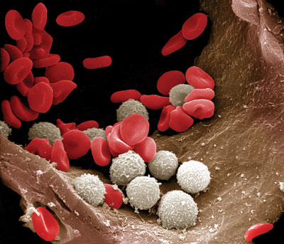
Risk Factors of Gene Therapy
Unwanted immune system reaction. Your body's immune system may see the newly introduced viruses as intruders and attack them (inflammation & organ failure).
Targeting the wrong cells. Viruses cold infect healthy cells and cause other illnesses, including cancer.

Slide 29
Risk Factors of Gene Therapy
Infection caused by the virus. Viruses may recover their original ability to cause disease.
Possibility of causing a tumor. If the new genes get inserted in the wrong spot in your DNA, there is a chance that the insertion might lead to tumor formation.

Slide 30
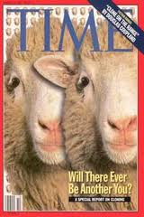
V. GENETIC ENGINEERING: What Can We Do With Genes?
3. Gene cloning: Creating genetically IDENTICAL copies

Slide 31

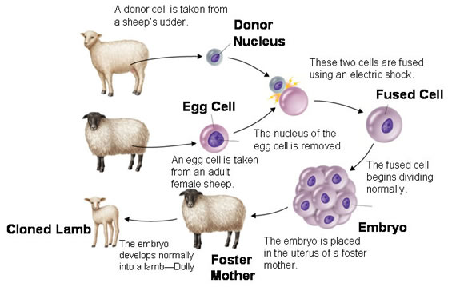
Ex: Dolly (1996-2003)- it took 276 attempts before successful

Slide 32
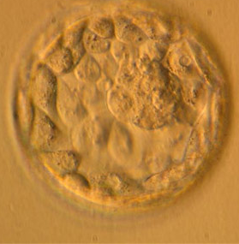
V. GENETIC ENGINEERING: What Can We Do With Genes?
Stem cells are extracted from the egg after it has divided for 5 days.
Stem Cells

Slide 33

V. GENETIC ENGINEERING: What Can We Do With Genes?
The extraction process destroys the embryo, which raises a variety of ethical concerns.
Researchers hope that stem cells can be a treatment for heart disease, Alzheimer's, cancer, and other diseases.

Slide 34
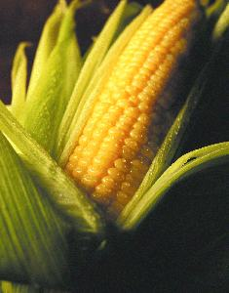
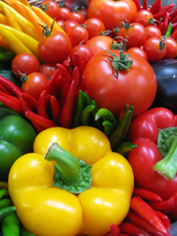
V. GENETIC ENGINEERING: What Can We Do With Genes?
5. Genetically Modified Organisms (GMO) = are organisms with artificially altered DNA. They can be created by:

Slide 35
Genetically Modified Organisms
Adding a foreign gene: Organisms that are altered in this way are known as transgenic organisms.
Altering the base sequence of an existing gene: (Gene therapy)

Slide 36
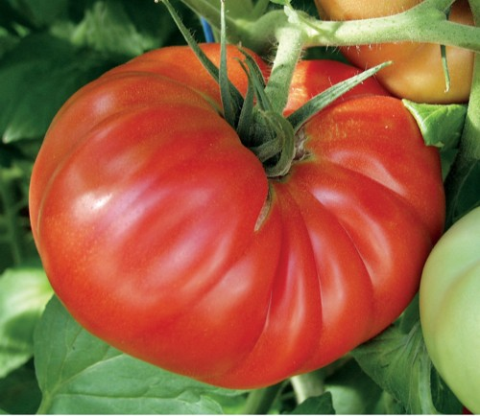
Genetically Modified Organisms
Deleting or "Turning off" an existing gene: (so they don't produce their protein).
  Ex: deactivating the gene responsible for the ripening of tomatoes. This new gene can then be inserted into tomato DNA to give them a longer shelf life.

Slide 37
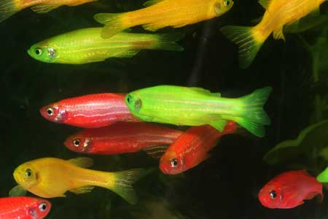
Genetically Modified Organisms
GMO are also called, transgenic organisms: organisms that contain functional recombinant DNA
GloFish: World’s First Transgenic Pet
Genes from jellyfish and coral give the GloFish their vivid colors: starfire red, electric green, and sunburst orange.

Slide 38

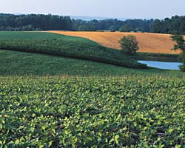
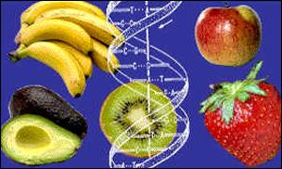
A.) Transgenic PLANTS
Disease-resistant and insect-resistant crops
Hardier fruit
70-75% of food in supermarket is genetically modified.

Slide 39
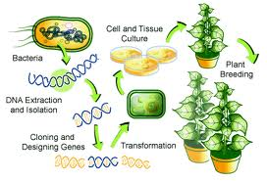
Examples of Transgenic Plants

Slide 40
A.) Transgenic Plants:
Round-up ready corn/soybeans- Incorporating bacterial genes for resistance to herbicides, so a crop plant is not killed by weed killer (herbicide).
  Round-up (an herbicide) kills weeds
  Farmers can spray crops with Round-up and it will kill the weeds and not the corn/soybeans.

Slide 41
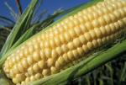
A.) Transgenic Plants:
Incorporating bacterial genes, which produce their own insecticide into corn plants.
  Bt corn contains a gene from the bacterium Bacillus thuringiensis.
  The "Bt" gene expresses a protein that is toxic to corn-boring insects but is harmless to birds, fish, and mammals (including humans).
  Herbivorous insects are thus prevented from eating such plants.

Slide 42
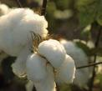
A.) Transgenic Plants:
B.t. cotton – Bacillus thuringiensis bacteria make a toxin against insects – natural insecticide

Slide 43
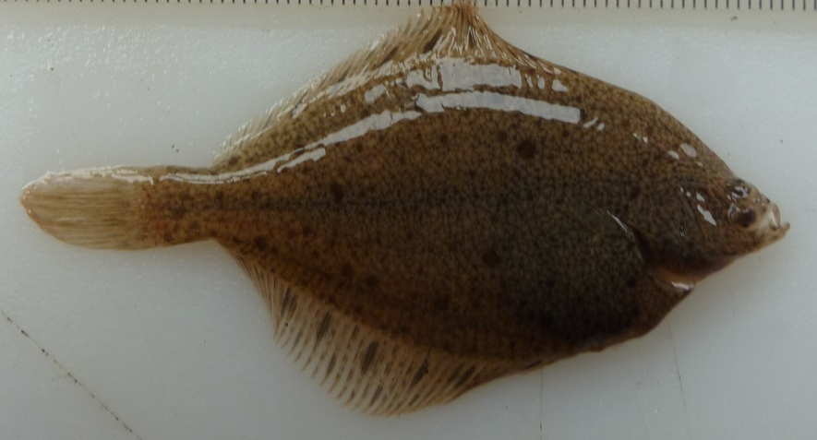
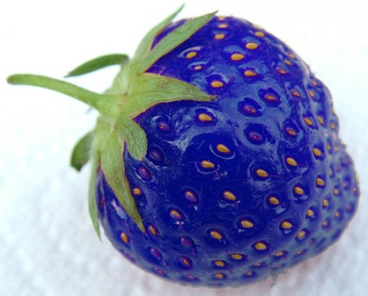
A.)Transgenic Plants
Frost-free strawberry- The Arctic Flounder Fish produces an anti-freeze that allows it to protect himself in freezing waters.
Anti-freeze gene was spliced into a strawberry's genome.
  Strawberry is blue, doesn't turn to mush or degrade after being placed in the freezer.

Slide 44
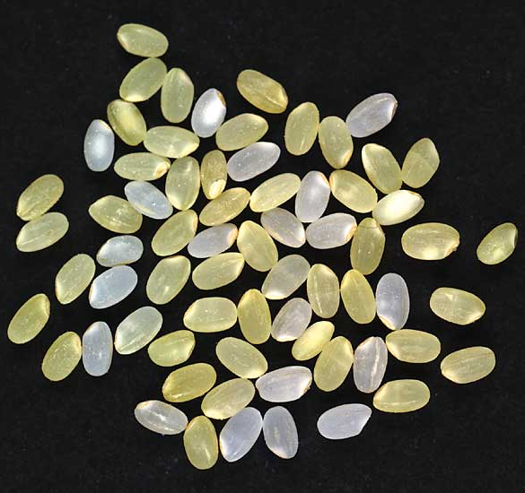
A.) Transgenic Plants
Golden rice - two daffodil genes and a bacterial gene spliced into the rice genome to produce more b-carotene, precursor to Vitamin A
  Still not available due to regulations

Slide 45
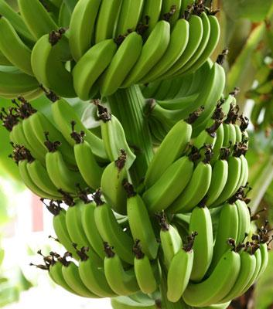
A.) Transgenic Plants:
Banana Vaccine: bananas that contain a vaccine for hepatitis B and cholera.
  When an altered form of a virus is injected into a banana sapling, the virus’ genetic material quickly becomes a permanent part of the plant’s cells.
  Bananas provide an easy means for delivering a vaccine (especially to children) without the need for needles.

Slide 46
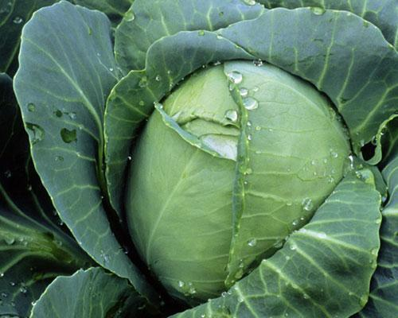
A.) Transgenic Plants:
Venomous Cabbage -These genetically modified cabbages would produce scorpion poison that kills caterpillars when they bite leaves — but the toxin is modified so it isn’t harmful to humans.

Slide 47

How to Create a Genetically Modified Plant:
Create recombinant bacteria with desired gene.
Allow the bacteria to “infect" the plant cells.
Desired gene is inserted into plant chromosomes.

Slide 48

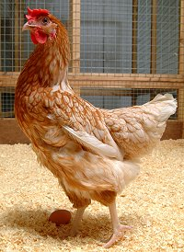
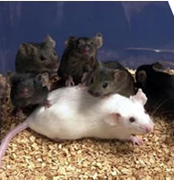
B. ) TRANSGENIC ANIMALS
Mice – used to study human immune system
Chickens – more resistant to infections
Cows – increase milk supply and leaner meat
Goats, sheep and pigs – produce human proteins in their milk

Slide 49
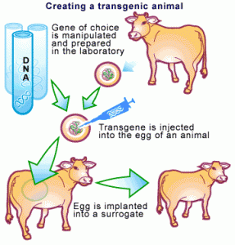
Examples of Transgenic Animals

Slide 50
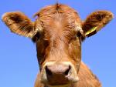
B.) Transgenic Animals:
Bovine growth hormone – increases milk production in cow by 10%

Slide 51
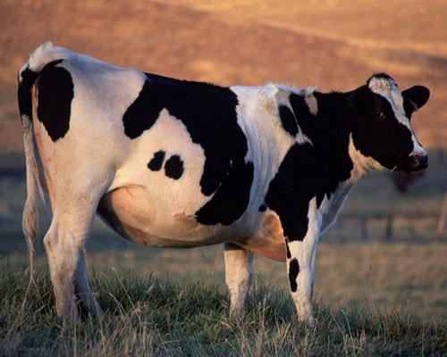
B.) Transgenic Animals:
Less-flatulent cows –
  Methane is a major contributor to the greenhouse effect, so scientists have been working to genetically engineer a cow that produces 25% less methane.

Slide 52

B.) Transgenic Animals:
Goats - produce milk containing high levels of a human protein that dissolves blood clots
Glowing zebra fish- inserted the protein for glowing from a jelly fish.

Slide 53
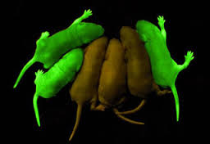
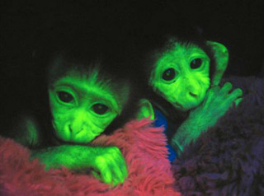
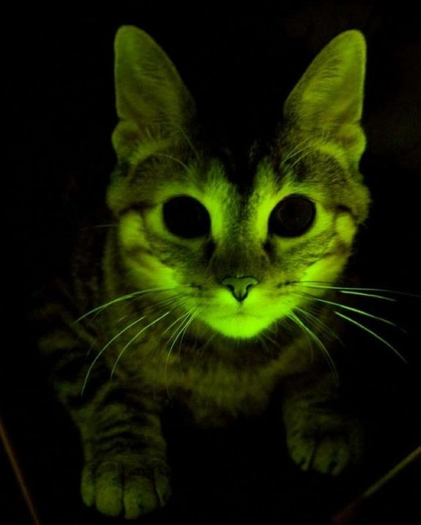
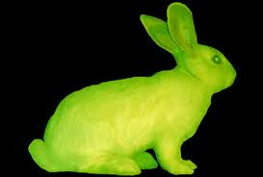
More Glowing Critters

Slide 54
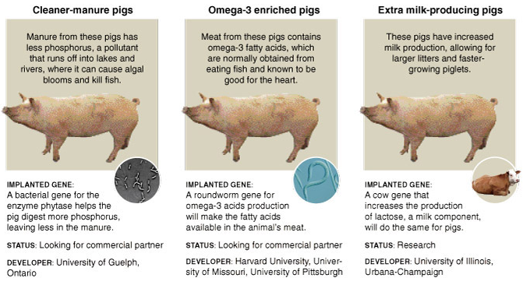
B.) Transgenic Animals:
Pigs that can produce less phosphorus, contain Omega-3 fats, and produce more milk

Slide 55
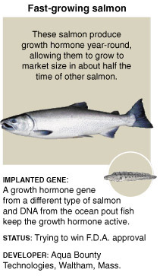
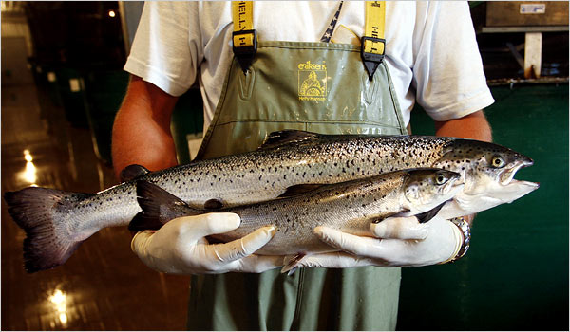
B.) Transgenic Animals:
Fast-Growing Salmon- Atlantic salmon that have been given a growth-hormone gene from the Chinook salmon to make lager in ½ the time

Slide 56
How to Create a Transgenic Animal
Desired DNA is added to an egg cell.

Slide 57
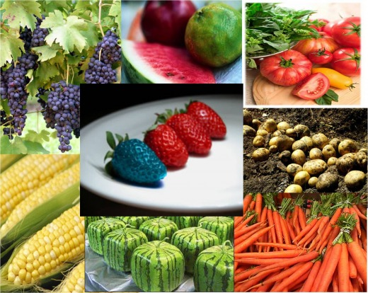

VI. PROS & CONS of Biotechnology

Slide 58

PROS
Disease resistant crops
New vaccines & medications (insulin, human growth hormone)
Bigger livestock- more meat, milk, wool etc.
Possible cures for diseases
Environmentally friendly organisms (enviro-pig, less methane producing cows, etc)

Slide 59

CONS:
Unpredictable- technology is new & no guarantee that products free of side affects
Money- companies patent genes & demand high prices
Unexpected impacts of genetically modified organisms and biotechnology processes on the environment
Biological weapons could be created using biotechnology
Concerns over the safety and ethics of incorporating GMO’s into food for human consumption
  Allergens

Slide 60
VII. Genetically modified Foods (GM Food)

Slide 61
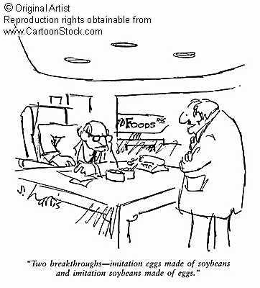
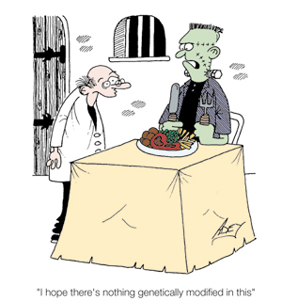
What do you think about eating genetically modified foods?

Slide 62
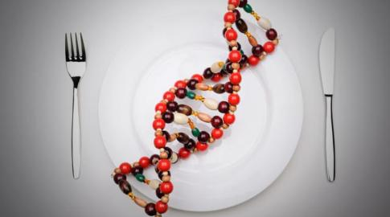
What is a Genetically Modified (GM) Food?
Foods that contain an added gene sequence
Foods that have a deleted gene sequence
Animal products from animals fed GM feed
Products produced by GM organisms

Slide 63
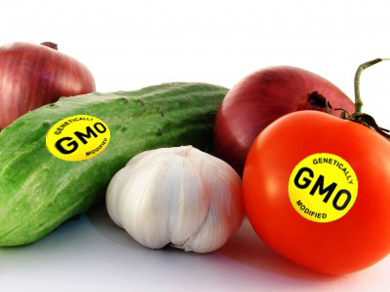
What Foods Contain GMOs?
As of 2012, the USDA reports the following percent of all crops grown in the U.S. are genetically modified:
• Cotton – 94%
• Soybeans – 93%
• Sugar Beets – 90%
• Canola – 88%
• Corn – 88%
• Hawaiian papaya – more than 50%
• Zucchini and Yellow Squash – small %
• Quest brand tobacco – 100%
• Alfalfa (recently approved by the FDA; widely fed to animals to produce meat and milk)

Slide 64

Labeling GM Foods:
Food manufacturers may indicate through voluntary labeling whether foods have or have not been developed through genetic engineering.
  GM foods in the U.S. are required to be labeled only if the nutritional value is changed or a new allergen is introduced.

Slide 65

Benefits of GE Crops Used For Foods
Reduced use of chemical pesticides
Less runoff of chemicals into waterways
Greater use of farming practices that prevent soil erosion
Higher profits for farmers
Less fungal contamination
More nutritious foods

Slide 66

Benefits of GE Crops Used For Foods
Easing of world hunger
  Crops that can be grown in poor soil
  Drought resistant crops
  Salt-tolerant crops

Slide 67

Benefits of GE Crops Used For Foods
Improved crop quality
  Frost resistant crops
  Disease resistant crops
  Flood resistant crops
Improved nutritional quality

Slide 68

Concerns of GE Crops Used For Foods
GMOs are now present in the majority of processed foods consumed in the U.S. (unless they’re organic).
US cancer rates are the 7th highest in the world, having skyrocketed during the same timeframe GMOs were introduced into our food.

Slide 69

Concerns of GE Crops Used For Foods
Insects might develop resistance to pesticide-producing GM crops
Herbicide-tolerant crops may cross-pollinate weeds, resulting in “super weeds”
Soil is being saturated with toxins, due to the ever-increasing use of herbicides and pesticides to counteract resistant weeds and insects.

Slide 70

Concerns of GE Crops Used For Foods
Certain gene products may be allergens, thus causing harm to human health
There may be unintended harm to wildlife and beneficial insects
  Bees, which we rely upon to pollinate all of our crops, are dying at unprecedented rates as a direct result of GMO crops.

