Slide 1
The Nature of Science
The Scientific Method

Slide 2

The Nature of Science
Continuous process that seeks to answer questions about the natural world.
Science only deals with things that are TESTABLE

Slide 3
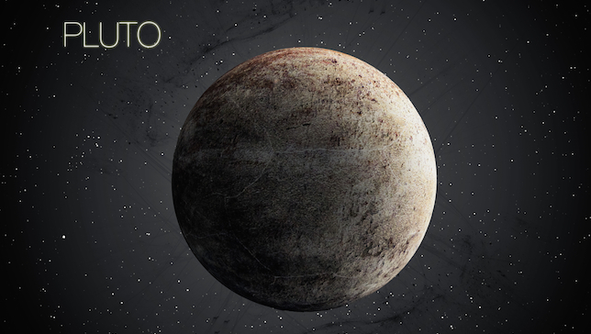

The Nature of Science
1. Science is subject to change.
Pulling medicine off shelves because researchers found out it harms people.
Scientists thought the world was once flat
Pluto is no longer considered a planet

Slide 4
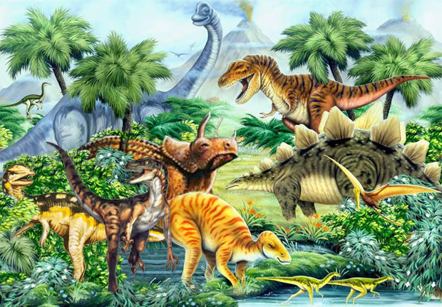
The Nature of Science
2. Does not always provide complete answers to all questions.
What happened to the dinosaurs?
  No one knows for sure!

Slide 5

The Nature of Science
3. Science demands evidence – i.e. DATA!!!
What certain medicines will treat

Slide 6


The Nature of Science
4. Creativity
Doctors and scientists have to think on their feet; not all cases are the same for doctors
Scientist have to be able to trouble shoot.

Slide 7
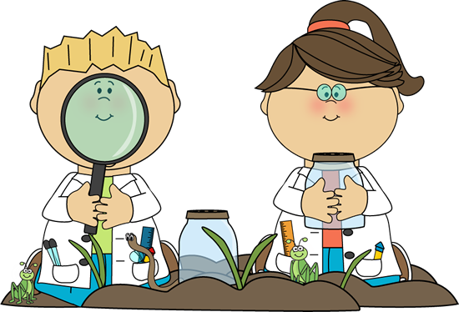
The Nature of Science
5. Explains and predicts
6. Scientist try to identify and AVOID bias

Slide 8
Theory vs. Law vs. Principle
Theory-is an explanation based on many observations (hypothesis is repeatedly verified over time and through may separate experiments)
Enable scientists to predict new facts and relationships of natural phenomenon
Often revised as new information is gathered.
  Ex: Cell Theory, Theory of Evolution

Slide 9
Theory vs. Law vs. Principle
Law = describes relationships under certain conditions in nature
  -Ex: Law of Gravity; Law of Conservation of Matter
Principle = A concept based on scientific laws and axioms (rules assumed to be present, true, and valid) where general agreement is present.

Slide 10
The Scientific Method

Slide 11


Steps of the Scientific Method
1. State the Problem
  -Ex: How does red light effect plant growth?
2. Gather Information
  -About the problem

Slide 12

Steps of the Scientific Method
3. Form a Hypothesis (educated guess)
– A hypothesis must be:
    Testable
    Related to the problem
    Written in “ IF …, THEN ”format
      Ex: If a plant is placed under red light, then the plant will not grow very tall.

Slide 13

Steps of the Scientific Method
4. Perform the Experiment
  A. Make OBSERVATIONS!!

Slide 14
Steps of the Scientific Method
B. Choose the variables:
  a) Your Independent variable is the factor that you will change in your experiment. (The factor being tested)
    •NOT controlled or influenced by something else
    •Ex: Red light

Slide 15
Steps of the Scientific Method
  b) The Dependent variable is what you predict will change as a result of variation in your experiment.
    ●Is controlled or influenced by something else (independent variable)
    ●Ex: Plant Growth
Note: the independent variable influences the dependent variable!

Slide 16

Steps of the Scientific Method
c) A Control
  •The control is a group that serves as a standard of comparison.
  It is exposed to the same conditions as the treatment groups except for the variable being tested.
  Ex: a plant placed in regular sunlight (not exposed to red light)

Slide 17

Steps of the Scientific Method
C. Decide the number of REPLICATIONS
Replications are the repetition of an experiment (trials) and the same conditions are kept in the experiment.
Provides better statistical data (averages)

Slide 18
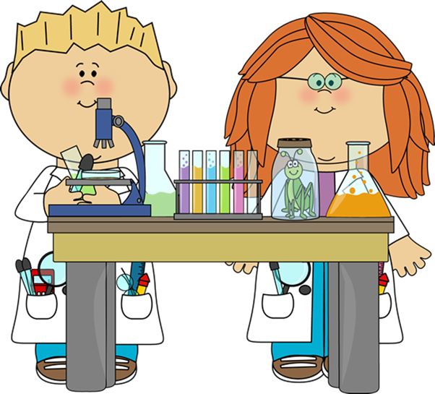
Steps of the Scientific Method
D. Specify the CONSTANTS
The constants in an experiment are the factors that DO NOT change. (Ex: temperature, equipment, etc.)
What your constants will be will depend on what question you are asking.
Ex: type of plant, amount of water, type of soil, amount of fertilizer, keeping plants at same temperature, same size pots, etc.

Slide 19

Steps of the Scientific Method
5. Collect and analyze the data

Slide 20

Steps of the Scientific Method
6. Draw Conclusions
  –Describe what happened
  –Restate the hypothesis
  –Explain the results using the data and research
  –Propose an alternative hypothesis, if original one was incorrect) based on the data that was collected

Slide 21
