Slide 1
Mendelian Genetics

Slide 2
Genetics Facts & Fallacies
Pre-Quiz
Certain acquired characteristics, such as mechanical or mathematical skills, may be inherited.
  FALSE
Identical Twins are always of the same sex.
  TRUE

Slide 3
Genetics Facts & Fallacies
Pre-Quiz
Fraternal twins are more closely related to each other than to other children in a family.
  FALSE
The father determines the sex of a child.
  TRUE

Slide 4
Genetics Facts & Fallacies
Pre-Quiz
Each parent contributes half of a child’s genetic makeup.
  TRUE
Certain drugs or alcohol can cause birth defects in a fetus.
  TRUE

Slide 5
Genetics Facts & Fallacies
Pre-Quiz
Colorblindness is more common in males than females.
  TRUE
A person may transmit characteristics to offspring which he, himself, does not show.
  TRUE

Slide 6
Genetics Facts & Fallacies
Pre-Quiz
Identical twins are more closely related than fraternal twins.
  TRUE
Certain inherited traits may be altered by the stars, moon, or planets early in development.
  FALSE

Slide 7
Genetics Facts & Fallacies
Pre-Quiz
Humans have 23 chromosomes.
  FALSE
The tendency to produce twins may run in families.
TRUE

Slide 8
Genetics Facts & Fallacies
Pre-Quiz
A craving for a food such as strawberries may cause a birthmark on an unborn child.
  FALSE
Many of a person’s inherited traits are not apparent.
  TRUE

Slide 9
Genetics Facts & Fallacies
Pre-Quiz
The parent with the strongest “will-power”” will contribute more to a child’s inheritance than the other parent.
  FALSE
If a person loses a limb in an accident, it is likely that he or she will have a child with a missing limb.
  FALSE

Slide 10
Genetics Facts & Fallacies
Pre-Quiz
Gregor Mendel was a monk and is known as the “Father of Genetics” based on his experiments with pea plants.
  TRUE
Children born to older parents may have a higher chance of birth defects than younger parents.
  TRUE

Slide 11
Genetics Facts & Fallacies
Pre-Quiz
The total number of male births exceeds the female births each year.
  TRUE
If a male “mutt” dog mates with a pedigree (show quality) female dog, all the future litters that the female would have (even with other dogs) can have traits from the “mutt” dog.
  FALSE

Slide 12
Genetic Terminology
Trait = any characteristic that can be passed from parent to offspring
Heredity = passing of traits from parent to offspring
Genetics = study of heredity

Slide 13
Genetic Terminology
Alleles = two forms of a gene (dominant & recessive)

Slide 14
Genetic Terminology
Dominant = stronger of two genes expressed in the hybrid; represented by the capital letter (R)
Recessive = gene that shows up less often in a cross (usually); represented by a lower case letter (r)

Slide 15
Genetic Terminology
Genotype + gene combination for a trait (ex: RR, Rr, rr)
Phenotype = the physical feature resulting from a genotype (e. g. tall, short)

Slide 16
Genetic Terminology
Homozygous genotype = gene combination involving 2 dominant or 2 recessive genes (ex: RR or rr); also called pure
Heterozygous genotype= gene combination of one dominant and one recessive allele (ex: Rr); also called hybrid

Slide 17
Genetic Terminology
Monohybrid cross = cross involving a single trait
Dihybrid cross = cross involving two traits

Slide 18
Genetic Terminology
Punnett Square = used to solve genetics problems (based on probability)

Slide 19
Fundamentals of Genetics
Heredity = the passing of traits from parents to offspring.
  Transmitted by means of information stored in molecules of DNA.

Slide 20
Fundamentals of Genetics
Genetics = scientific study of heredity
  Based on knowledge that traits are transmitted by chromosomes.
  Our chromosomes are made up of our genes, which are pieces of DNA that code for certain traits.

Slide 21
Fundamentals of Genetics
Humans have 46 chromosomes in all our somatic (body) cells.
  23 chromosomes from your mom and 23 chromosomes from your dad.

Slide 22
Fundamentals of Genetics
Environment = all the outside forces that act on an organism.
  Affects the development, later life, and the expression of hereditary traits of an organism.

Slide 23
Fundamentals of Genetics
What Makes You Who You Are Today?
  Heredity & Environment—are the two greatest influences, acting together all through your life.

Slide 24
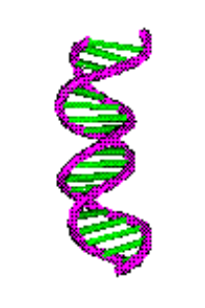
Fundamentals of Genetics
Genetic messages determine what organisms may become.
The interaction of messages and the environment determines what organisms DO become.

Slide 25
Fundamentals of Genetics
Organisms inherit genetic messages, not traits!
Traits develop when genetic messages interact with the environment.

Slide 26

Gregor Mendel
Gregor Mendel – “Father of Genetics” – (1865) Austrian monk
  His research with garden peas led to the discovery of the basic principles of heredity.
  Did a statistical study of traits in garden peas over an eight year period.

Slide 27

Gregor Mendel
Garden peas were a good choice for experimentation because:
  They can be cultivated quickly.
  They display several traits in one of two contrasting forms:
    Height –tall/short
    Seed color –yellow/green
  They are normally self-pollinating plants and are very easy to cross-pollinate

Slide 28

Gregor Mendel
Mendel used logical experimental methods and kept careful records.
He used his math principles of probability to interpret results.

Slide 29
Gregor Mendel
Mendel studied pea traits, each of which had a dominant & recessive form (alleles).
The dominant (shows up most often) gene or allele is represented with a capital letter & the recessive gene with a lower case of that same letter (ex: B, b)

Slide 30
Gregor Mendel
Mendel’s traits included:
Seed shape – Round (R) or wrinkled (r)
Seed color –Yellow (Y) or green (y)
Pod Shape – Smooth (S) or wrinkled (s)
Pod Color – Green (G) or yellow (g)
Seed coat color—Gray (G) or white (g)
Plant height – Tall (T) or short (t)
Flower color –(Purple (P) or white (p)

Slide 31
Mendelian Genetics Overview
Humans each have two sets of 23 chromosomes in their somatic (body) cells and about 30,000 genes

Slide 32
Mendelian Genetics Overview
The different forms or types of a specific GENE are called alleles.
  For example, a gene for eye color might have a blue allele, a brown allele, and a green allele.

Slide 33
Mendelian Genetics Overview
Because our chromosomes are in two sets, we have two copies of each gene, one from mom and one from dad.
If both of our parents gave us the same type of gene- the same allele- then we are:

Slide 34
Mendelian Genetics Overview
HOMOZYGOUS or pure (on both sets of our chromosomes, on both sets of genes; the allele is the same.)

Slide 35
Mendelian Genetics Overview
If one parent gave us one type of gene and the other parent gave us a different type, we are:
  Heterozygous or hybrid – we have two different alleles

Slide 36
Mendelian Genetics Overview
With Mendelian traits (the type of traits that Mendel studied), heterozygotes DO NOT have a blend of the two alleles.
  Instead, one type of allele dominates-
    We show the characteristics of this allele only- it is the DOMINANT trait.

Slide 37
Mendelian Genetics Overview
The other version of the trait is still there on half of our chromosomes (so we might still pass it on to our children, depending on meiosis) BUT it DOES NOT affect us right now—it is the RECESSIVE trait.

Slide 38
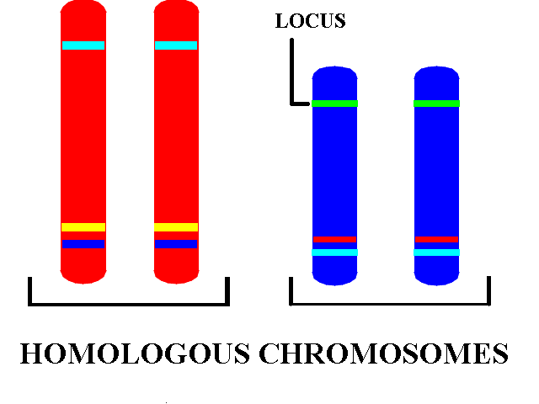
Mendelian Genetics Overview

Slide 39
Mendelian Genetics Overview
Whether we are heterozygous, homozygous with the dominant trait, or homozygous with the recessive trait, it is called our GENOTYPE (type of genes that we have).
Which trait we physically show is our PHENOTYPE (the type of allele that is expressed).

Slide 40
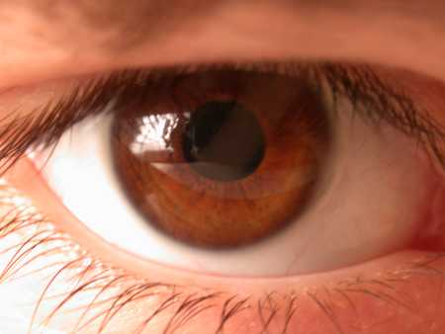
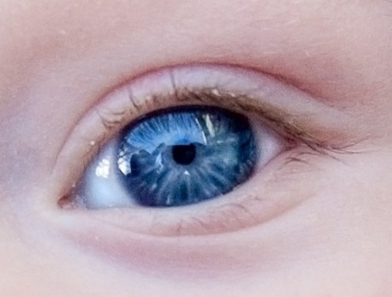
Mendelian Genetics Overview
For example, if the dominant allele of the eye color gene is brown and the recessive allele of the eye color is blue, then the person could have the following possibilities:

Slide 41

Mendelian Genetics Overview
Two blue alleles, bb, (one from mom and one from dad)
  Genotype would be homozygous recessive
  Phenotype would be blue-eyed.

Slide 42

Mendelian Genetics Overview
Two brown alleles, BB (one from mom and one from dad)
  Genotype would be homozygous dominant
  Phenotype would be brown-eyed.

Slide 43
Mendelian Genetics Overview
One brown and one blue allele, Bb, (one from mom and one from dad)
  Genotype would be heterozygous dominant
  Phenotype would be brown-eyed.

Slide 44
Mendelian Genetics Overview
When only one trait is being studied in a genetic cross. It is called a monohybrid cross.
  When parent organisms, called the P generation, are crossed, the resulting offspring are the first filial, or F₁ generation.
  When organisms of the F₁ generation are crossed, their offspring make up the second filial, or F₂ generation.

Slide 45
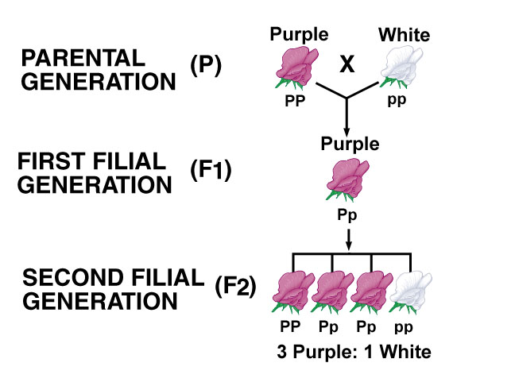
Mendelian Genetics Overview

Slide 46
Mendel’s Experiments:
Mendel produced pure strains by allowing the plants to self-pollinate for several generations.
These strains were called the parental generation or P₁ strain.

Slide 47
Mendel’s Experiments:
Mendel cross-pollinated two strains and tracked each trait through two generations. (ex: TT X tt)
  Traits = plant height
  Alleles = T (tall), t (short)

Slide 48
Mendel’s Experiments:
P₁ cross = TT x tt
T T
F₁ genotypic ratio = 100% Tt
F₁ Phenotypic ratio = 100% Tall
t
t
Tt Tt
Tt Tt

Slide 49
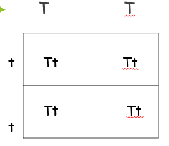
Mendel’s Experiments:
The offspring of this cross were all hybrids showing ONLY the dominant trait & were called the first filial or F₁ generation.

Slide 50
Mendel’s Experiments:
Mendel then crossed two of his F₁ plants and tracked their traits; known as an F₁ cross.
  Trait = plant height
  Alleles = T (tall), t (short)

Slide 51
Mendel’s Experiments:
F 1 cross = Tt x Tt
T t
F2 genotype ratio =
1 TT: 2 Tt: 1 tt
F2 phenotype ratio =
3 Tall: 1 short
T
t
TT Tt
Tt tt

Slide 52
Mendel’s Experiments:
When 2 hybrids were crossed, 75% (3/4) of the offspring showed the dominant trait and 25% (1/4) showed the recessive trait.
Two hybrid ALWAYS create 3 dominant traits : 1 recessive trait ratio.
The offspring of this cross were called the F₂ generation.

Slide 53
Results of Mendel’s Experiments:
Inheritable factors or genes are responsible for all heritable characteristics.
Phenotype is based on genotype.

Slide 54
Results of Mendel’s Experiments
Each trait is based on two genes, one from the mother and the other from the father.
True-breeding individuals are homozygous (both alleles) or the same.
Formulated 3 laws of heredity in the early 1860’s.

Slide 55
Mendel’s 3 Laws of Heredity:
Law of Dominance states that when different alleles for a characteristics are inherited (heterozygous) the trait of only one (the dominant one) will be expressed. The recessive trait’s phenotype only appears in true-breeding (homozygous) individuals.

Slide 56
Law of Dominance

Slide 57

2. Law of Segregation
= states that each genetic trait is produced by a pair of alleles which separate (segregate) during reproduction.
Rr
R r
  Explains the disappearance of a specific trait in the F₁ generation and its reappearance in the F₂ generation.

Slide 58
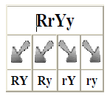
3. The Law of Independent Assortment
= states that each factor (gene) is distributed (assorted) randomly and independently of one another in the formation of gametes (egg or sperm).

Slide 59
The Law of Independent Assortment
Explains that different traits are inherited independently, if on different chromosomes.
Ex: wrinkled seeds do not have to be yellow. They can be green.
Ex: A gamete with RrYy
  R and r – separate into different gametes
  Y and y – Separate into different gametes
  They can then recombine 4 ways to form gametes: RY Ry rY ry

Slide 60
Inheritance of Human Traits
Dominance/Recessive
No cleft in chin /cleft on chin
Straight thumb/hitch hiker’s thumb
Inability to fold tongue/ability to fold tongue
Tongue roller/non-roller

Slide 61
Inheritance of Human Traits Dominant/Recessive
Dark hair / light hair
Non- red hair / red hair
Widow’s peak /straight or curved hair line
White forelock / normal hair
Freckles / no freckles
Dimples /No dimples

Slide 62
Inheritance of Human Traits Dominant/Recessive
Brown eyes /Blue eyes
Normal eye sight / Near sighted
Almond shaped eyes /round eyes
Long eyelashes /short eyelashes
Broad nostrils / narrow nostrils
Roman nose / straight nose

Slide 63
Inheritance of Human Traits Dominant/Recessive
Free ear lobe /attached ear lobe
Bent little fingers / parallel little finger
Left over right thumb /right over left thumb

Slide 64
Inheritance of Human Traits Dominant/Recessive
A or B blood /O blood
RH + blood /RH – blood
Normal clotting / Hemophilia
Normal /Allergies

Slide 65
Human Genetics

Slide 66
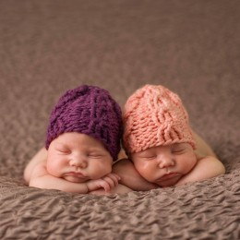
Fraternal vs. Identical Twins
Identical twins develop from a single fertilized egg that splits shortly after fertilization.
  Since they developed from the same egg, they have exactly the same genetic makeup.

Slide 67
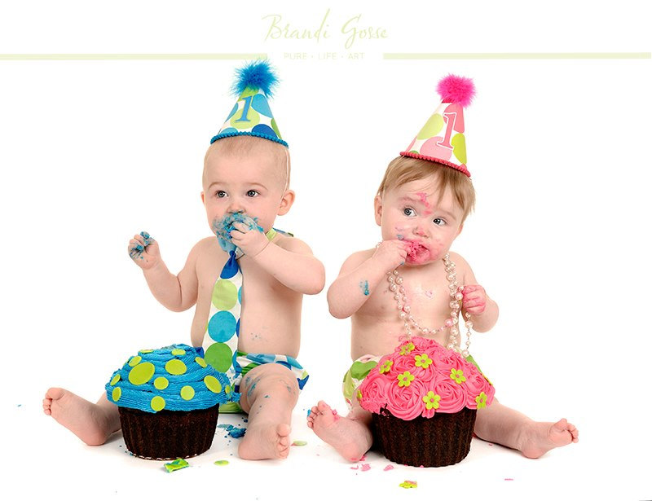
Fraternal vs. Identical Twins
Fraternal twins develop from two eggs that are fertilized by different sperms.
  They are completely different people.

Slide 68

Fraternal vs. Identical Twins
By studying identical twins, geneticists have learned that genes seem to have a greater influence than the environment on such traits as height, weight, blood pressure, speech patterns, and gestures.

Slide 69
Fraternal vs. Identical Twins
They have also discovered that genes play a role in some medical problems once thought to be caused only by environmental factors.
For instance, genes can cause a susceptibility to diseases such a diabetes and certain types of cancer.

Slide 70
Inherited Diseases
Infections and infectious diseases MAY be inherited.
  Ex: Aids (HIV) can be passed onto offspring
  Ex: Common cold (rhino virus) can’t be passed onto offspring genetically

Slide 71
Inherited Diseases
Disorders resulting from abnormal structure or function of body organs are more likely to be hereditary.

Slide 72
Inherited Diseases
Some disorders that are associated with genes are:
  Diabetes –respiratory allergies –colorblindness – down syndrome – farsightedness – sickle cell anemia – etc.

Slide 73

Sex Determination
Sex chromosomes – determine the sex of an individual
  The X chromosomes (XX) produce a female
  An X chromosome paired with a Y chromosome (XY) produces a male

Slide 74
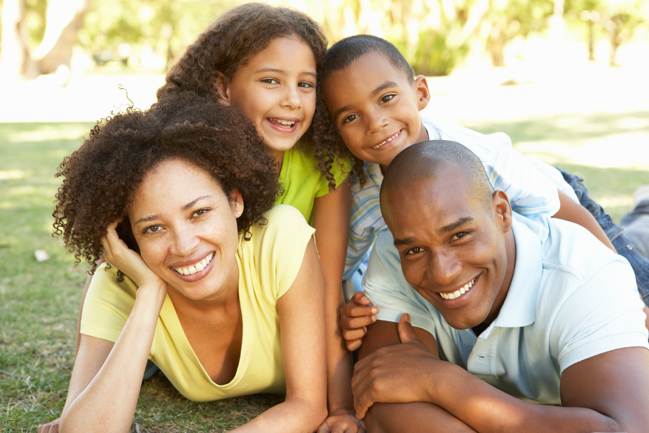
Sex Determination
Since only a male can produce a gamete bearing a Y chromosome, the father determines the sex of the child
  Note: the X chromosome contains additional genetic information that they Y chromosome does not have, therefore the male child actually more genetic information from his mother than his father (a very tiny amount)

Slide 75
Sex – Linked Traits
Traits that occur more frequently in one sex than another (usually males)
  Males – color blindness and hemophilia

Slide 76
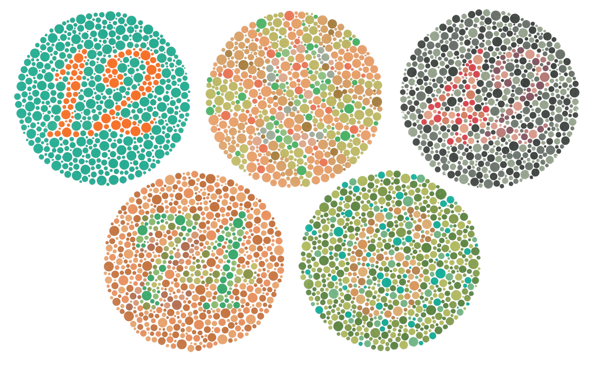

Slide 77
Sex – Linked Traits
Occurs because other genes besides the alleles for sex are also located on the sex chromosomes
  They are recessive to the normal condition and the Y chromosomes appear to lack genes for these traits
  These traits generally do not show up in females

Slide 78
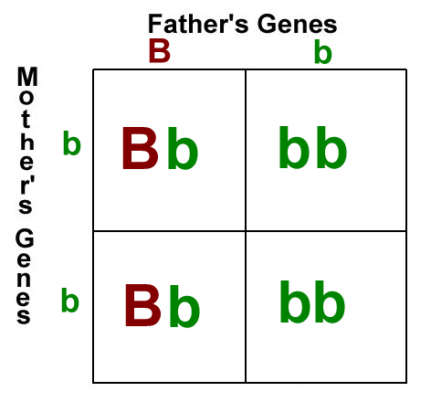
Punnett Squares
Use Punnett Squares to solve genetic problems (based on probability)

Slide 79
Punnett Squares
Ex: Crossing two heterozygous genotypes (Rr x Rr)
Remember the letters of a genotype (R, r’s) represent possible gamete (egg/sperm) combinations

Slide 80
Test Cross Punnett Square:
You cannot tell by looking at an organism that shows the dominant trait whether it is heterozygous (Rr) or homozygous (RR) for the trait.
  To determine the genotype of an organism showing the dominant trait, a test cross would be done.
  Test cross = the organism of unknown dominant genotype is crossed with a homozygous recessive (rr) organism.

Slide 81
In class Practice Problems-
Monohybrids (one trait)
Black coat color in guinea pigs is dominant over white coat color. Using a Punnett Square, show the results of crossing a hybrid black with pure white. The show the results of crossing a hybrid black with a hybrid black.

Slide 82
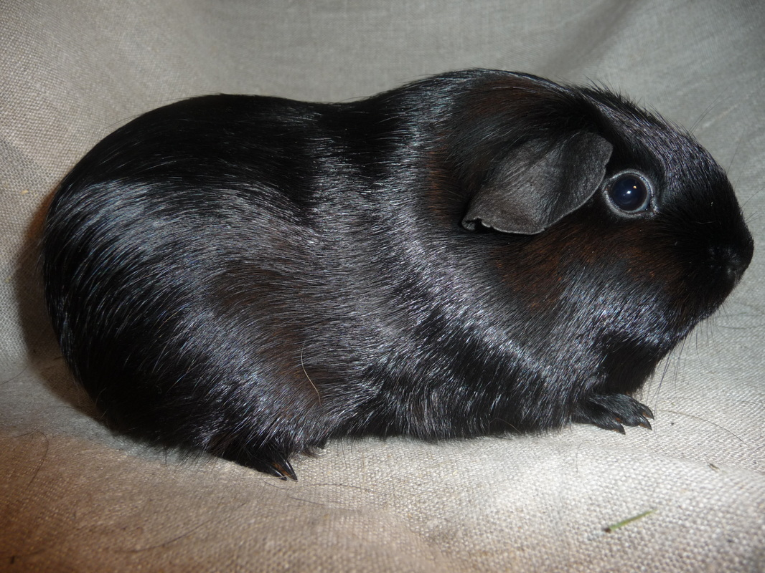
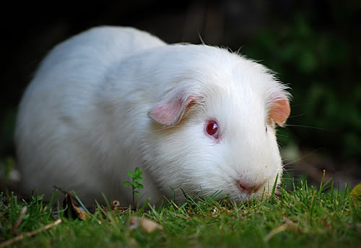
In class Practice Problems-
Monohybrids (one trait)
Black Trait – B (dominant)
White trait – b (recessive)
Hybrid black = Bb
Pure white = bb

Slide 83
In class Practice Problems-
Monohybrids (one trait)
P₁ cross: Bb x bb
Genotypes of F₁ offspring
2 Bb : 2 bb
B b
b
b
Bb
bb
Phenotypes of F1 offspring
2 black : 2 White
(or 50% black & 50 % white)
Bb
bb

Slide 84
In class Practice Problems-
Monohybrids (one trait)
Bb x Bb
P₁ cross: _____________
Genotypes of F₁ offspring
1 BB: 2 Bb : 1 bb
B b
B
b
Bb
BB
Phenotypes of F1 offspring
3 black : 1 White
(or 75% black & 25% white)
Bb
bb

Slide 85
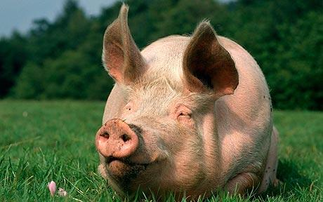
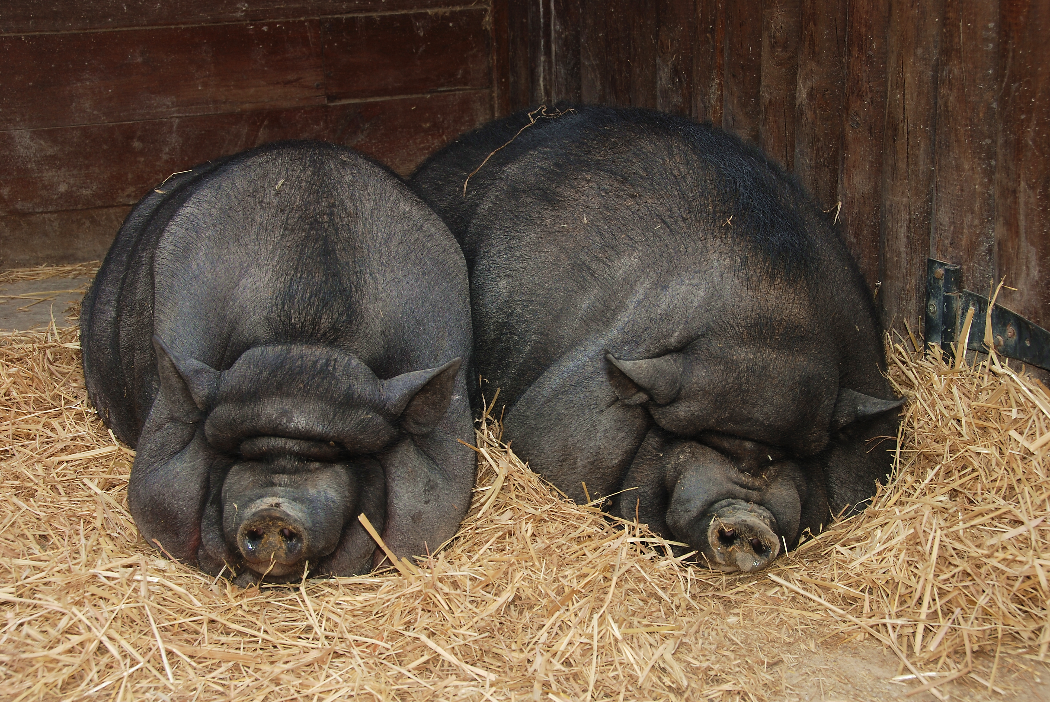
Now you try some;
In pigs, the white color (W) is dominant; the black color (w) is recessive. Using a Punnett Squares, show the expected results of the following crosses.

Slide 86
1a) A pure (homozygous) white pig is mated with a black pig.
WW x ww
P₁ cross: _________
F₁ Genotype:
100% Ww
F₁ Phenotype:
100% White
W W
w
w
Ww
Ww
Ww
Ww

Slide 87
b) Show a cross between two of the F₁ offspring from number 1a. Determine the genotype and phenotypes of the offspring in the F₂ generations.
Ww x Ww
F₁ cross:_________
F₁ Genotype:
1 WW: 2 Ww: 1 ww
F₁ Phenotype:
3 White: 1 black
W w
W
w
WW
Ww
Ww
ww

Slide 88
Complete the rest of the monohybrid practice problems in the packet.

Slide 89
Dihybrids
( two traits)

Slide 90
Dihybrids (two traits)
Because each parent and offspring are using two traits, each one would have 4 alleles, 2 for each trait.
Each gamete produced by the P₁ generations will contain 2 allele, one for each trait.

Slide 91
Dihybrid: seed color and shape

Slide 92
Dihybrids ( two traits)
Example: A plant that is heterozygous for being tall and having green seeds is crossed with a homozygous yellow and short plant.
    Traits = seed color and plant height
    Alleles: G = green T = Tall
    g = yellow t = short
Cross : _________ x ___________
TtGg
ttgg

Slide 93
Dihybrids ( two traits)
Determine the gametes produced by each parent by using the FOIL method.
TtGg produces 4 different gametes:
  TG Tg tG tg
Ttgg produces only 1 gamete:
  tg

Slide 94
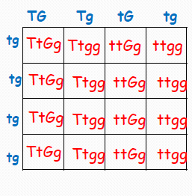
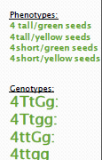

Slide 95
Dihybrid (2 traits) Homework Set
In a dihybrid cross, when two traits are considered, the number of possible combinations of the offspring increases. Suppose that black hair (B) is dominant over blonde hair (b) and brown eyes (E) are dominant over blue (e)
What percent of offspring could be expected to have blonde hair and blue eyes?

Slide 96
Dihybrid (2 traits) Homework Set
The father has black hair (heterozygous) and brown eyes (heterozygous) an the mother has blonde hair and blue eyes.
Genotype of father = _________
Genotype of mother = _________
Complete the cross using the Punnett Square. Determine what percent of the offspring will have blonde hair and blue eyes.

Slide 97
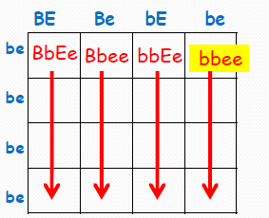


Slide 98
Dihybrid (2 traits) homework set
Both parents have black hair (heterozygous) and brown eyes (heterozygous).
Genotype of father = __________
Genotype of mother = __________
Complete the Punnett Square below. Determine what percent of offspring will have blonde hair and blue eyes.
BbEe
BbEe

Slide 99
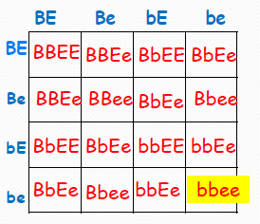


Slide 100
Complete the rest of the problem (Dihybrid) in packet.

