Slide 1
Mutations
and
Nature vs. Nurture

Slide 2
What are mutations?
  Changes in the nucleotide sequence of DNA
  May occur in somatic cells (aren’t passed to offspring); called somatic mutations
  May occur in gametes (sperm and egg) and be passed to offspring (germ mutations)

Slide 3
Are mutations helpful or harmful?
Mutations happen regularly
Some mutations are silent or neutral
Chemicals and UV radiation causes mutations (mutagens)
Many mutations are repaired by enzymes
Some types of skin cancers and leukemia result from somatic mutations
Some mutations may improve an organism’s survival (beneficial)
Most changes in DNA are not beneficial

Slide 4
A. Gene Mutations
Change in the nucleotide sequence of one gene
May only involve a single nucleotide
May be due to copying errors, chemicals, viruses, etc.
Two types of gene mutations exist

Slide 5
Gene Mutations
  Point mutations - change in DNA at one location (addition, deletion, substitution)
    Substitution – substituting a nucleotide for another
    Insertions – adding a nucleotide
    Deletions – removing a nucleotide

Slide 6
Gene Mutations
  2. Frameshift – changes the DNA triplet resulting in changes to mRNA and amino acid

Slide 7
Gene Mutations
Point mutation
      Changes a single nucleotide
      Includes the deletion, insertion, or substitution of ONE nucleotide in a gene
      Only one amino acid is changed if it is a substitution.
        THE CAT ATE THE BIG RAT
          Substitute a “T” for the “A” in ATE
        THE CAT TTE THE BIG RAT
      Sickle cell disease is the result of one nucleotide substitution (recessive trait)
      Occurs in the hemoglobin of the blood

Slide 8
Gene Mutations
Frameshift Mutation is really just an effect of a Point mutation.
    Inserting or deleting one or more nucleotides
    Changes the “reading frame” like changing a sentence
      THE CAT ATE THE BIG RAT
        Insert an “A” after CAT
      THE CAT AAT ETH EBI GRA T
    Protein is built incorrectly

Slide 9
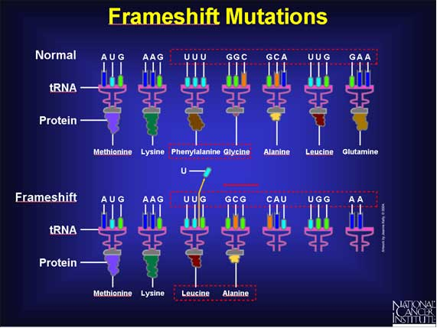

Slide 10
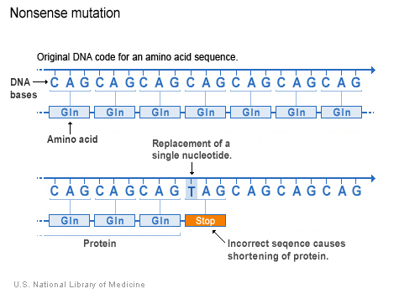
Nonsense mutations
A point mutation that codes for a stop codon in the middle of a protein.
Shortens protein.
Makes no sense.

Slide 11
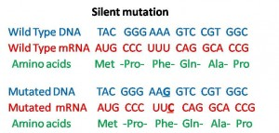
Silent mutation
Change in the base sequence that does NOT alter the amino acid placement in the protein.
Has no effect on the protein.

Slide 12
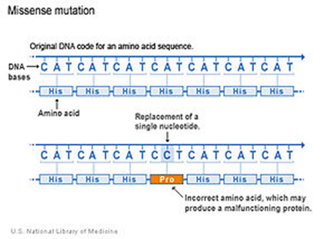
Missense mutation
Mutations that occurs when a single point mutation occurs and a different amino acid is inserted, changing the protein.
Protein malfunctions.

Slide 13
Types of mutations
B. Chromosomes Mutations
  May involve:
    Changing the structure of a chromosome
    The loss or gain of part of a chromosome
    More dramatic changes to organism

Slide 14
Chromosome Mutations
Six types of chromosome mutations exist:
  Deletion
  Inversion
  Duplication
  Nondisjunction
  Translocation
  Insertion

Slide 15
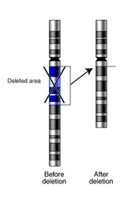
Deletion
  Due to breakage
  A piece of a chromosome is lost

Slide 16
Inversion

Slide 17
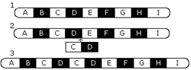
Duplication
  Occurs when a gene sequence is repeated

Slide 18
Nondisjunction

Slide 19
Translocation

Slide 20
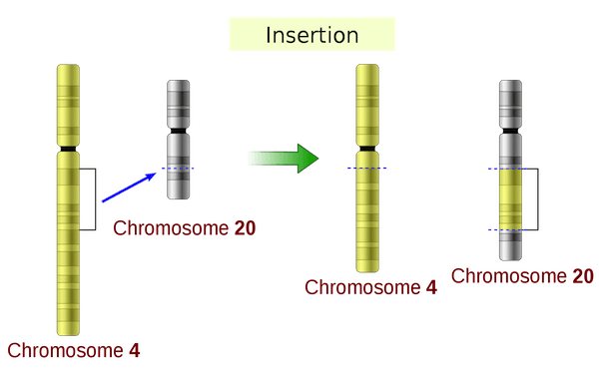
Insertion
Part of a chromosomes is inserted into a non-homologous chromosome

Slide 21
Nature vs. Nurture- the debate?
Nature = passed on to next generation through genes (ex. Blood types)
Nurture = controlled by environmental factors
  Body size, intelligence, personality, homosexuality/heterosexuality
Geneticists can measure the influence of both heredity and environment on the development of a trait by studying twins, especially those identical twins who were raised in different environments

Slide 22
Twins
Fraternal Twins—the most common ones.
  They develop from 2 different eggs, each one fertilized by a different sperm.
  They are genetically different people.
Identical Twins
  They develop from a single fertilized egg.
  Early in the development, the zygote splits and separates into 2 embryos.
  Since they come from the same fertilized egg and sperm, identical twins have the same genetic makeup.
  They are always the same sex.

Slide 23
Chromosome Disorders
Biologists can examine chromosomes of human cells under the microscope to see if there are any abnormalities. They photograph them and cut out individual chromosomes from the picture and arrange them in homologous pairs. This type of arrangement of chromosomes is called a karyotype.

Slide 24
Detecting Genetic Disorders
Testing people for genetic disorders is called genetic screening.
Today, many genetic defects are being detected in babies before they are born by a process called amniocentesis. By this process, a sample of the baby’s cells is taken and the chromosomes within them are studied for genetic disorders.

