Slide 1
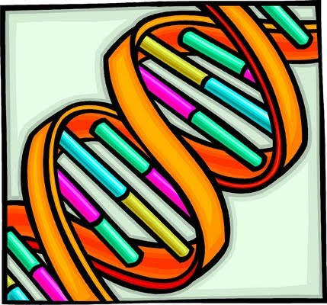
DNA
The Molecule of Heredity

Slide 2
Heredity
Heredity = passing on of characteristics from parents to offspring
How?......................... DNA!

Slide 3
I. DNA, Chromosomes, Chromatin, and Genes
DNA = blueprint of life (has the instructions for making an organism.)
Chromatin = uncoiled DNA
Chromosome = coiled DNA

Slide 4

You have 46 chromosomes or 23 pairs in the nucleus of each body cell.
  23 from mom and 23 from dad

Slide 5
Gene = a segment of DNA that codes for a protein, which in turn codes for a trait (skin tone, eye color, etc.); a gene is a stretch of DNA
  There is a gene for every protein your body has to make.

Slide 6

II. DNA
Deoxyribonucleic Acid
Located in the nucleus of the cell
Codes for your genes
Frank Griffith- discovered DNA in 1928

Slide 7
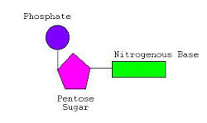
A. Shape and Structure
Made from nucleotides
DNA nucleotide components
Deoxyribose (simple sugar)
Phosphate group
Nitrogen bases (A, T, C, and G)

Slide 8
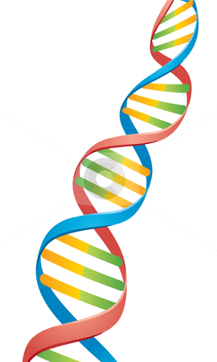
Shaped similar to a twisted ladder…aka…double helix.
The uprights of this ladder are composed of phosphates and deoxyribose sugar.

Slide 9
DNA
The rungs are composed of 2 bases (a purine and a pyrimidine) joined at the center by weak hydrogen bonds.

Slide 10
DNA
Purines = adenine (A) and guanine (G)
Pyrimidines = thymine (T) and cytosine (C)

Slide 11
Direction of the 2 DNA strands:
5’ = orientation of the sugar; has carbon on the left
3’ =orientation of the sugar; has carbon on the right

Slide 12
Direction of the 2 DNA strands:
Ex: (look at pic. Below) the top strand is oriented 5’-3’ and the bottom strand is opposite 3’-5’

Slide 13
B. Base Pairings
1962: James Watson and Francis Crick discovered that A always bonds with T and C bonds with G.

Slide 14
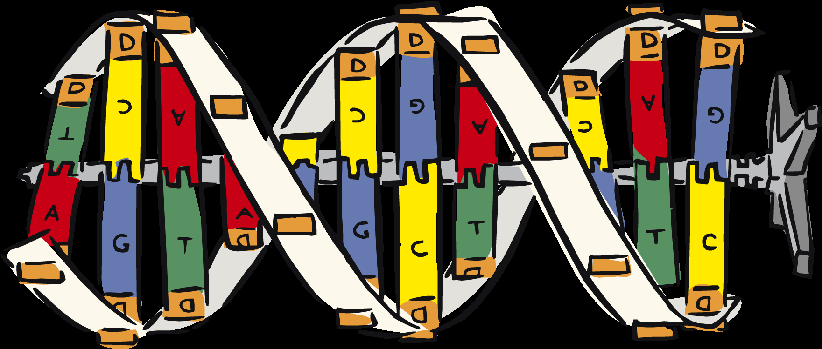
Adenine and thymine are complimentary. They both require 2 hydrogen bonds.
Cytosine and guanine are complimentary. They both require 3 hydrogen bonds.

Slide 15
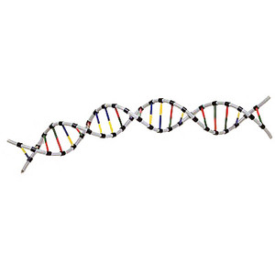
Sequence of bases determines the genetic information and is unique to each organism.
If the organisms are closely related the more alike the DNA molecule nucleotide sequence would be.

Slide 16
The rungs of the ladder can occur in any order (as long as the base-pair rule is followed)
If the order of base pairs in a DNA molecule is changed, what might occur?
  MUTATIONS!

Slide 17
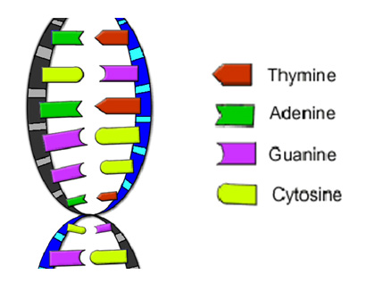
DNA is made of double strand of nucleotides.
The DNA from each side is complimentary to the other side.

Slide 18
If you know the sequence of one side, you can determine the sequence of the other side.

Slide 19
Ex: What is the complimentary strand of this DNA molecule?
A A T C G T A C C G A T
T T A G C A T G G C T A

Slide 20
C. Two Functions of DNA
To direct the control of protein synthesis
DNA replication = reproducing an exact copy of DNA so that the information can be passed on during cellular division

Slide 21
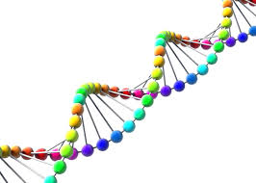
D. DNA Replication
Replication is the process where DNA makes a copy of itself

Slide 22
D. DNA Replication
Semiconservative replication = parental strands of DNA separate, serve as a template, and produce DNA molecules that have one strand of parental DNA and one strand of new DNA.

Slide 23
Semiconservative replication
Helps reduce the number of copying errors
3 stages: unwinding, base pairing, and joining

Slide 24
Why Does DNA need to replicate?
Cells divide for an organism to grow or reproduce; every new cell needs a copy of the DNA or instructions to know how to be a cell.
DNA replicates right before a cell divides (MITOSIS)

Slide 25
E. Replication Steps
1) Unwinding: DNA helicase (an enzyme) unwinds and unzips the double helix and begins to break the H bonds between the nitrogen bases.

Slide 26
E. Replication Steps
2)Base pairing: DNA polymerase (an enzyme) runs along the parent chain of DNA in the 3’-5’ direction and bonds free floating nucleotides to the parent (original) chain—based on base pairing rules.
  The newly assembled strand is called a leading strand of nucleotides and reforms the double helix.
  Each new strand is a complement of the parent strand.

Slide 27
E. Replication Steps
3) Because DNA synthesis can only occur 5’-3’, a second type of DNA polymerase binds to the other template strand as the double helix opens.
  DNA polymerase synthesizes discontinuous segments of nucleotides (called Okazaki fragments).

Slide 28
E. Replication Steps
4) Joining: Another enzyme, DNA ligase, then bonds these Okazaki fragments together into the lagging strand.

Slide 29
E. Replication Steps
5) Therefore, the result is the formation of 2 DNA molecules, each of which is identical to the original DNA molecule.
Crash Course DNA Replication

Slide 31
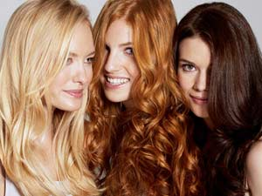
F. What makes up our characteristics?
If you have brown hair, what makes it brown, as opposed to blonde or red?
A pigment called melanin, a protein, is what you see as ”brown” in the hair.

Slide 32
What makes you tall or short?
The length of you bones are make up of a framework of protein fibers.

Slide 33
So, if heredity material controls your traits, and your traits are made of proteins, then shouldn’t heredity material control the making of proteins?

Slide 34
This is exactly what DNA does!!
The order of nitrogen bases (A,T,C,G) determines the type of protein that is assembled.

Slide 35
If the order of bases is accidentally changed, then mutations occur which can change the proteins that need to be made!

Slide 36
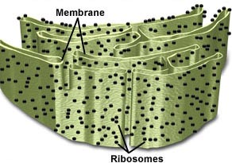
III. Link between DNA & Proteins
In the cytoplasm of each cell, there are tiny organelles where proteins are assembled. What are they called?
Ribosomes!

Slide 37

If a hair cell needs to make melanin,
How do the instructions to synthesize this protein get from the DNA to the ribosome?

Slide 38
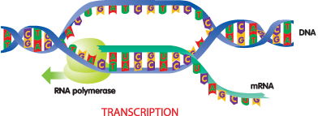
Something must carry these instructions from the nucleus to the ribosomes in the cytoplasm. This “messenger” is mRNA!!

Slide 39
A. RNA: Ribonucleic Acid

Slide 40
3 kinds of RNA
mRNA –messenger RNA

Slide 41
Structure: single stranded
Function: carries the DNA message from the nucleus to the ribosomes
Codon = set of three nitrogen bases representing an amino acid

Slide 42
2. tRNA – transfer RNA

Slide 43
tRNA
Structure: has an anticodon that is a complement to the mRNA codon at one end and an amino acid at the other end
Clover shaped

Slide 44
tRNA
Function: Carries the amino acids to the ribosomes for protein production.

Slide 45
3. rRNA –ribosomal RNA
Structure: a part of the ribosome
Function: Creates the peptide bonds between the amino acids during protein production.

Slide 46
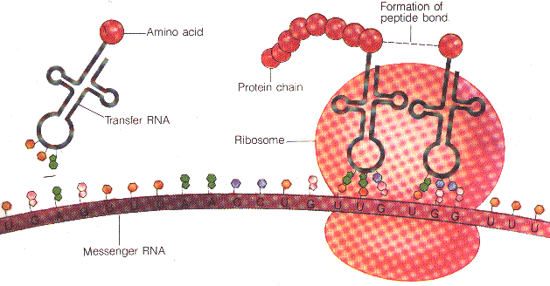
Protein Synthesis

Slide 47
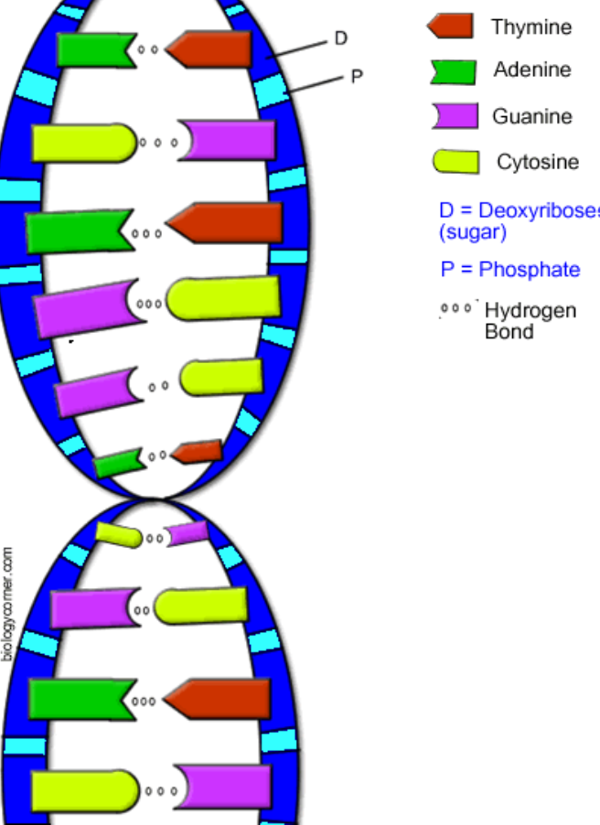
IV. Protein synthesis Overview:
The protein created is determined by the base arrangement in DNA (code sequence)

Slide 48
DNA transfers this information to mRNA, which carries the code to the ribosomes where tRNA decodes it. tRNA anticodons pair with mRNA’s codon. Then rRNA forms peptide bonds between amino acids to form a protein.

Slide 49
The process of protein synthesis is broken down into two sub processes: transcription and translation.
  Transcription = is the process through which DNA transfers the code to mRNA
    Takes place in the nucleus

Slide 50
Translation = is the process through which mRNA is decoded and forms a protein
  Takes place at the ribosome

Slide 51


Slide 52
RNA polymerase (enzyme) attaches at a specific location on DNA
The enzyme then causes the DNA strands to separate from one another and allow one of the DNA strands to be decoded

Slide 53
mRNA nucleotides that are floating around in the nucleus find their complement on the DNA strand and bond together. This is possible due to the base-pairing rules.
Once the DNA segment has been copied by the mRNA bases, the mRNA strand separates from the DNA

Slide 54

The mRNA (messenger RNA) leaves nucleus through a nuclear pore and enters the cytoplasm → goes to ribosomes for protein synthesis
DNA zips up again to create the original double helix

Slide 55
Why is Transcription Important?
It is needed to get the DNA message out of the nucleus so the ribosomes know what protein to make?

Slide 56
Without transcription, the ribosome would have no idea what proteins the body needed and would not make any.

Slide 57

You could NOT replace the hair that you lose every day; could NOT grow long fingernails; be able to fight off diseases; cells would fall apart because the proteins were not being replaced!!

Slide 58
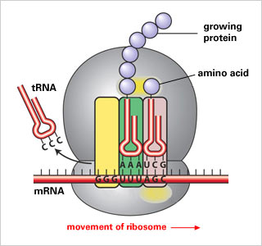
B. Translation: (protein synthesis) From RNA to Protein
First codon of mRNA attaches to ribosome

Slide 59
tRNA (transfer RNA)-each carries a specific amino acid; the tRNA anticodon will pair up with its complementary mRNA codon.

Slide 60
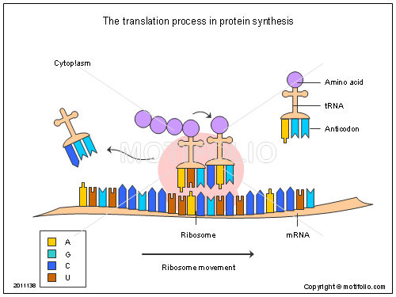

Slide 61
When the 1st and 2nd amino acid is in place, the rRNA joins them by forming a peptide bond. As the process continues, the amino acid chain is formed until a stop codon comes along

Slide 62
The tRNA is recycled to find another of the same amino acid so the process can occur again and again.
The protein chains are then transported to other areas of the body that need them

Slide 64
Why is translation important?
Makes all the proteins that the body needs
Without translation, proteins would not be made and we would not replace the proteins that are depleted or damaged.

Slide 65
Crash Course DNA, Hot Pockets, and the Longest Word Ever

Slide 66
Codons and amino acids
You will need to look up the mRNA codon and amino acid that corresponds to it using a table or a wheel

Slide 67
Special codons
There are 2 special codons on the mRNA
  Start or initiation codon = AUG
    Tells where a protein will begin
  Stop or termination codon = UAA, UAG, UGA
    Tells where the protein ends

Slide 68
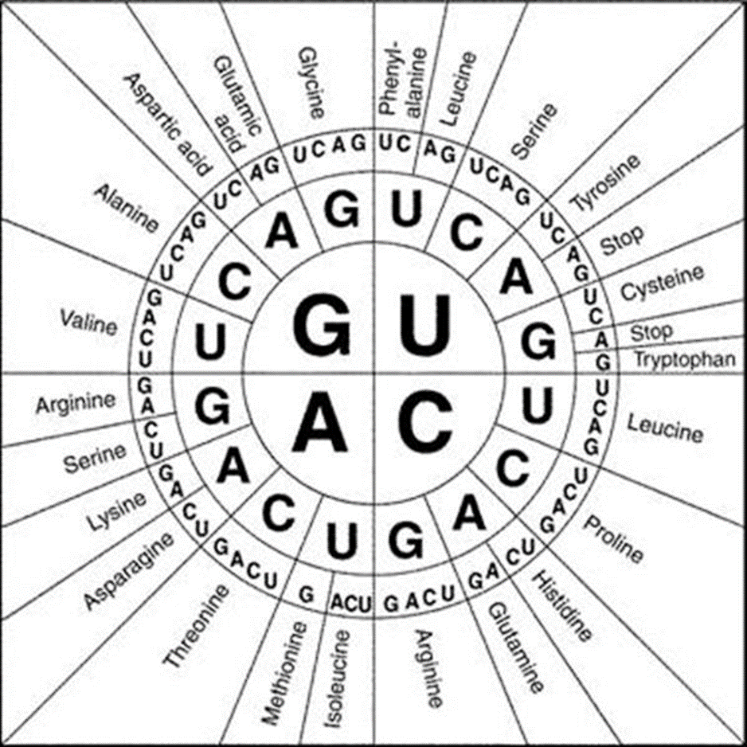

Slide 69
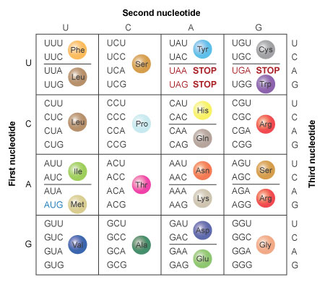

Slide 70
Summary of Protein Synthesis
Below you will find the base sequence of a single strand of DNA. Please fill in the complementary bases of mRNA, tRNA, and the correct amino acid sequence.
Note: mRNA and tRNA never have T’s in the sequence! Always use the mRNA strand to code for the amino acids.

Slide 71
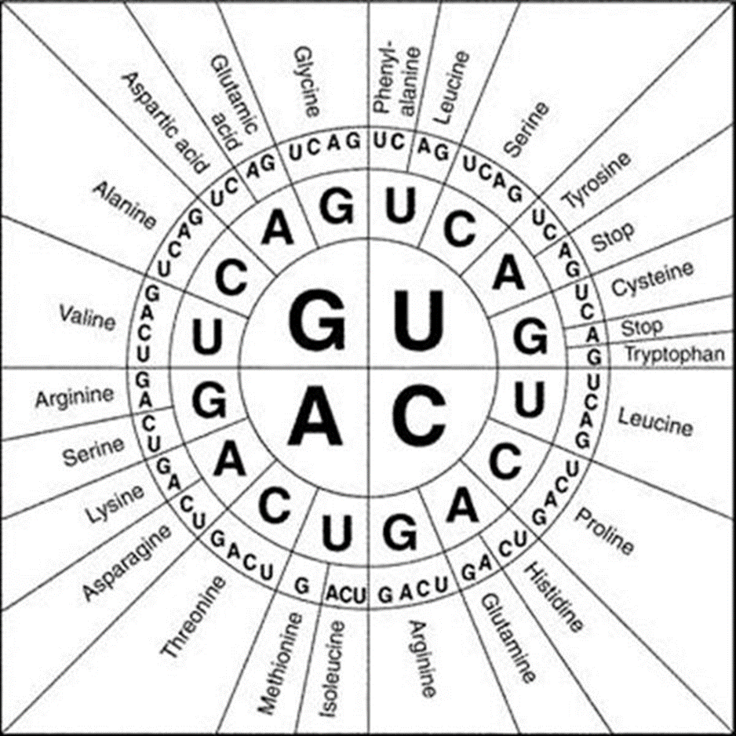

Slide 72
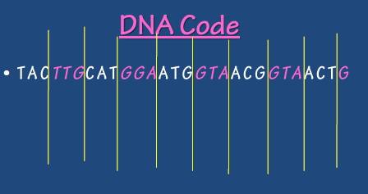
mRNA
tRNA
AUG AAC GUA CCU UAC CAU UGC CAU UGA
UAC UUG CAU GGA AUG GUA ACG GUA ACU
Use the mRNA strand:
Met Asp Val Pro Tyr His Cys His Stop

Slide 73

The first part of protein synthesis is
Takes place in the
Where DNA is decoded into
transcription
mRNA
nucleus
Leaves through a
translation
The 2nd part of protein synthesis
Goes to a
ribosome
Nuclear pore
Where
tRNA anticodons bond with
creates
mRNA codons
then
Peptide bonds
rRNA
between
Creating a
PROTEIN
Amino acids

