Slide 1
Meiosis
Division of sex cells

Slide 2
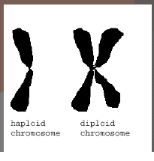
Meiosis Vocabulary
Diploid = a cell containing TWO sets of chromosomes
  One set inherited from each parent
  2n (number of chromosomes)
  Body Cells (Somatic cells)

Slide 3
Meiosis Vocabulary
Haploid = a cell with only ONE set of chromosomes
  1n (number of chromosomes)
  Sex cells (gametes)

Slide 4
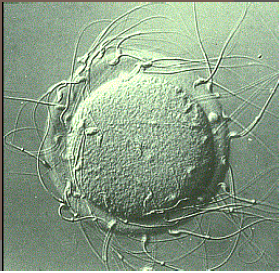
Meiosis Vocabulary
Gamete = sex cells
  Sperm = male gamete
  Egg = female gamete

Slide 5
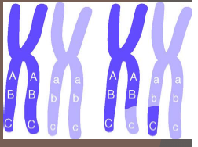
Meiosis Vocabulary
Homologous Chromosomes = paired chromosomes that have genes for the same traits arranged in the same order.
  One homologous chromosomes is inherited from the organism’s father, the other from the mother.

Slide 6
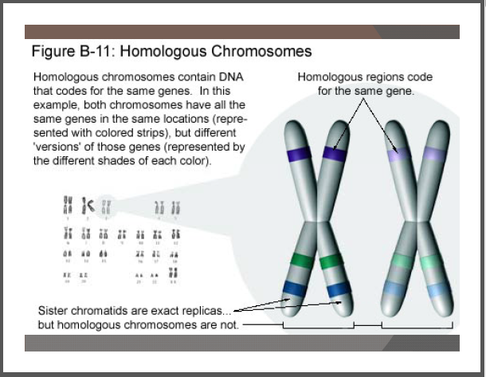

Slide 7
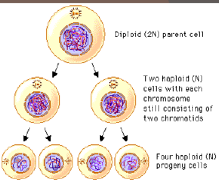
Meiosis Vocabulary
Meiosis = a two stage type of cell division that results in gametes with half the number of chromosomes as the body cells

Slide 8
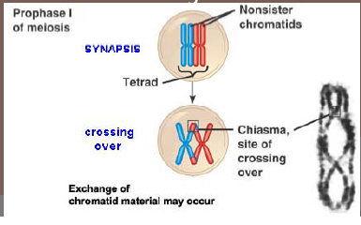
Meiosis Vocabulary
Crossing over = when non sister chromatids of homologous chromosomes exchange genetic information, results in a new combination of genes.

Slide 9
Meiosis Vocabulary
Fertilization = the process of joining gametes
Zygote = when sperm (haploid) fertilizes the egg (haploid), the resulting cell is the zygote (diploid).

Slide 10
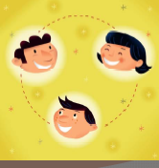
I. GENES,CHROMOSOMES, AND NUMBERS
In humans, each somatic cell (any cell other than a sperm or egg, has 46 chromosomes.

Slide 11
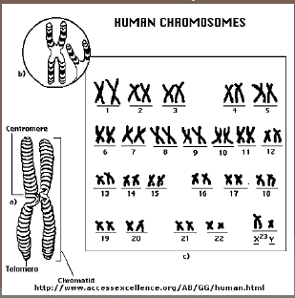
46 chromosomes → 23 pairs (humans get 1 pair from each parent)

Slide 12
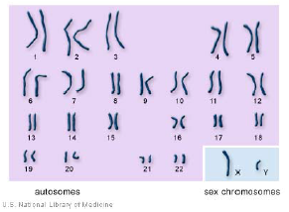
Sex Chromosomes – determine the sex of an individual
  Last pair of chromosomes –23rd pair for humans
  XX = female
  XY = male

Slide 13
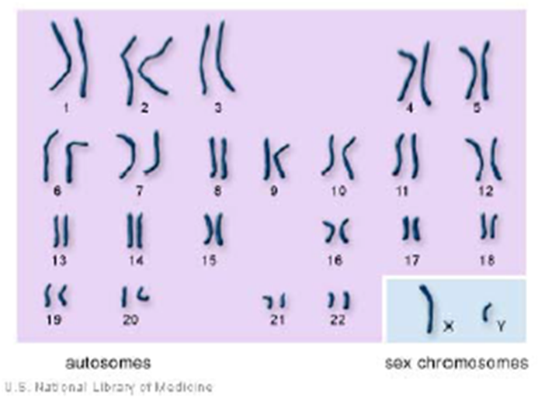
Autosomes
Or autosomal chromosomes
  The first 22 pairs of chromosomes
  Not involved in sex determination

Slide 14
The number of chromosomes for an organism is NOT related to the complexity of that organism!!
  Ex: A dog has 78 body chromosomes and humans have 46 body chromosomes
A thousand or more genes are lined up on a chromosome at one time.

Slide 15
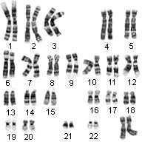
Haploid and Diploid Numbers
Each somatic cell of an organism contains paired chromosomes

Slide 16
Half of each pair came from each parent. These cells are said to have 2n chromosomes, or a full set.
  They are DIPLOID
    Humans have 46 body chromosomes

Slide 17
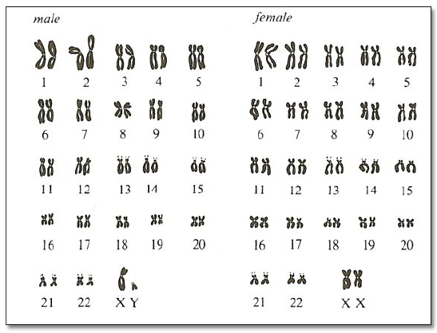

Slide 18
Each sex cell of an organism contains only half of a chromosome set.
    These cells are HAPLOID and have 1n chromosomes
      Ex: Humans have 23 chromosomes in their gametes (egg or sperm)

Slide 19
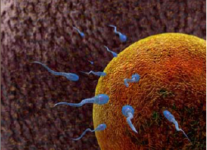
Sex cells will fuse with another sex cell during fertilization to create a 2n organism.

Slide 20
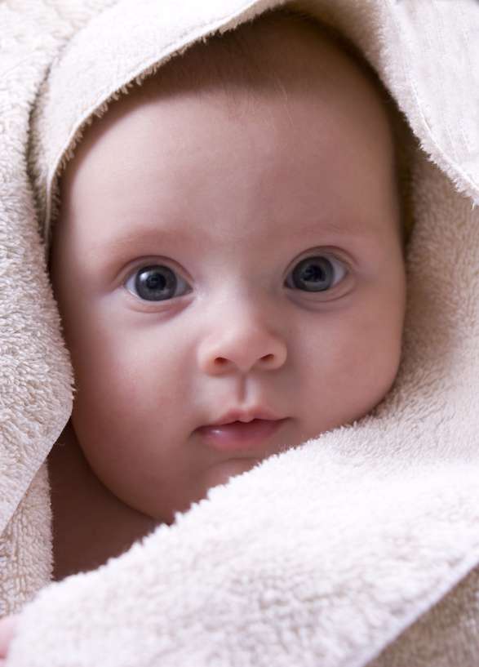
So if a human sperm and egg both have 23 chromosomes, after fertilization, an embryo would have 46 chromosomes!

Slide 21
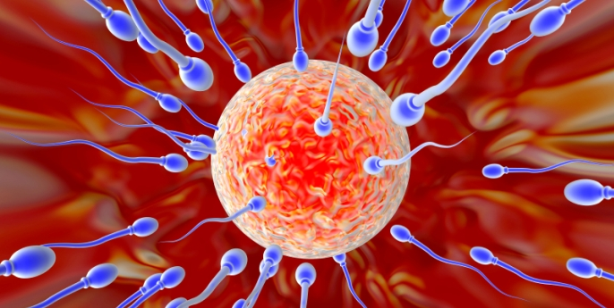
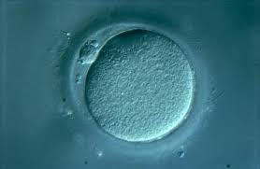
2 Reasons why Meiosis is significant!!
Meiosis is another form of cell division that creates haploid cells to be used for reproduction (sexual)

Slide 22
2 Reasons why Meiosis is significant!!
If mitosis was the only form of cell division, then new offspring would always have 2 times as many chromosomes as their parents.

Slide 23

2 Reasons why Meiosis is significant!!
Eventually, there would be so many chromosomes, the organism would not survive or be severely mutated.

Slide 24
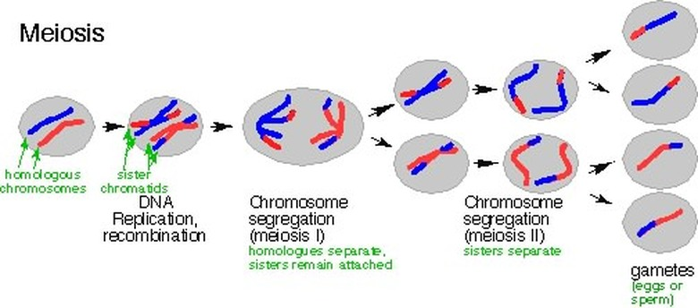
2 Reasons why Meiosis is significant!!
Meiosis provides GENETIC VARIATION- the reshuffling of genes carried by the individual members of a population.

Slide 25
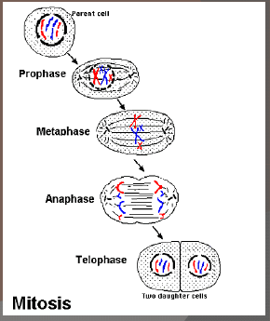
II. Meiosis vs. Mitosis
Remember: Mitosis = asexual division of diploid body cells

Slide 26
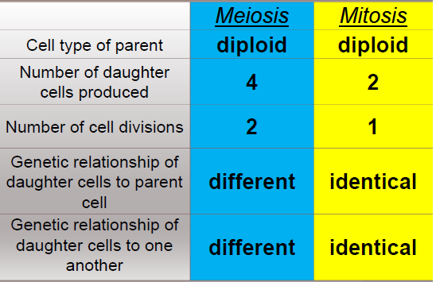
II. Meiosis vs. Mitosis

Slide 27
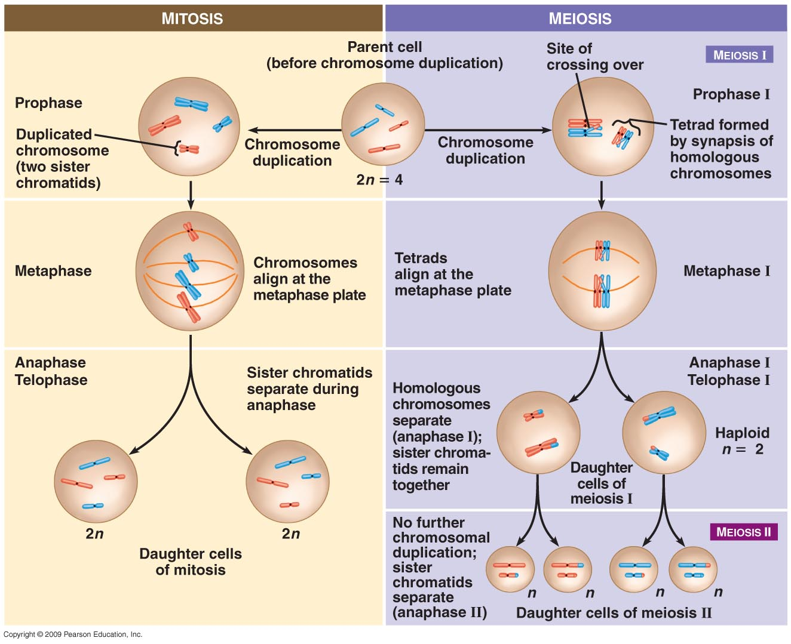

Slide 28
Meiosis I
Separates homologous pairs of chromosomes, NOT sister chromatids of individual chromosomes.

Slide 29
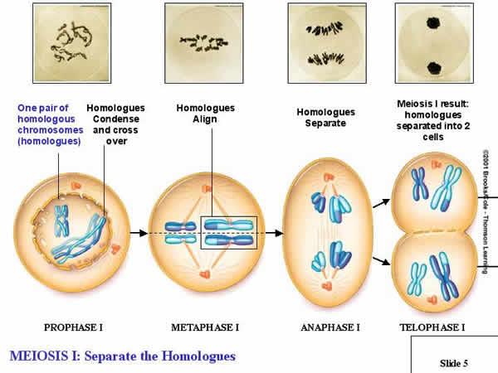

Slide 30
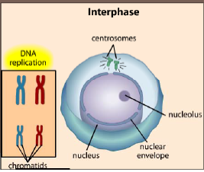
1. Interphase
Metabolic activities and replicate chromosomes

Slide 31
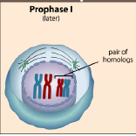
2. Prophase I
Synapsis occurs – the pairing or homologous chromosomes
Each pair of homologous chromosomes come together to form a tetrad (4 part structure)

Slide 32
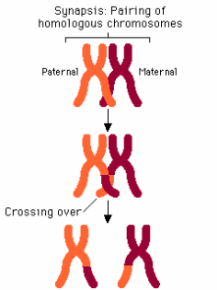
Genetic material is exchanged in a a process called crossing over (swapping portions of adjacent DNA)
  Must be done with great precision so that neither chromatid gains or loses any genes!
  Increases Variation in a species

Slide 33
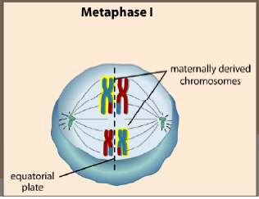
3. Metaphase I
Homologous chromosomes line up at the equator in pairs.

Slide 34
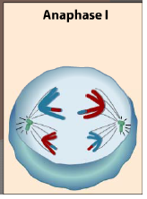
4. Anaphase I
Homologous chromosomes separate and move to opposite ends of the cell.
  This occurs because the centromeres do NOT split like in mitosis.

Slide 35
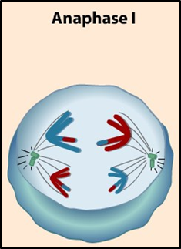
This ensures that each new cell will receive only one chromosome from each homologous pair

Slide 36
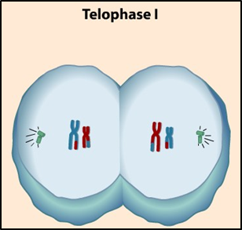
5. Telophase I
The new cells are haploid but another division is required to create single stranded haploid cells

Slide 37


Slide 38
Meiosis II
The mechanism of Meiosis II is almost the same as mitosis.
  However, the chromosomes DO NOT replicate between meiosis I and meiosis II.
  The final outcome of meiosis is halving the number of chromosomes per cell.

Slide 39
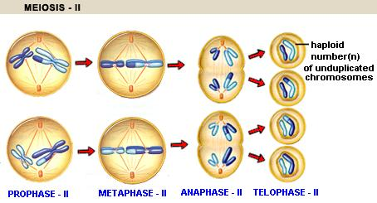

Slide 40
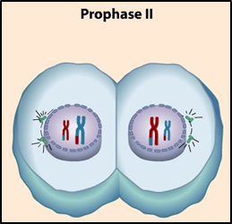
1. Prophase II
Same as Prophase I except NO tetrads are formed.

Slide 41
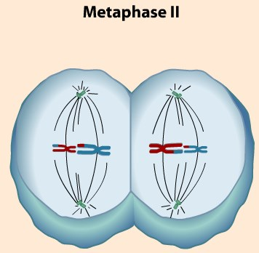
2. Metaphase II
Chromosomes line up at the equator

Slide 42
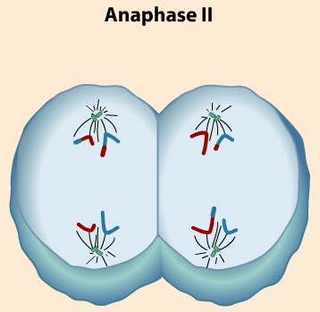
3. Anaphase II
Sister chromatids move to the opposite ends of the cell.

Slide 43
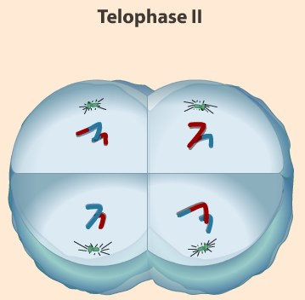
4. Telophase II
Creates 4 haploid cells (gametes)

Slide 44
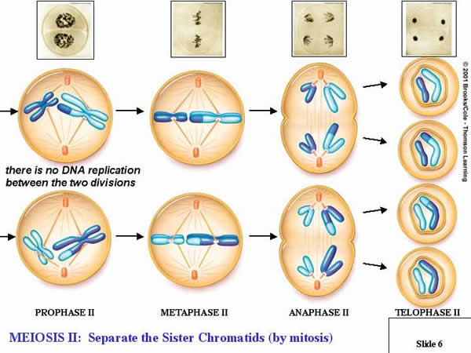

Slide 45
Crash Course Meiosis: Where the Sex Starts

Slide 46
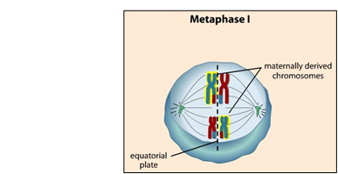
Meiosis provides genetic variation in 2 ways
Independent assortment of homologous chromosomes during meiosis I
  The amount of different chromosomes that can be produced increases greatly as the number of chromosomes an organism has.

Slide 47
Meiosis provides genetic variation in 2 ways
A pea plant has 7 pairs of chromosomes. Each pair can line up 2 different ways. Therefore, each gamete can have 2⁷ = 128 possibilities!!
Humans: n= 23; so the number of different kinds of eggs or sperm a person can produce is more than 8 million (2²³)

Slide 48

Meiosis provides genetic variation in 2 ways
When fertilization occurs, 2²³ X 2²³ zygotes are possible or 70 trillion!!
No wonder brothers and sisters can be so different!

Slide 49
Meiosis provides genetic variation in 2 ways
Crossing over between homologous chromosomes during prophase of meiosis I
  Increase the number of genetic variations

Slide 50
Meiosis is NOT flawless
It is estimated that from 10-20% of all human fertilized eggs contain chromosome abnormalities, and these are the most common causes of pregnancy failure (35% of the cases)

Slide 51
These chromosome abnormalities:
Arise from errors in meiosis, usually meiosis I
Occur more often (90%) during egg formation than during sperm formation
Become more frequent as a woman ages.

Slide 52
Animation

