Slide 1
The Cell Cycle
&
Cellular Division

Slide 2
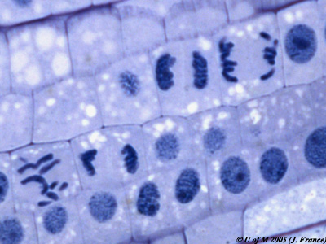
I. Cell Division:
All cells are derived from preexisting cells (Cell Theory)
Cell division is the process by which cells produce new cells

Slide 3
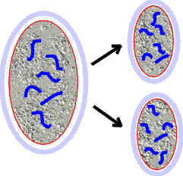
I. Cell Division:
Cells grow in number, NOT in size
  Smaller cells more efficient (cellular transport, cellular communication/signaling)
  Easier to take in nutrients & get rid of wastes

Slide 4
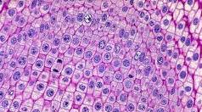
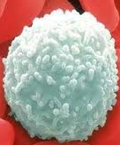
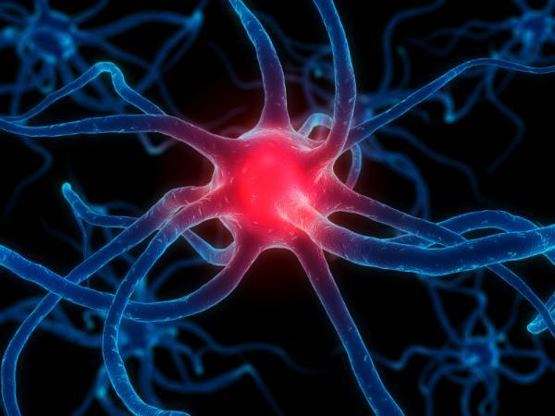
How Often Do Cells Divide?
Some cells must be repaired often such as cells lining the intestines, white blood cells, skin cells; cells with a short lifespan
Other cells do not divide at all after birth such as muscle, nerve cells, brain cells, female egg cells

Slide 5
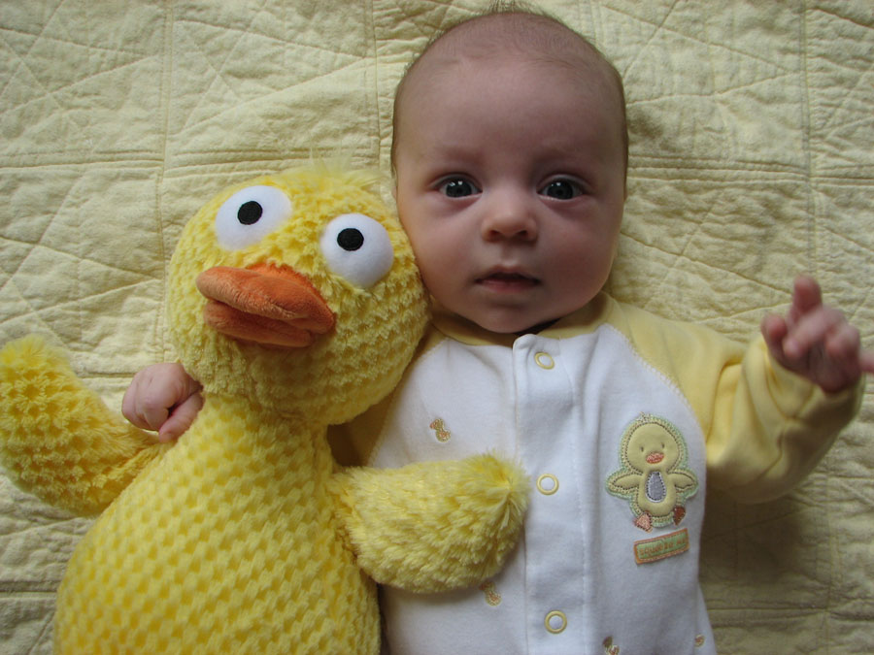
II. Reasons for Cell Division:
Cell growth
Repair & replacement of damaged cell parts
Growth and development of an embryo
Cell is too large.

Slide 6
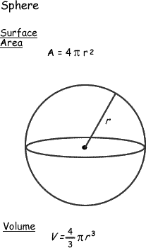
r = 1 cm
SA = 4 x 3.14 x 1cm²=
12.56 cm ²
V = 4/3 x 3.14 x 1 cm ³ =
4.19 cm ³
SA / V = 3
r = 2 cm
SA = 4 x 3.14 x 4cm²= 50.24 cm ²
V = 4/3 x 3.14 x 8 cm ³ = 33.49 cm ³
SA / V = 1.5
r = 3 cm
SA = 4 x 3.14 x 9cm²= 113.04 cm ²
V = 4/3 x 3.14 x 27 cm ³ = 113.04 cm ³
SA / V = 1
3

Slide 7
Large cells
When the surface area and volume get too close in number, the cell will divide.
  Ratio close to 1:1.
Cells are much better functioning when there is more surface area than volume.
  3:1 or 10:1

Slide 8
III. Chromosomes & Their Structure:
The plans for making cells are coded in DNA
DNA, deoxyribonucleic acid, is a long thin molecule that stores genetic information
DNA is organized into giant molecules called chromosomes

Slide 9
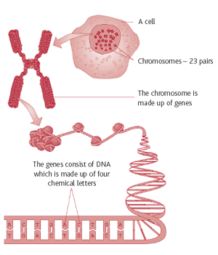
III. Chromosomes & Their Structure:
Chromosomes are made of protein & a long, single, tightly-coiled DNA molecule visible only when the cell divides
When a cell is not dividing the chromosome (DNA) is less visible & is called chromatin

Slide 10
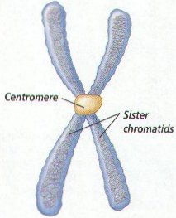
III Chromosomes & Their Structure:
Centromeres hold duplicated chromosomes together before they are separated in mitosis
When DNA makes copies of itself before cell division, each half of the chromosome is called a sister chromatid
  Each sister chromatid contains identical genetic information

Slide 11
IV. Cell Cycle & Cell Division:
Eukaryotes (nucleus & membrane-bound organelles) must be copied exactly so the 2 new cells formed from division will be exactly alike
  The original parent cell & 2 new daughter cells must have identical chromosomes
  Ex: Humans have 46 chromosomes in our somatic cells (body cells). After one of these somatic cells goes through mitosis, 2 daughter cells are produced each having 46 chromosomes (genetically identical).

Slide 12
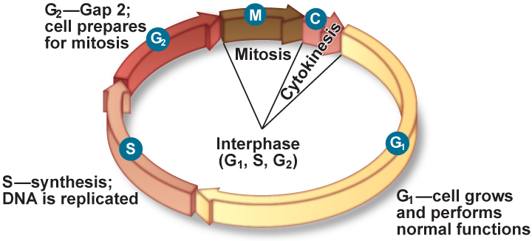
IV. Cell Cycle & Cell Division:
Both the nucleus (mitosis) and the cytoplasm (cytokinesis) must be divided during cell division in eukaryotes

Slide 13
IV. Cell Cycle & Cell Division:
Cells go through phases or a cell cycle during their life before they divide to form new cells
  Cell cycle is about 12-24 hrs. for most animal cells
  Cell cycle is controlled by proteins and enzymes

Slide 14
IV. Cell Cycle & Cell Division:
The cell cycle includes 3 main parts --- interphase, mitosis, and cytokinesis
  mitosis = nuclear division
  cytokinesis = division of the cytoplasm

Slide 15
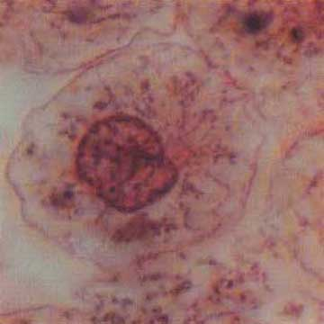
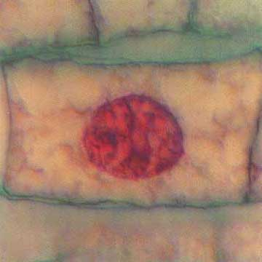
A. Interphase:
Interphase is the longest part of a cell's life cycle and is called the "resting stage" because the cell isn't dividing
Animal Cell
Plant Cell
Nucleus

Slide 16
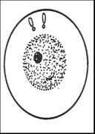
A. Interphase:
Divided into 3 stages:
1) G₁ (Gap 1) = cell is growing, carrying out normal cell functions, preparing to replicate DNA
  Cells mature & increase in size by making more cytoplasm & organelles

Slide 17
A. Interphase:
2) S (synthesis) = DNA is copied or replicated
  DNA is in the form of chromatin (uncoiled DNA) and is not visible

Slide 18
A. Interphase:
3) G₂ (Gap 2) =cell prepares for nuclear division (mitosis)
  cells makes all the structures needed to divide

Slide 19
Centrioles
Nucleolus
Cell
membrane
Nucleus

Slide 20
B. 4 Stages of Mitosis:
Division of the nucleus or mitosis occurs first
Mitosis is an asexual method of reproduction
  Only one parent cell
  Daughter cells have same number of chromosomes (genetic info.)
Mitosis consists of 4 stages --- prophase, metaphase, anaphase, & telophase

Slide 21
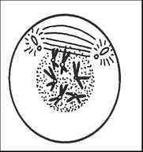
\. Prophase:
Longest phase of MITOSIS
Chromatin (uncoiled DNA) condenses and coils into the form of chromosomes
  chromosomes are visible (shaped like a “X”)
Sister chromatids (half of a “X”) attach to each other by the centromere

Slide 22
\. Prophase:
Centrioles in animal cells move to opposite ends of cell
Spindle forms from each centriole (only in animal cells)
  Plant cells DO NOT have centrioles (spindle forms from a microtubule)
Nuclear membrane dissolves (disappears)
Nucleolus disintegrates

Slide 23
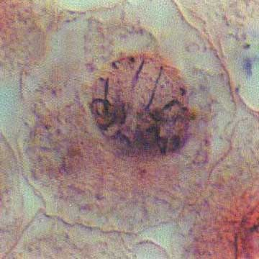
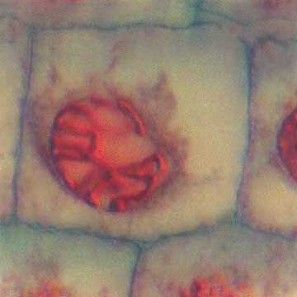
\. Prophase:
Animal Cell
Plant Cell
Chromosomes

Slide 24
Spindle Fibers
Centrioles
Centromere
Chromosome

Slide 25
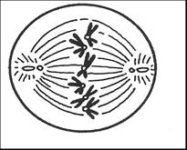
2. Metaphase:
Shortest phase of MITOSIS
Chromosomes line up in center or equator of the cell
the centromere of each chromosome attaches to spindle fibers

Slide 26
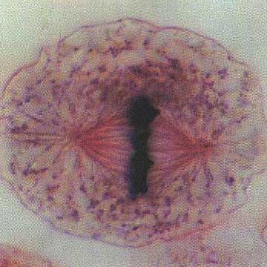
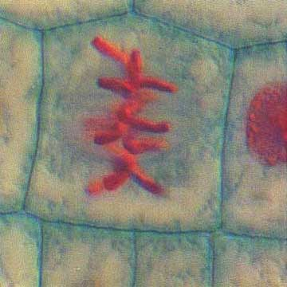
2. Metaphase:
Plant Cell
Animal Cell
Spindle fibers

Slide 27
Chromosome

Slide 28
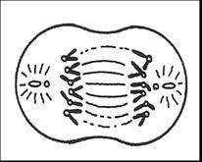
3. Anaphase:
Spindle fibers attached to the centriole pull the sister chromatids apart at their centromere
Separated chromosomes travel along the spindle fibers to the two poles (ends) of the cell.

Slide 29
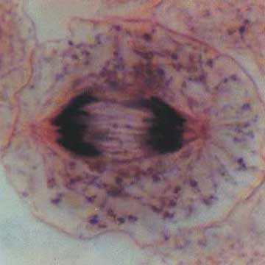
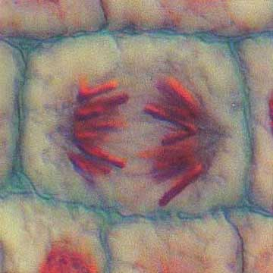
3. Anaphase:
Sister chromatids
Sister chromatids
Animal Cell
Plant Cell

Slide 30
Sister Chromatids
(genetically identical)

Slide 31
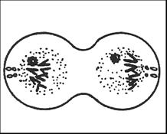
4. Telophase:
Nuclear membrane forms at each end of the cell around the chromosomes
Nucleolus reforms
Spindle fibers begin to break down
Chromosomes become less tightly coiled & appear as chromatin again
Cytokinesis begins

Slide 32
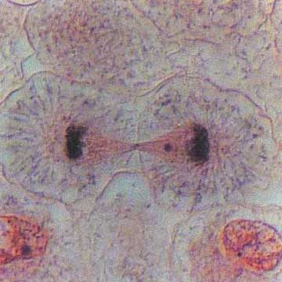
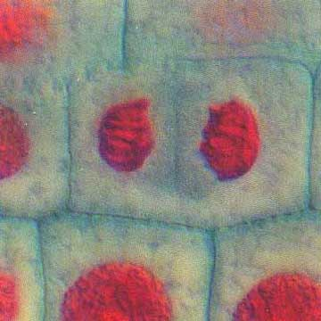
4. Telophase:
Animal Cell
Plant Cell

Slide 33
Nuclear membrane (forming)
Nucleolus (forming)
DNA uncoiling-becoming chromatin

Slide 34
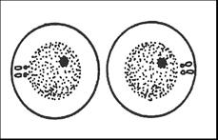
C. Cytokinesis:
Cytokinesis = division of the cytoplasm of the cell and its organelles separate into 2 new daughter cells
2 new daughter cells
(genetically IDENTICAL)

Slide 35
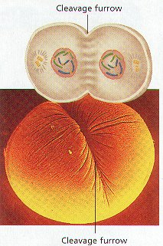
C. Cytokinesis:
In animals, a groove called the cleavage furrow forms pinching the parent cell in two

Slide 36
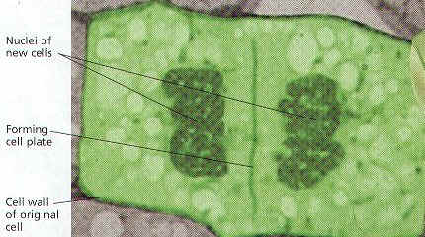
C. Cytokinesis:
In plants, a cell plate forms down the middle of the cell where the new cell wall will be

Slide 37
C. Cytokinesis:
2 new daughter cells
(genetically IDENTICAL)

Slide 38
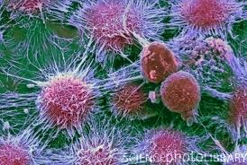
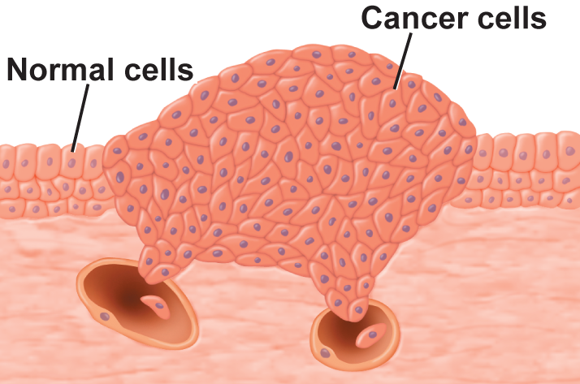
V. Cancer:
Cell division must be controlled, otherwise cell growth will occur without limit (cancer)
  DNA mutations lead to changes in the proteins/enzymes that regulate the cell cycle
Cancerous Kidney Cells

Slide 39
VI. Cancer:
Cancer = a cell or group of cells that grow out of control and create a tumor
    Crowds out normal cells and results in the loss of tissue function
Cancerous Kidney Cells

Slide 40
VI. Cancer:
  Tumor = mass of growing, unregulated cells
    2 types of tumors:
        Benign- tumor that does not spread
        Malignant- tumor that spreads and destroys healthy tissue

Slide 41
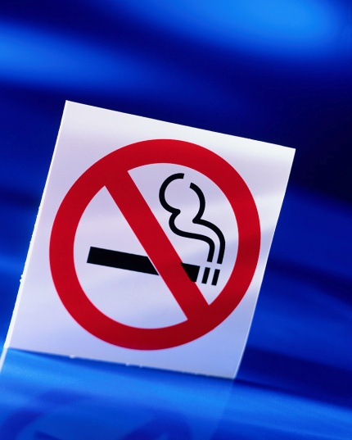

Causes of cancer:
Genetics (family history)
Smoking
Carcinogens (cancer-causing chemicals)
Viruses:
  HPV can lead to cancer of reproductive organs
Radiation:
Sunlight- skin cancer

Slide 42
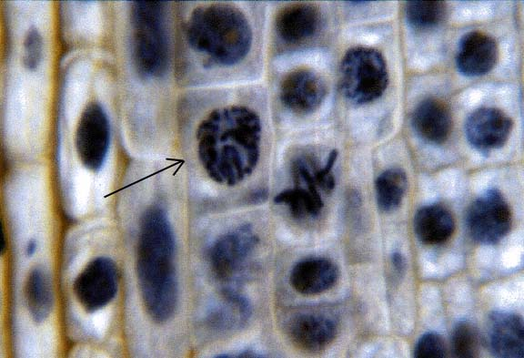
What phase of the cell cycle would this be?
PROPHASE
http://www.jburroughs.org/science/resources/mitosis/cellcycle.html

Slide 43
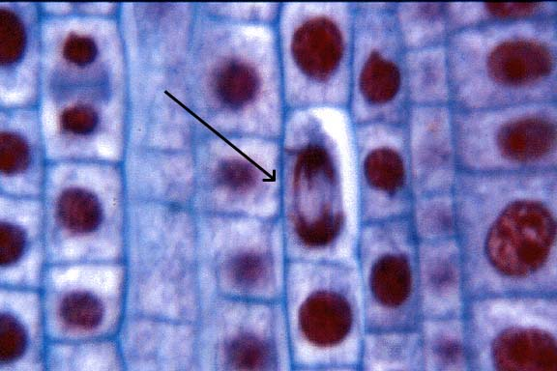
What phase of the cell cycle would this be?
ANAPHASE
http://www.jburroughs.org/science/resources/mitosis/cellcycle.html

Slide 44
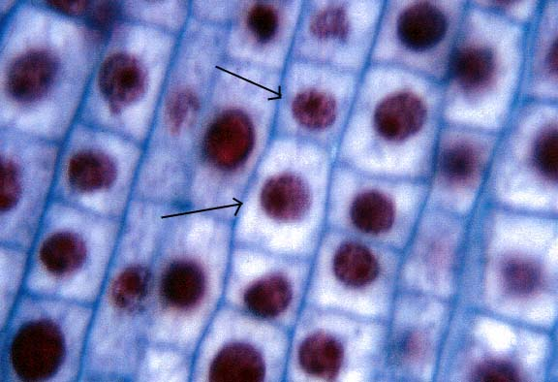
What phase of the cell cycle would this be?
INTERPHASE
http://www.jburroughs.org/science/resources/mitosis/cellcycle.html

Slide 45
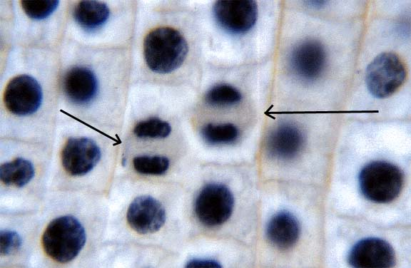
What phase of the cell cycle would this be?
TELOPHASE
http://www.jburroughs.org/science/resources/mitosis/cellcycle.html

Slide 46
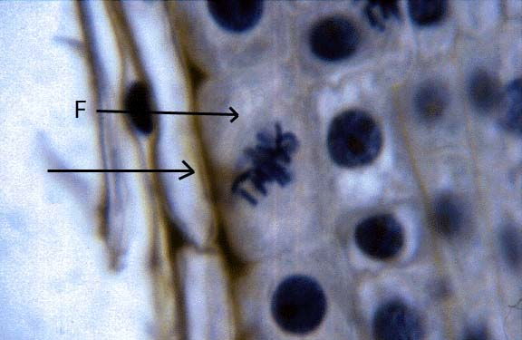
What phase of the cell cycle would this be?
METAPHASE
http://www.jburroughs.org/science/resources/mitosis/cellcycle.html

Slide 47
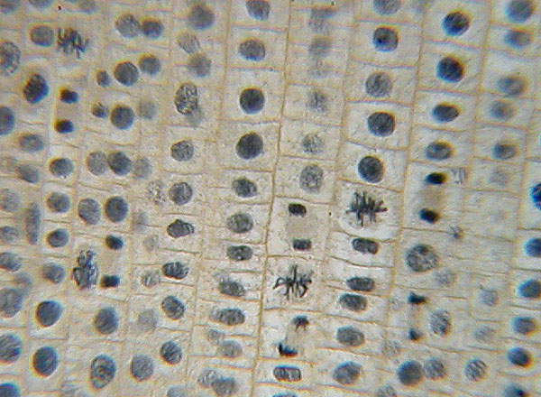
Can you identify 5 stages?
http://district.bluegrass.kctcs.edu/billd.snyder/sharedfiles/biowebsite/BiologyLabs/BIO137/137Lab2/Lab2MitosisSlides.html

Slide 48
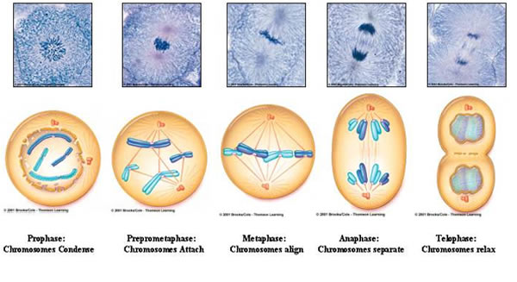
Mitosis occurring in ANIMAL CELLS

Slide 49
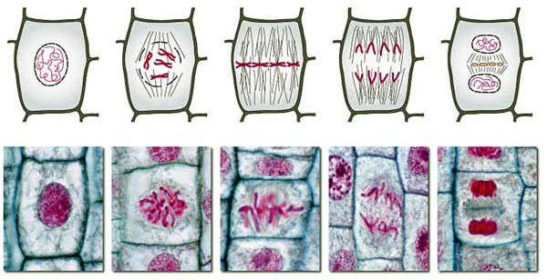
Mitosis occurring in PLANT CELLS

Slide 50
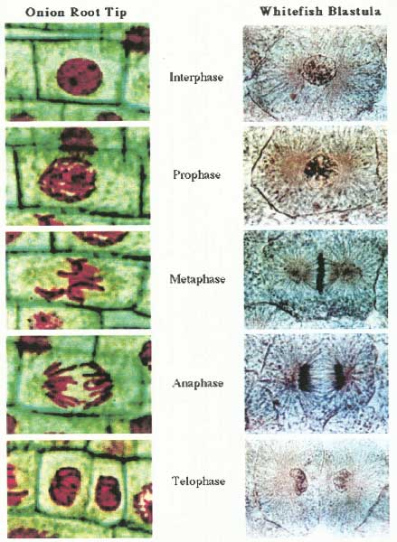

Slide 51
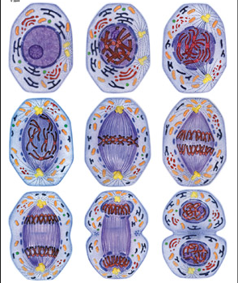

Slide 52
Crash Course Mitosis: Splitting up is Complicated

