Slide 1


Slide 2
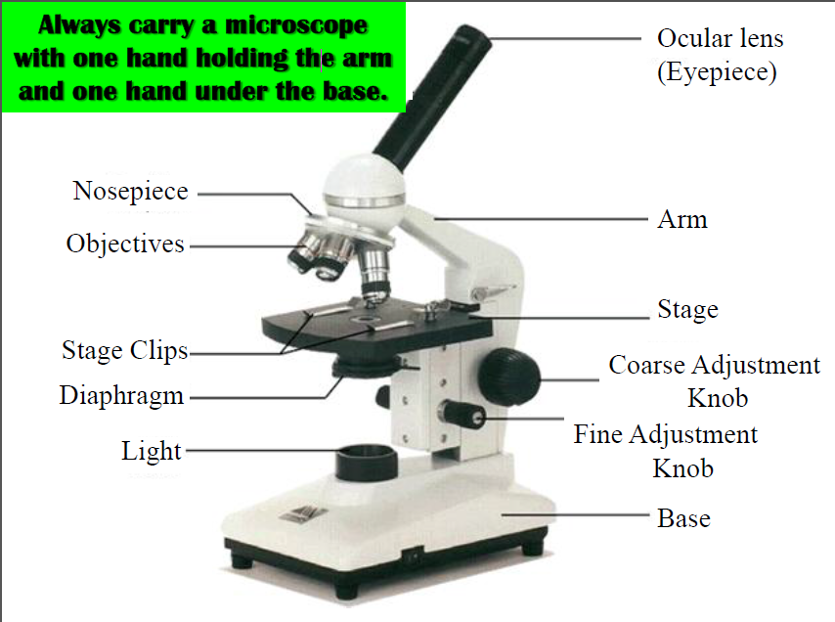
Body tube

Slide 3
Monocular Microscope Parts & Functions
Ocular = eyepiece; look into microscope here; magnifies 10 X
Body tube =places exact distance between ocular and objective; mirrors here to reflect light into eye
Revolving nosepiece = moves objective into place
Objective lenses = used to magnify objects; scanning (4X), low (10X), high (40X)
Stage = lay specimen to be viewed here; on slide
Stage clips = hold slide in place
Iris diaphragm = adjust amount of light going into the eye

Slide 4
Microscope Parts & Functions
Light (or mirror) = directs light into the eye
Base = supports entire microscope
Fine adjustment knob = make slight adjustments on the focusing;
Coarse adjustment knob = make rapid adjustments on the focusing; NEVER use on HIGH power!
Arm = supports body tube; used to carry microscope

Slide 5
Microscope Do’s & Don’ts
Carry microscope by the arm and base.
Lenses should be cleaned with lens paper.
Coarse adjustment knob only used on Low and Scanning power.
When finished using scope for the day, return to scanning objective for storage.
When moving the slide on the stage, the object moves to the opposite direction as seen in the ocular.
Object viewed must be on a slide and covered with a cover slip; specimen must be thin.

Slide 6
What’s My Power?
To calculate the power of magnification, multiply the power of the ocular lens by the power of the objective.
Scanning Power
  Ocular lens = 10X
  Objective lens = 4X
    TOTAL magnification for scanning power = 40X

Slide 7
What’s My Power?
Low Power
  Ocular lens = 10X
  Objective lens = 10X
    TOTAL magnification for LOW power = 100X
High Power
  Ocular lens = 10x
  Objective lens = 40X
    TOTAL magnification for HIGH power = 400X

Slide 8
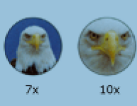
Comparing Powers of Magnification
We see better details with HIGHER powers of magnification but we can’t see as much of the image.

Slide 9
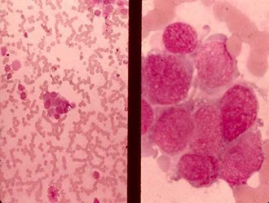
Magnification Power
Which of these images would be viewed at a higher power of magnification?

Slide 10
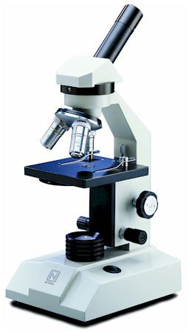
Compound Light Microscope
You will be using the compound light microscope in several labs.
These microscopes have a maximum magnification of 400X.
  So you CANNOT see most of the organelles like ribosomes, Golgi bodies, lysosomes, etc.
  More powerful microscopes are needed (2,000X plus)

Slide 11
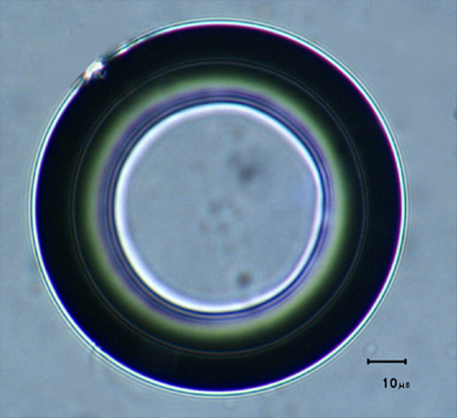
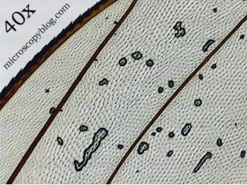
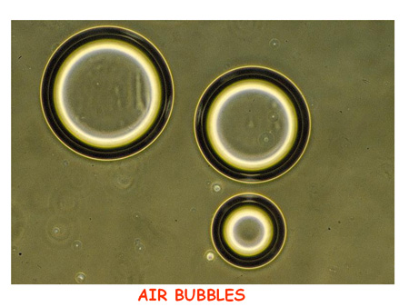
Common Problem … AIR BUBBLES

Slide 12
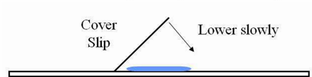
How to Make a Wet Mount Slide
Get a clean slide and cover slip from your supply box.
Place ONE drop of water/stain in the middle of the slide. Don’t use too much or the water/stain will run off and make a mess!
Place the edge of the cover slip on top of the drop.
Slowly lower the cover slip on top of the drop.
Place the slide on the stage and view it first with the SCANNING power objective. Once you see the image, you can rotate the nosepiece to view the slide with the different objectives.
YOU DO NOT NEED TO USE STAGE CLIPS WHEN VIEWING WET MOUNT SLIDES!

Slide 13
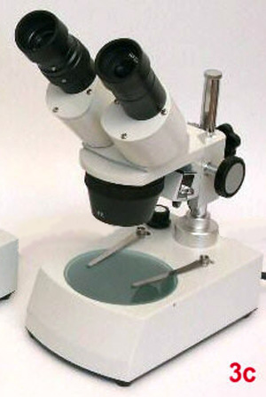
Stereo Microscope (Binocular)
Used to view objects in 3D.
Object does not need to be on a slide.
Object does not need to be thin.
Eyepiece magnifies 10X.
Objective lenses are 1X and 3X or just 2X.
Object moves in the same direction.

