Slide 1
Biochemistry:
Nucleic Acids

Slide 2

Nucleic Acids
Complex polymer that stores information in cells in the form of a code.
Monomers (basic building blocks): nucleotides, which contain C, H, O, N, & P
These elements are arranged in 3 groups: nitrogen base, simple sugar, & a phosphate group

Slide 3
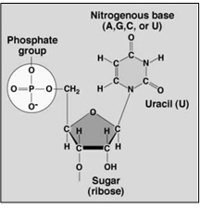
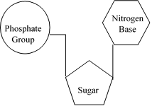
Nucleic Acids

Slide 4

2 Types of nucleic acids:
DNA (deoxyribonucleic acid) contains all the instructions for an organism’s development…AKA genetic information
  Double stranded molecule

Slide 5
2. RNA (ribonucleic acid) forms a copy of DNA and is used for protein synthesis (production)
  Single stranded molecule

Slide 6
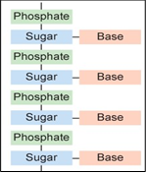
Nucleic acid structure

Slide 7
