Slide 1
Biochemistry:
Proteins

Slide 2
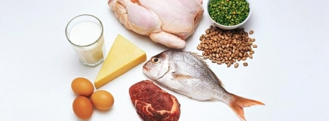
Proteins
Foods: meats, soy, cheese
Large complex polymer composed of C, H, O, N & sometimes S
Monomers (basic building blocks): Amino acids
  20 different amino acids

Slide 3
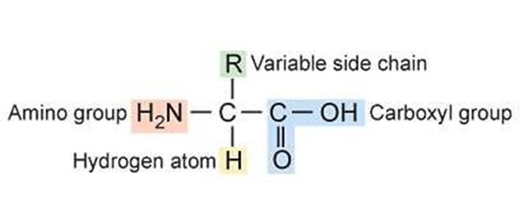
Proteins
Example: amino acids:

Slide 4
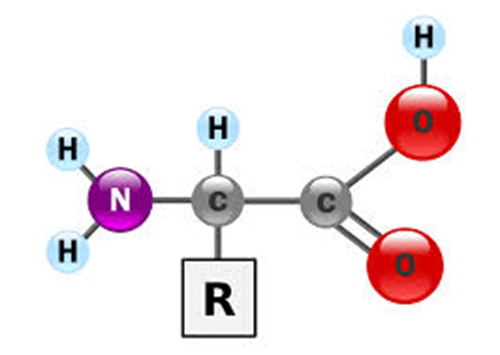
Proteins
Structure of an amino acid
Central carbon atom bonded with hydrogen. The other 3 bonds are with an amino group (-NH2), a carboxyl group (-COOH), and a variable group (-R).
The variable makes each amino acid different!

Slide 5
Proteins
Amino acids are linked together by dehydration synthesis to form a protein.

Slide 6
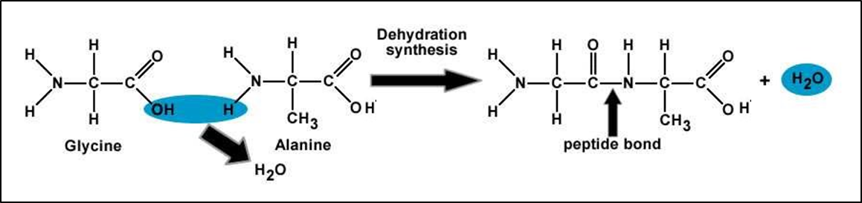
Proteins
Ex: 2 amino acids joined by dehydration synthesis.

Slide 7
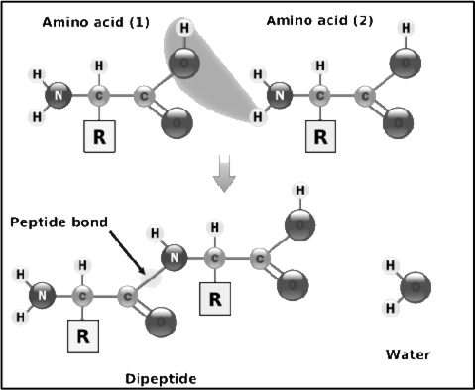
Peptide bond = a covalent bond that joins amino acids to each other.
  Forms between the amino group of one amino acid and the carboxyl group of the other amino acid.

Slide 8
Proteins
Proteins – named for the number of amino acids that make them.
Ex:
  Two amino acids = dipeptide
  Three amino acids = tripeptide
  Many amino acid = polypeptide

Slide 9
Proteins
Essential Amino Acids:
  8 of the 20 amino acids are “essential” because they are required by the body but NOT created by it.
    As a result, it must be provided by our diet. If one is missing, then proper growth and repair cannot be maintained.

Slide 10
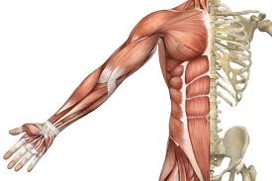
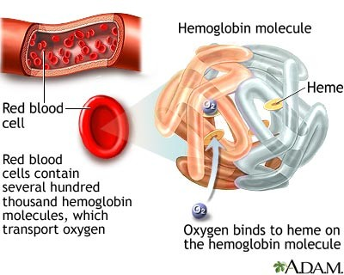
Types & Functions of proteins in our body:
Muscle contraction (actin and myosin)
Transport oxygen in the bloodstream (hemoglobin)

Slide 11
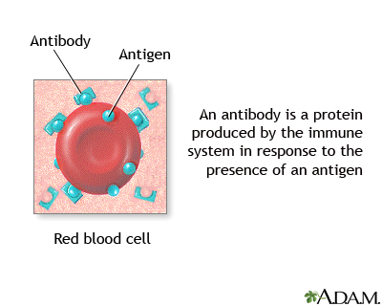
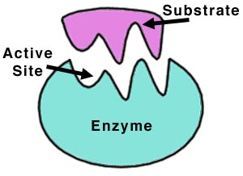
Types & Functions of proteins in our body:
Provides immunity (antibodies)
Carry out chemical reactions (enzymes and hormones)

Slide 12
Types & Functions of proteins in our body:
Collagen
  Structural protein in animals
  Gives connective tissue elasticity
    Skin
      Anti wrinkle creams?
Keratin
  Structural protein in humans
  Found in hair, nails, skin
  Adds strength

Slide 13
Types & Functions of proteins in our body:
All proteins help with growth and repair of cells in our diet
  Increase protein intake during rapid growth years or injury repair.

Slide 14
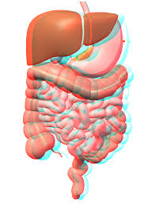
What happens to PROTEINS in the body?
Broken down by the digestive system via HYDROYSIS into amino acids which are then absorbed into the body through the bloodstream, where the body cells take the amino acids and make protein for muscles.

Slide 15
Crash Course: You are What You Eat.

