Slide 1
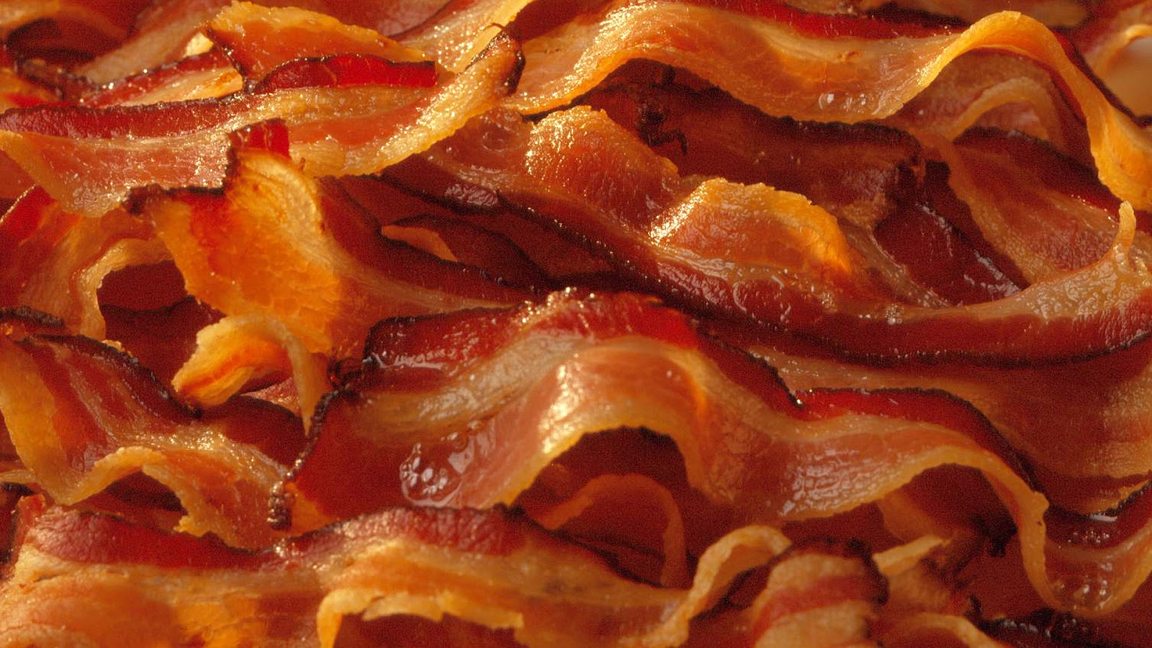
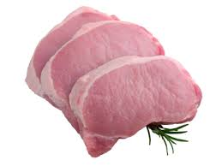
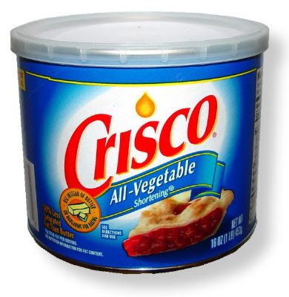
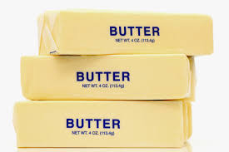
Biochemistry:
Lipids

Slide 2
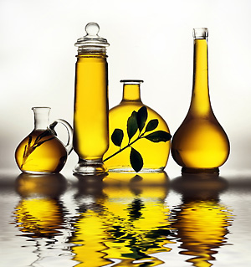
I. Lipids
Foods: butter, oil, Crisco, lard
Commonly called fats & oils
Contain more C-H bonds and less O atoms than carbohydrates
  Ex: C₅₇H₁₁₀O₆
Nonpolar; therefore repels water (insoluble)

Slide 3
Functions of lipids in our body
Long term energy storage (used when carbohydrates are NOT available.)
Insulation
Protect body tissue (cushioning)

Slide 4
Which has more energy-Lipids or Carbs?
One gram of fat contains TWICE as much energy as one gram of carbohydrates. Therefore, fats are better storage compounds!

Slide 5
Fats vs. Carbs & Energy Storage
1 gram of carbs (glycogen) = about 4 Kcal of energy
  A short term rapid energy source (sprint events)
1 gram of fat = about 9 Kcal of energy
  A long term energy source (endurance events – marathons)

Slide 6
Fats vs. Carbs & Energy Storage
Average human contains about 0.5 kg of stored glycogen = 2,000 Kcal of energy
About 16 kg of body fat = 144,000 Kcal of energy

Slide 7
Fats vs. Carbs & Energy Storage
To carry the same amount of energy (144,000 Kcal) as carbs, we would have to store 36 kg (79.4 pounds) more glycogen to lose 1 kg of body fat which means, you need to burn lots of calories!

Slide 8
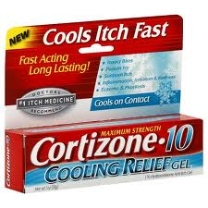
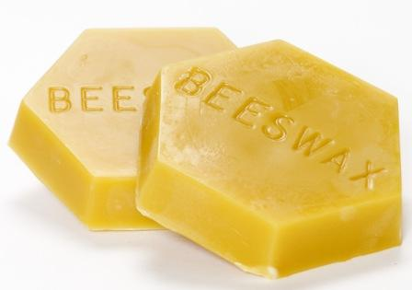
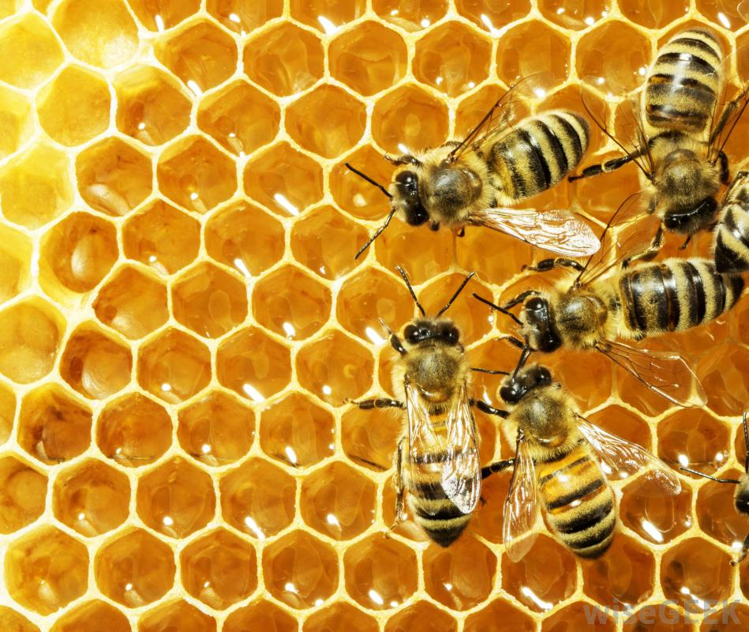
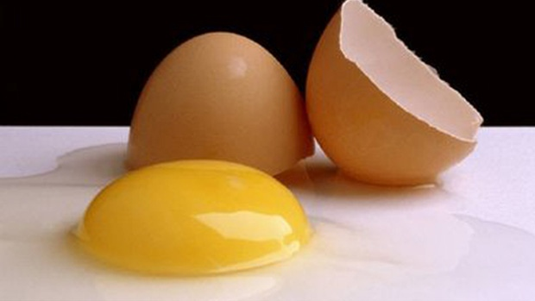
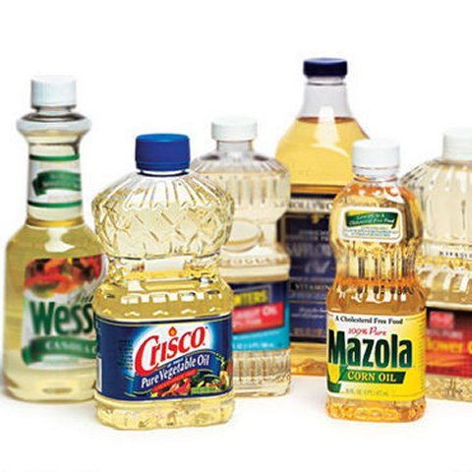
Types and Examples of Lipids
Sterols – steroids, hormones
Waxes –bee, furniture, ear, car, plant
Cholesterol – in egg yolks, red meat
Fats – from animals
Oils – from plants
Phospholipids – cell membranes
Pigments - plants

Slide 9
Structure of Lipids
Basic building blocks:
    3 fatty acids + 1 glycerol
Fatty acids
  Long chains of carbon with a carboxyl group at one end

Slide 10
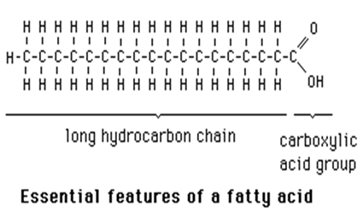
One fatty acid

Slide 11
Structure of Lipids
Glycerol and each fatty acid chain are joined to each other by dehydration synthesis.

Slide 12
Structure of a Lipid
(1 glycerol + 3 fatty acids)

Slide 13
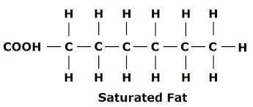
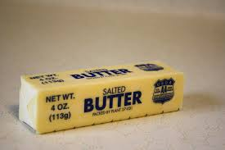
4 Types of Fats
Saturated Fats – fatty acid chains of carbon with only single bonds between the carbon atoms
  “Bad fats” – cholesterol (heart disease)
  Solid at room temperature
    Ex: butter, animal fat

Slide 14
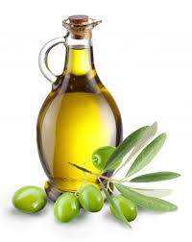
4 Types of Fats
Unsaturated fats = fatty acid chains of carbon with ONE double bond between the carbon atoms.
  “Good fats”
  Liquid at room temperature
    Ex: olive oil

Slide 15
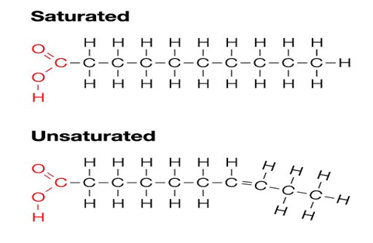

Slide 16
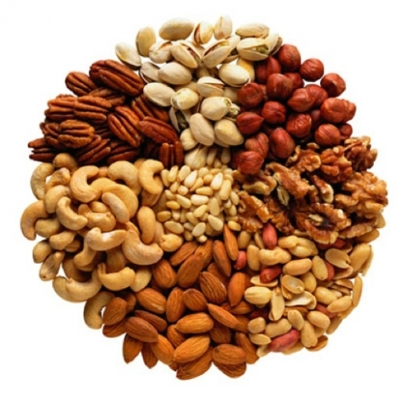
4 Types of Fats
Polyunsaturated fats = more than one double bond between the carbon atoms in the chain
  Nuts, seeds, fish, leafy greens

Slide 17
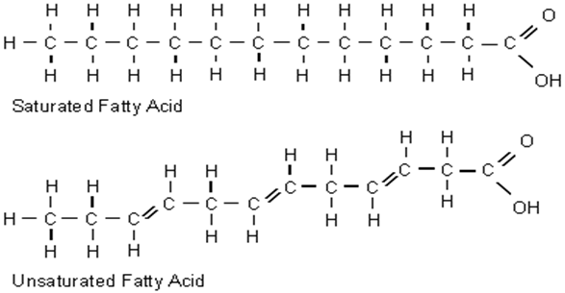
Structural formulas for saturated and polyunsaturated fatty acids
Polyunsaturated Fatty Acid

Slide 18

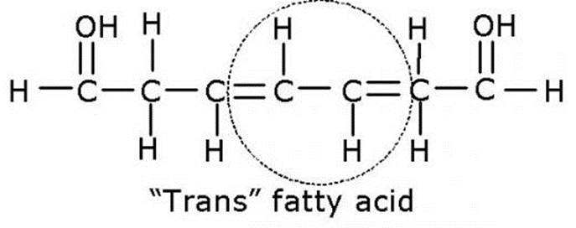
4 Types of Fats
  4. Hydrogenated vegetable oil (trans fat)
    Unsaturated fats that have been artificially saturated by addition of hydrogen atoms
      Solid at room temperature
        Margarine
        Vegetable shortening

Slide 19
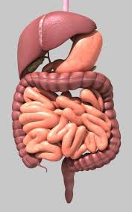
What happens to LIPIDS in the body?
Broken down by the digestive system via HYDROLYSIS into fatty acids and glycerol which are then absorbed into the body through the bloodstream.
The fatty acids can then be broken down directly to get energy, or can be used to make glucose.

Slide 20
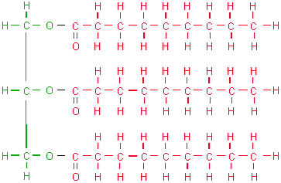
Lipids
Triglycerides = majority of fat in an organism consists of this type of fat molecule
  Derived from fats eaten in foods or made in the body from other energy sources like carbohydrates

Slide 21
Lipids
Calories ingested in a meal and not used immediately by tissues are converted to triglycerides and transported to fat cells to be stored.
  Storage – 3 month supply of energy vs. glycogen’s 24 hour supply

Slide 22
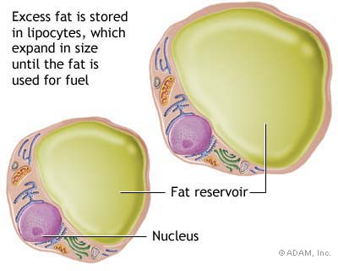
Lipids
Hormones regulate the release of triglycerides from fat tissue so they meet the body’s needs for energy between meals.

Slide 23
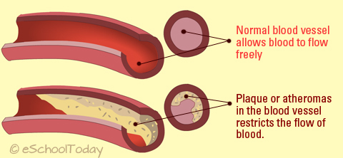
Excess Triglycerides = Life Applications:
Causes plaque to build up
Arteriosclerosis = walls of the arteries get thick and hard: fat builds up inside the walls and slows the blood flow
Causes blood clots – heart attacks, strokes
Hypertension (high blood pressure)

Slide 24
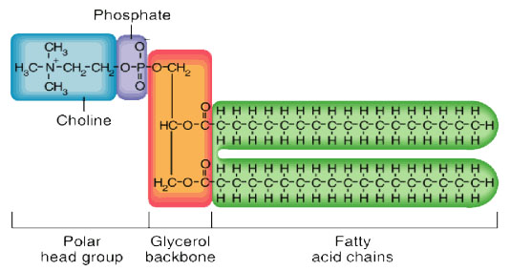
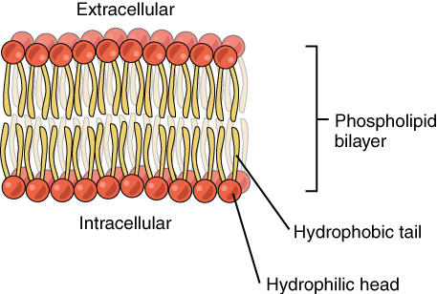
Phospholipids (part of cell membrane structure)

