Slide 1

Conflict and Stress in the Workplace
Unit 2

Slide 2
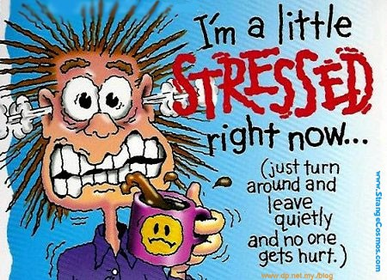

Slide 3
What is Stress?
Definition. Any physical, chemical, or emotional factor that causes bodily or mental tension.
Where does it come from? What stresses you?
  Comes from many sources
Is all stress bad?

Slide 4
Positive Effects of Stress
Provides excitement
Motivates people to work harder

Slide 5
Negative Effect
Emotional
Physical
Depression
Insomnia
Loss of appetite
Substance abuse
Mood swings
Loss of motivation
Headache
Backache
High Blood pressure
Muscle tightness

Slide 6
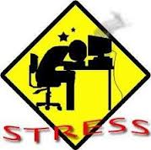
Burnout
Occurs when excessive stress causes a person to lose interest in his or her job.

Slide 7
How do you manage stress?
Listening to music
Yoga, meditation
Exercise
Employee assistance programs
  Company sponsored programs that help employees deal with personal problems and refer them if necessary for treatment.

Slide 8
Wellness Programs
Company sponsored programs designed to prevent illness and enhance employee well-being. They can include
  Periodic medical examinations
  Clinics to quit smoking
  Education on nutrition, weight control, exercise
  Exercise facilities
  Immunizations
  CPR training

Slide 9

Why It’s Important to Manage Stress
Stress from home or on the job causes tension, effects job performance, and relationships with other employees
Unresolved tensions between
employees reduce productivity and
create a poor work environment
Stress has been directly linked to
diseases including:
  Heart attacks
  Hypertension
  Migraines
  Cancer

Slide 10
Sources for Stress
Making crucial, split second decisions (air traffic controller, stock broker)
Constantly rotating your work shifts (interrupts your daily sleep-wake cycle)
Performing boring and repetitive tasks with little chance for making decisions (assembly line workers)
Having a great deal of responsibility but little power or control (middle managers)
Sitting or working in one position for long periods of time.

Slide 11
Two situations that produce the strongest risk of heart attack
High pressure deadlines
Laying off someone.
  Managers are more than twice as likely to have a heart attack within a week of firing an employee.

Slide 12

Stress often leads to conflict in the workplace

Slide 13
Conflict
Conflict is part of everyday life and can be viewed as an opportunity for change and growth
Due to competitive nature of our society, conflict is often experienced as a contest to be won or lost
Many of us prefer to ignore or avoid conflict rather than deal with it.
In today’s workplace, most conflict situations are resolved in a team environment that promotes collaboration and cooperation.
Knowing how to deal with conflict will help to promote fairness and develop sensitivity that is respectful of individual difference.

Slide 14
Warm up
Your reaction to the following quote:
“When you get into a tug of war, drop the rope” Bart Jarvis

Slide 15
Myths and Truths About Conflict
Conflict in the workplace is always dysfunctional.
All conflicts can be resolved
Conflict tends to go away if it is ignored.
Conflicts always result in winners and losers.
Conflict is a normal part of life within an organization.
Most conflicts can be managed.
Conflict can motivate change.
Conflict can help build relationships between people.

Slide 16
Effects of Conflict
Managers once thought conflict within organizations should be avoided at all costs .
Today, many managers recognize that some conflict can have a positive effect.
Managers understand that not all conflicts create winners and losers.
Conflict can actually bring about desirable changes.
It can force people to confront situations they might otherwise ignore.
“When two men in business always agree , one of them is unnecessary.” William Wrigley

Slide 17
Positive Effects of Conflict
Conflict energizes people.
Conflict is a form of communication. May open up a new channel of communication.
Parties to a conflict can learn from the experience.
  Conflict can make people more aware and raise understanding of other people’s functions and challenges in an organization.
PREDICT: At what point does workplace conflict become too intense to be positive?

Slide 18
Negative Effects of Conflict
Anger can make it difficult for people to continue to work together.
Resentment can make it difficult for employees to accept other people as managers.
Unresolved conflicts can create an unproductive work environment.
  Unresolved conflicts can distort reality.
Ongoing conflict makes if difficult for people to concentrate on their jobs.

Slide 19
The Nature of Workplace Conflict
Conflict in the workplace usually stems from disputes between
  individuals
  between groups
  between groups of individuals and the organization itself
Managers need to know how to address each of these types of conflicts

Slide 20
Critical Thinking
Name some interpersonal differences that might cause conflict in the workplace.
Name some interpersonal differences that might cause conflict in your life.

Slide 21
Interpersonal Conflict
Major source of conflict in the work environment
Different values and traits can make it difficult for some people to work together

Slide 22
Intergroup Conflict
Different groups within organizations disagree because they have different goals.

Slide 23
Organizational Conflict
Pits employees against the organization itself
  Changes in policy
  Reorganizations
  Corporate downsizing or laying off workers
  Lack of resources

Slide 24
Managing Conflict
Create the Appropriate Atmosphere
Establish an atmosphere that promotes partnership and problem solving among their employees.
Conflict issues should be address in a quiet, neutral place, such as a meeting room.
Encourage cooperation.

Slide 25
Assessments
Identify two positive effects of workplace conflict.
Identify two negative effects of workplace conflict.
List and describe the three types of conflicts that occur in the workplace.
What are some things managers can do to help resolve conflict?

Slide 26
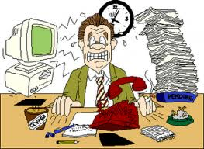
Flyer Project
Create a workplace flyer using Word, encouraging positive conflict resolution and positive conflict effects. This will be sent to employees via email.

Slide 27

I still have a question about this topic or
What didn’t I understand about this unit?

