Slide 1
Chapter 24 section 3
Political Division

Slide 2
1. Give two opposing viewpoints on how the war should be decided.
Some Americans favored increasing the war effort in order to bring about military victory.
b. Some Americans believed the war was morally wrong and urged immediate withdrawal of U.S. troops.
As the war progressed this division would become increasingly visible.

Slide 3
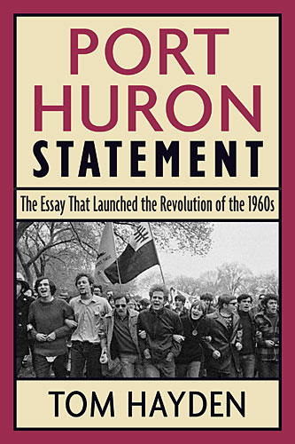
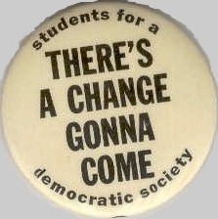
2. SDS =
Students
for a
Democratic Society
3. The New Left believed that problems such as poverty and racism called for radical changes.

Slide 4
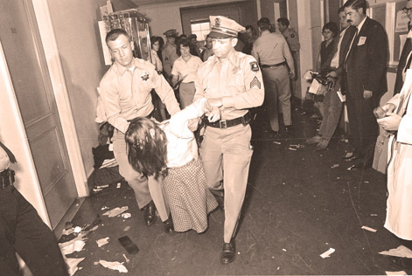
4. Explain what happened at Berkley in 1964.
Students at U.C. Berkley became agitated when administrators said that they could not distribute civil rights leaflets. Students maintained that their right to free speech was being denied. Students resisted the universities directives. The Free Speech Movement was born.
Students took over the University Administration Building. More than 700 students were arrested. As a result student activism began to spread to other campuses.

Slide 5
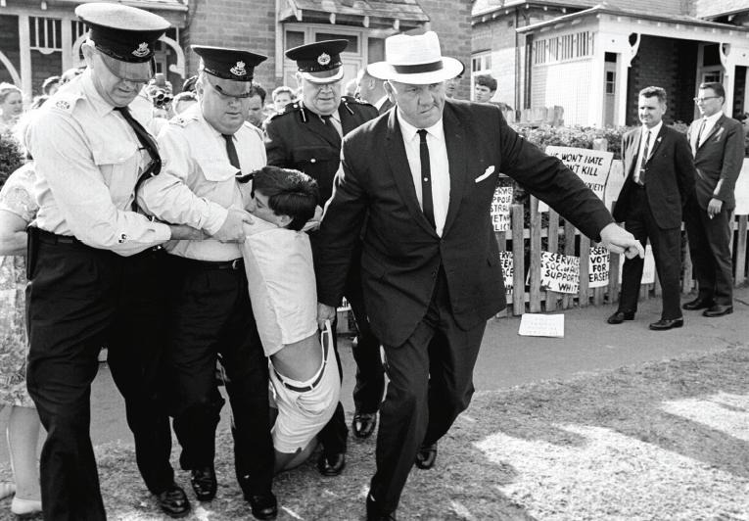
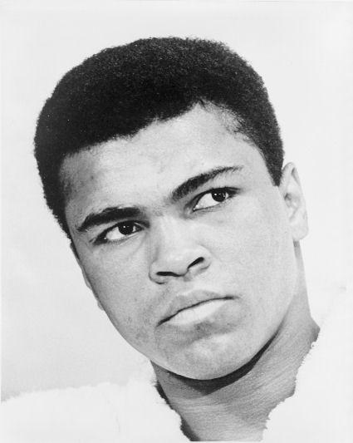
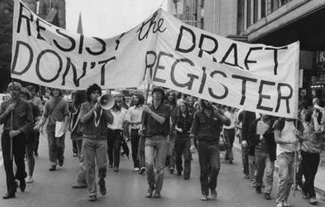
5. Those who opposed the war on moral or religious grounds were called conscientious objectors.

Slide 6
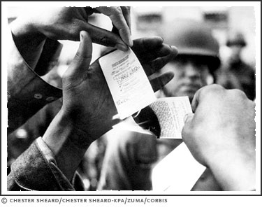
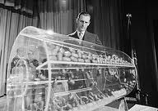
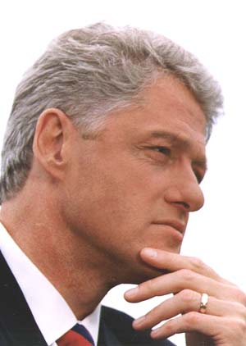
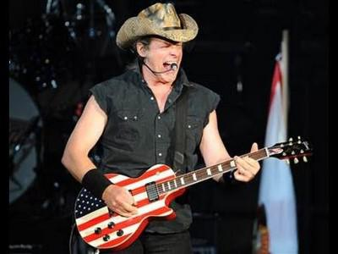
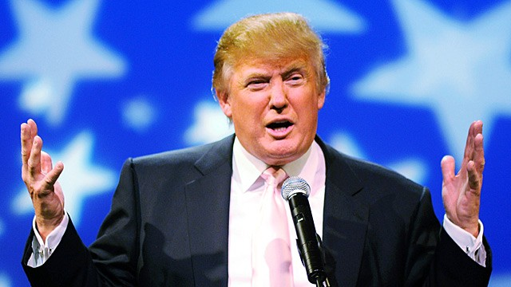
6. In 1965 LBJ doubled the number of men who could be drafted.

Slide 7
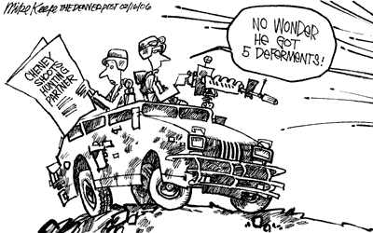
7. College students could receive a deferment or postponement of service.

Slide 8
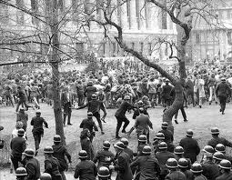
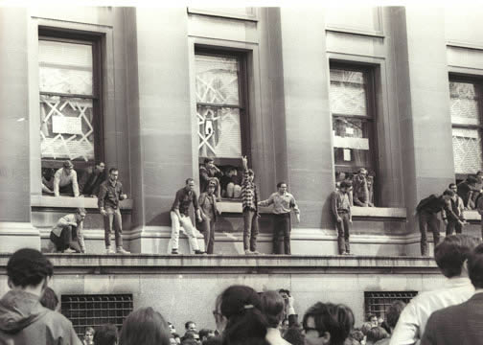
8. In the first six months of 1968 more than 200 major demonstrations broke out on college campuses.

Slide 9
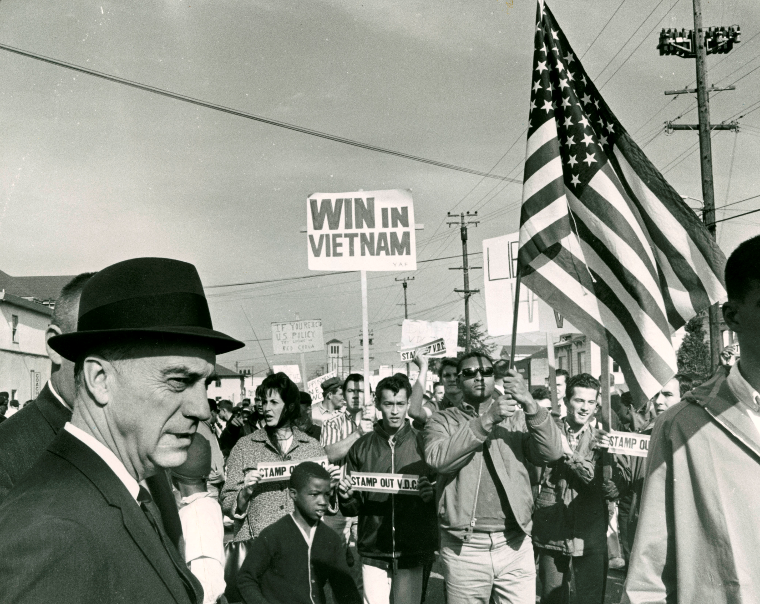
9. What can you learn from the photograph on page 808?

Slide 10
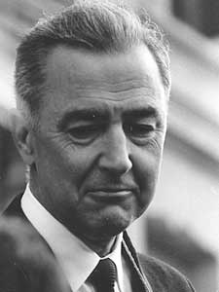
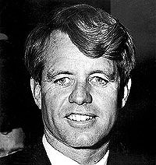
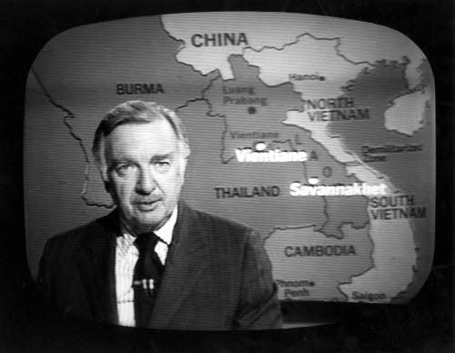
10. List three reasons why Lyndon Johnson did not run for reelection in 1968?
The results of the Tet Offensive on support for the war
Popularity of antiwar candidate Eugene McCarthy
Robert Kennedy’s entry into the race
Loss of Walter Cronkite/Middle America

Slide 11
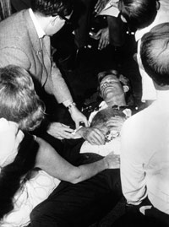
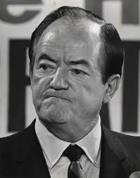
11. Robert Kennedy was assassinated in 1968.
11. Hubert Humphrey was chosen to be the democratic nominee.

Slide 12
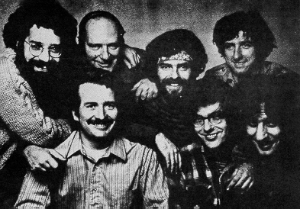
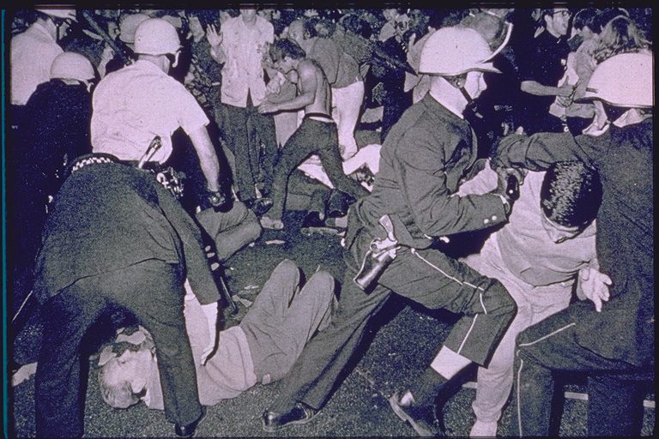
12. Who was fighting in the streets of Chicago during the Democratic National Convention?
Antiwar protesters and the Chicago city police who were under the direction of Chicago Mayor Richard Daley.
Among the protestors were key leaders of Students for a Democratic Society, The Yippies and the Black Panthers

Slide 13
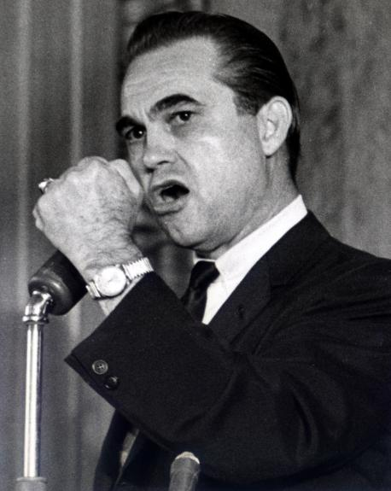
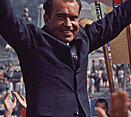
13. Republicans chose Richard Nixon to be their nominee.
14. George Wallace ran as a third party candidate from the American Independent Party.

Slide 14
15. What groups supported the candidate from the American Independent Party?
Blue collar voters in the North who resented student protestors and antiwar activists.
Southern whites who oppose civil rights legislation.

Slide 15
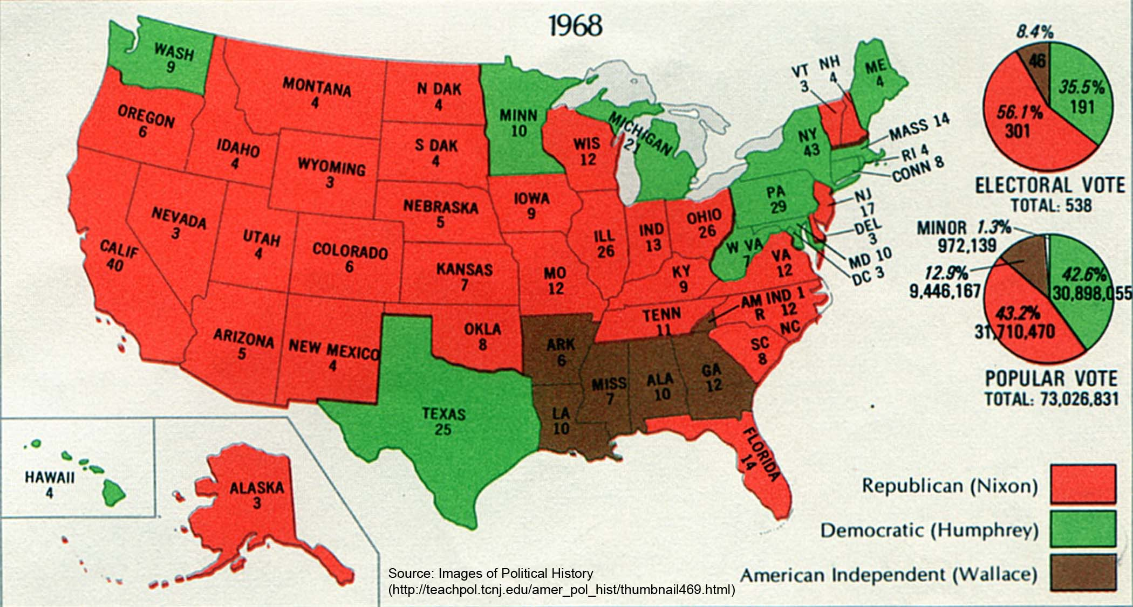
16. Describe the results of the election of 1968. Include results fro the third party.

Slide 16
17. Who was Middle America?
Beginning in 1968 “Middle America” would become key supporters of the Republican Party.
This segment of America had traditionally supported the Democratic Party.
Mainstream America
Begins an era of dominance for the Republican Party

