Slide 1
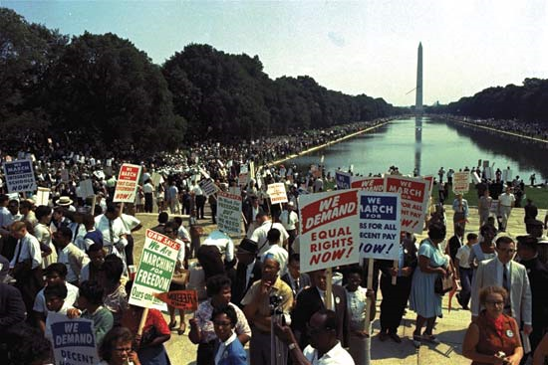
The Civil Rights Movement

Slide 2
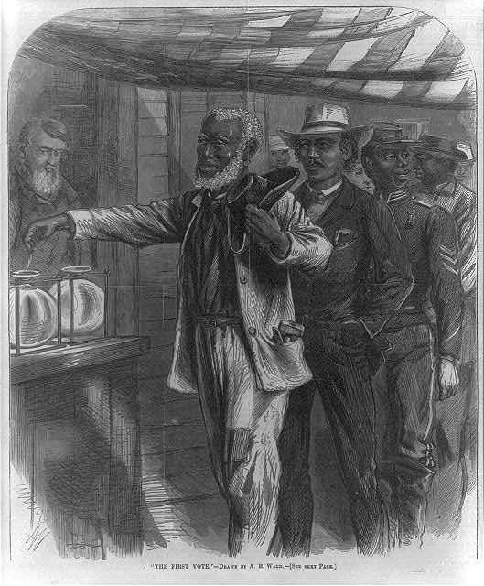
What are Civil Rights?
The rights a person has as a member of a nation
Equal treatment from the government and individuals
Civil Rights activists were not asking for new or special rights but instead the rights that had already been granted as a result of the 13th, 14, 15th amendments to the U.S. Constitution
13th (1865) freed slaves and made slavery illegal
14th(1866)- granted citizenship for all those born in the U.S. (equal protection under the law)
15th(1869)- can not deny the vote based on “race, color, or previous condition of servitude”
Women were granted the right to vote in the 19th amendment (1920)

Slide 3
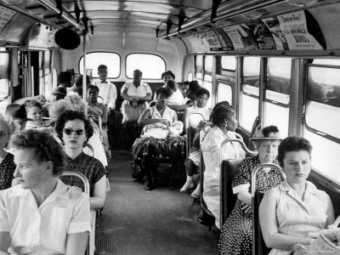
The Origins of the Civil Rights Movement
Jim Crow: laws and actions designed to segregate and disfranchise African Americans in the South that
Jim Crow Laws violated the Constitution
Segregation: system by which “races” were separated from one another
Became law after Reconstruction
Disfranchisement: denying one the right to vote or participate in politics
Poll Tax, Grandfather Clause, Intimidation, Violence
Civil Rights activists during the Movement sought to end segregation and then disfranchisement

Slide 4

Plessy v. Ferguson (1896)
Louisiana law segregated trains and other public transportation
Homer A. Plessy was arrested for attempting to ride in a “whites only” train car
Plessy sued based on the argument that the law violated the 14th Amendment and denied “equal protection”
Supreme Court decided 8 to1 to uphold the LA law
“Separate but Equal”
Set a precedent for legalized segregation

Slide 5
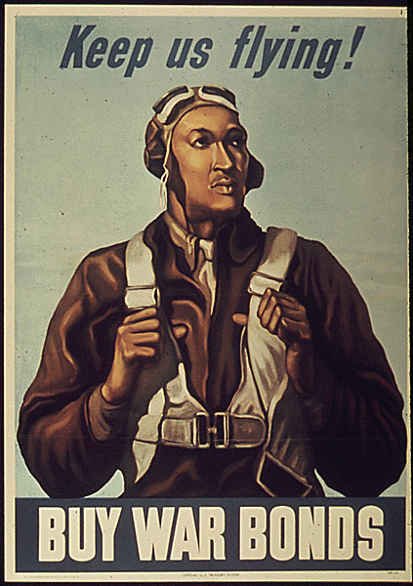
The Civil Rights Movement and World War II
The U.S. military was segregated during WWII
Black soldiers returned with a determination to force the U.S. to uphold the democratic ideals they fought for in the war
NAACP membership: 1940- 50K; 1945- 450K
Other groups emerged during and after WWII
A. Philip Randolph: “Double V” campaign (1940) victory against fascism and racism
Brotherhood of Sleeping Car Porters
Planned to organize a march on Washington D.C. to protest military segregation
FDR avoided the march by issuing executive order #8802 (1941) that ended discrimination in the defense industry

Slide 6
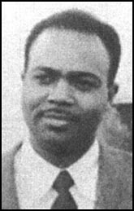
C.O.R.E
Congress of Racial Equality
The nation’s first civil rights group
“Intra racial” group designed to confront racism (1942)
Founded by James Farmer in Chicago to protest discrimination in restaurants
Introduced the idea of change through nonviolence used throughout the Movement
Most early chapters were in the North and comprised of white middle class
1. Voter registration drives
2. Gave support to sit-in movement and freedom rides
3. Argued that black political power offered the best hope for racial equality

Slide 7
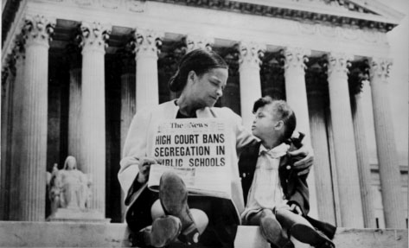
Ending Segregation
Brown v. Board of Education of Topeka Kansas (1954)
The NAACP funded several civil rights attorneys to challenge Plessy v. Ferguson led by Thurgood Marshall
Oliver Brown’s daughter Linda Brown, a third grader, had to ride to Monroe Elementary, her segregated black school miles away, while Sumner Elementary, a white school, was seven blocks from her home
NAACP leadership directed the parents to enroll their children in the closest neighborhood school in the fall of 1951
They were refused enrollment and directed to segregated schools
Brown combined five cases from DE, KS, SC, VA, DC into a class action suite

Slide 8
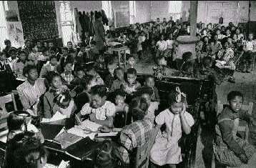
Brown v. Board of Education
9-0 decision of the Supreme Court declared the concept of racial segregation “… violated the 14th amendment to the U.S. Constitution, which guarantees all citizens equal protection of the laws”
Jim Crow segregation laws were struck down by the court’s decision and were declared unconstitutional
Ending segregation meant Jim Crow laws were no longer to be enforced

Slide 9
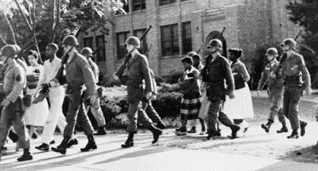
Backlash
Not everyone accepted the Brown v. Board of Education decision
In Virginia, Senator Harry F. Byrd, Sr. organized the Massive Resistance Movement that included the closing of schools rather than desegregating them
In Arkansas, Gov. Orval Faubus called out his state's National Guard to block black students' entry to Little Rock High School
President Dwight Eisenhower responded by deploying the 101st Airborne Division and by Federalizing Arkansas’ National Guard
After the Brown decision, enthusiasm across the country gained momentum

Slide 10
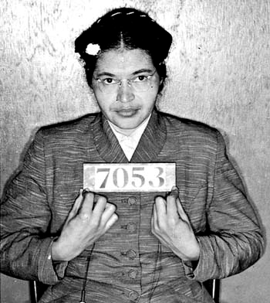
Desegregation
The Montgomery Bus Boycott began on December 1, 1955.
African Americans in Montgomery, Alabama, decided that they would boycott the city buses until they could sit anywhere they wanted, instead of being relegated to the back
Rosa Parks boarded a city bus and sat in the fifth row, the first row that blacks could occupy
The front four rows were filled with whites, and one white man was left standing. According to law, blacks and whites could not occupy the same row, so the bus driver asked all four of the blacks seated in the fifth row to move
Parks refused and was arrested

Slide 11
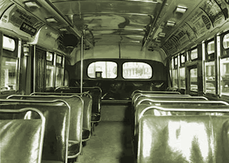
Desegregation
That night, Jo Ann Robinson began to plan for a one-day boycott
She mimeographed handouts urging African Americans not to ride the city buses on Monday, when Parks' case was due to come up
She and her students distributed fliers throughout Montgomery on Friday morning
Rev. Dr. Martin Luther King, Jr., minister at Dexter Avenue Baptist Church, thought the boycott would be brief but was surprised when the boycott was nearly 100%.
King’s house was attacked repeatedly
Buses were shot at, but the boycott lasted a year until they were desegregated in 1956

Slide 12
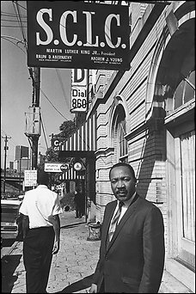
Rev. Dr. Martin Luther King Jr.
On January 10 and 11, 1957, ministers from around the South met in Atlanta, Georgia
They founded the Southern Christian Leadership Conference (SCLC) and elected Dr. Martin Luther King, Jr., as president
SCLC helped plan and organize many actions during the Movement
The lasting legacy of the boycott, as historian Roberta Wright wrote, was that "It helped to launch a 10-year national struggle for freedom and justice, the Civil Rights Movement, that stimulated others to do the same at home and abroad."

Slide 13
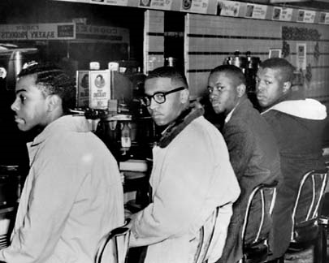
The Sit-In Movement
On February 1, 1960, Joseph McNeil, Franklin McCain, David Richmond, and Ezell Blair, Jr., walked into an F.W. Woolworth Company store in Greensboro, North Carolina
They four NC A&T freshmen went to the lunch counter and asked to be served at the segregated lunch counter
"We believe, since we buy books and papers in the other part of the store, we should get served in this part."
When they were forced to leave as the store closed, they still had not been served

Slide 14
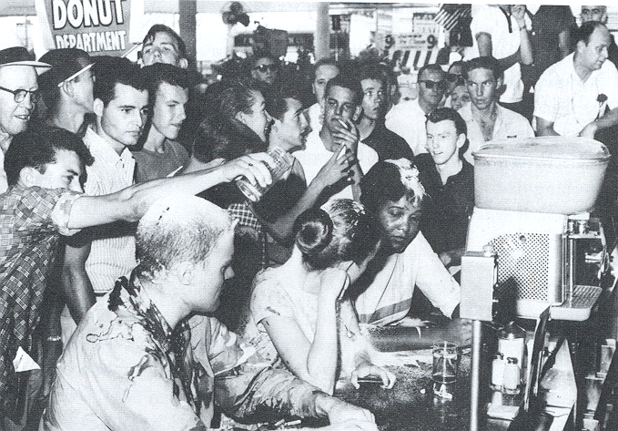
The Sit-In Movement
This first sit-in had very little effect
When a larger group of students returned the next day, wire services picked up the story, and civil rights organizations began to spread the word to other college campuses
The basic plan of the sit-ins was that a group of students would go to a lunch counter and ask to be served
If they were served, they would move on to the next lunch counter
If they were not, they would not move
If they were arrested, a new group would take their place
The students always remained nonviolent

Slide 15
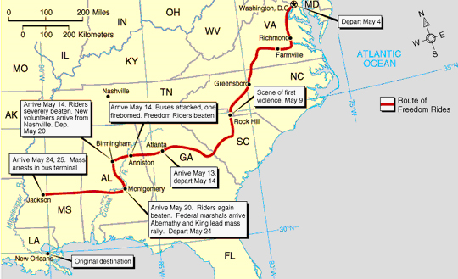
The Freedom Rides (1961)
An interracial group boarded buses destined for the South
The whites sat in the back and the blacks in the front to challenge segregation
At rest stops, the blacks would go into the “whites only” areas and vice versa
"This was not civil disobedience, really," explained CORE director James Farmer, "because we [were] merely doing what the Supreme Court said we had a right to do."
The Freedom Ride left Washington DC on May 4, 1961
It was scheduled to arrive in New Orleans on May 17, the seventh anniversary of the Brown decision

Slide 16
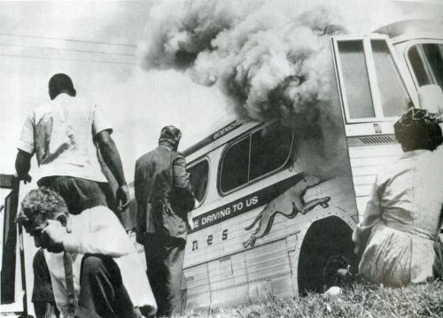
The Freedom Rides
On May 14, the Freedom Riders split up into two groups to travel through Alabama
The first group was met by a mob of about 200 angry people in Anniston
The mob stoned the bus and slashed the tires
The bus managed to get away, but when it stopped about six miles out of town to change the tires, it was firebombed
The other group did not fare any better
It was greeted by a mob in Birmingham, and the Riders were severely beaten
Birmingham's Public Safety Commissioner, Bull Conner, claimed he posted no officers at the bus depot because of the holiday, however, it was later discovered that the FBI warned of the planned attack and that the city police stayed away on purpose

Slide 17
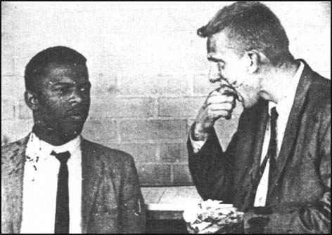
The Freedom Rides
The Freedom Riders never made it to New Orleans
Many spent their summer in jail or the hospital but their efforts were not in vain
They forced the Kennedy administration to take a stand on civil rights, which was the intent of the Freedom Riders
The Interstate Commerce Commission, at the request of Robert Kennedy, outlawed segregation in interstate bus travel that took effect in September, 1961

Slide 18
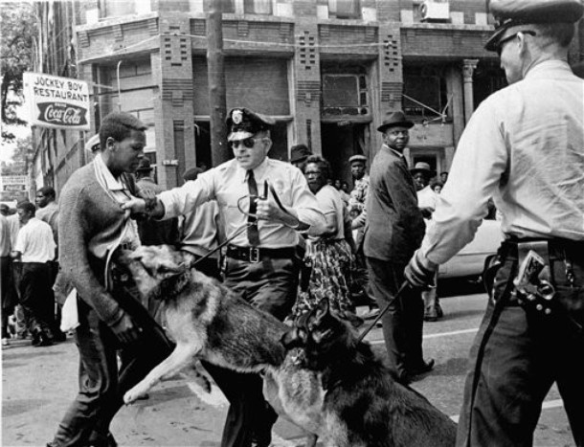
The Birmingham Protests (1963)
Nicknamed "Bombingham" because it was the site of eighteen unsolved bombings in black neighborhoods over a six-year span and of the vicious mob attack on the Freedom Riders
In 1963, the city government was undergoing a major change
Voters decided to rid the city of the three-man city commission and instead elect a mayor, mostly to force Bull Connor to step down
The city commission, however, refused to step down, leaving Birmingham with two city governments until the courts decided which was the legitimate one
After a protest the courts issued order 133 preventing protests

Slide 19
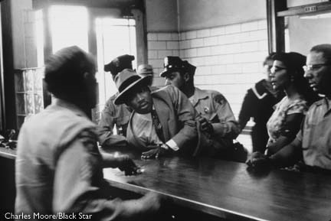
The Birmingham Protests
Civil rights leaders, including King, were arrested and thrown in jail
King wrote the Letter from a Birmingham Jail
The demonstrations escalated
“We will clog their jails”
The Birmingham business community, fearing damage to downtown stores, agreed to integrate lunch counters and hire African Americans

Slide 20
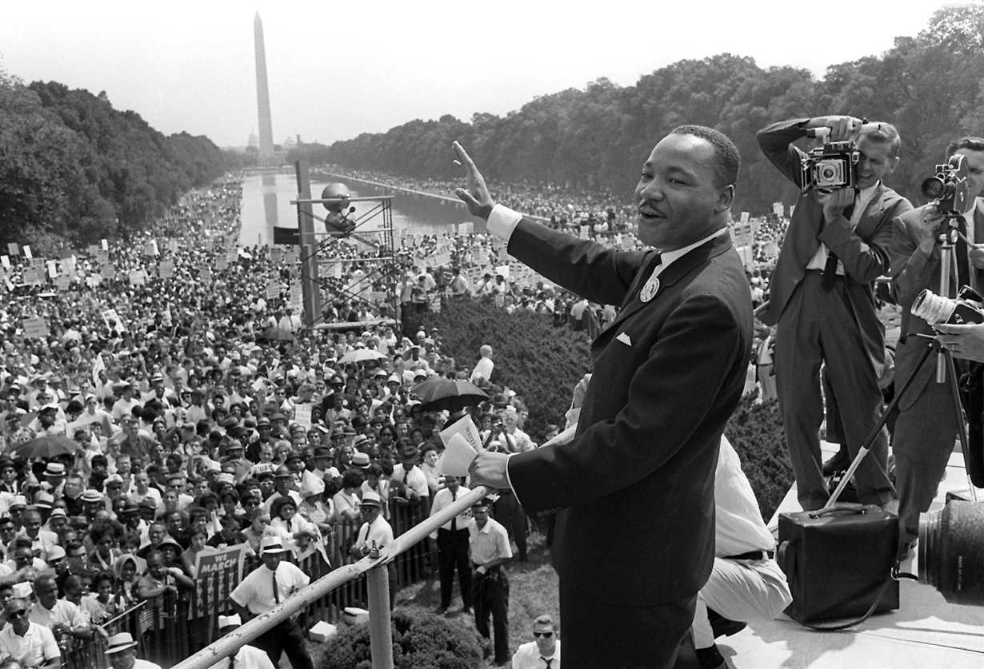
Ending Segregation
After Birmingham, President Kennedy proposed a new civil rights bill which later became known as the Civil Rights Act of 1964
Outlawed discrimination based on race, color, religion, sex, or national origin and declared Jim Crow illegal
To show that the bill had widespread support, civil rights groups united to organize a March on Washington
250,000 people descended on Washington, DC on August 28, 1963.
There, they heard speeches and songs from numerous activists, artists, and civil rights leaders
Martin Luther King, Jr., delivered the closing address, his famous "I Have a Dream" speech

Slide 21
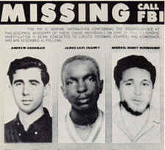
Ending Disfranchisement
Freedom Summer
Throughout the south civil rights workers attempted to register African Americans to vote and to challenge the existing Jim Crow laws that kept African Americans from voting
In 1964 the Student Non-Violent Coordinating Committee (SNCC) went mainly to Mississippi to register voters during the summer
On August 4, the bodies of the three civil rights workers were found in a dam on a farm near Philadelphia, Mississippi
They had all been shot and James Chaney had been brutally beaten
In 1964, 6.7% of Mississippi's voting-age blacks were registered to vote, 16.3% below the national average
By 1969, that number had leaped to 66.5%, 5.5% above the national average

Slide 22
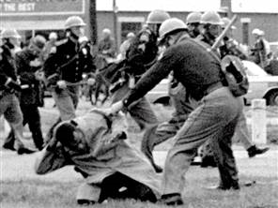
The Selma Marches
King organized a march from Selma to Montgomery in support of a Voting Rights Bill
On Sunday March 7, 1965 SNCC led a march of 600 people who intended to walk the 54 miles from Selma to the state capital in Montgomery
Only six blocks into the march, at the Edmund Pettus Bridge, state troopers and local law enforcement
Some were mounted on horseback and attacked the peaceful demonstrators with billy clubs, tear gas, rubber tubes wrapped in barbed wire and bull whips, driving marchers back into Selma
Became known as Bloody Sunday
King, who had been preaching in Atlanta immediately started making plans for a new march on Tuesday

Slide 23
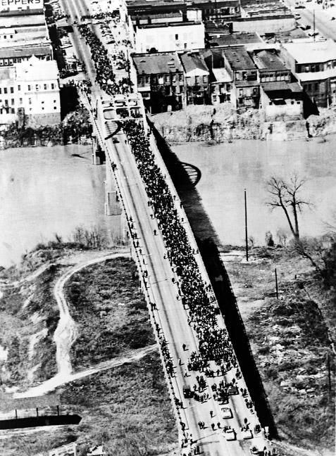
The Selma Marches
Hundreds of people, shocked by what they had seen on TV that night, dropped everything and responded
The March was stopped until protection from the courts was obtained and on March 21, fourteen days after Bloody Sunday, the marchers crossed over the Edmund Pettus bridge and kept going
The march took five days and the marchers were greeted by 25,000 people and included many of the leaders of the civil rights movement, such as Martin Luther King, Rosa Parks, and John Lewis

Slide 24
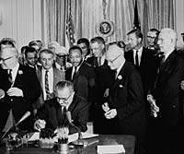
Voting Rights Act (1965)
On August 6, 1965, several weeks after the Selma March, President Johnson signed the Voting Rights Act into law
The act suspended poll taxes, literacy tests and other voter tests, and authorized federal supervision of voter registration in states and individual voting districts where such tests were being used
By 1965 the Civil Rights Movement legally ended segregation and disfranchisement in the United States
By 1969, 61% of voting-age African Americans in America were registered to vote, compared to 23% in 1964

Slide 25
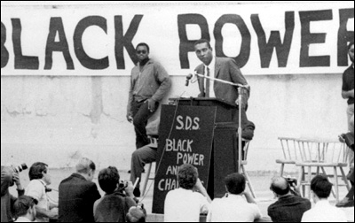
“Black Power”
Stokely Carmichael, who became the leader of SNCC in 1966, was one of the earliest spokespersons for what became known as the "Black Power" movement
He urged African American communities to meet white supremacist group armed and ready for battle because he felt it was the only way to ever rid communities of the terror caused by groups such as the Ku Klux Klan
Black Power was made most public by the Black Panther Party which was founded in Oakland, California in 1966
This group followed ideology stated by Malcolm X using a "by-any-means necessary" approach to stop inequality

Slide 26
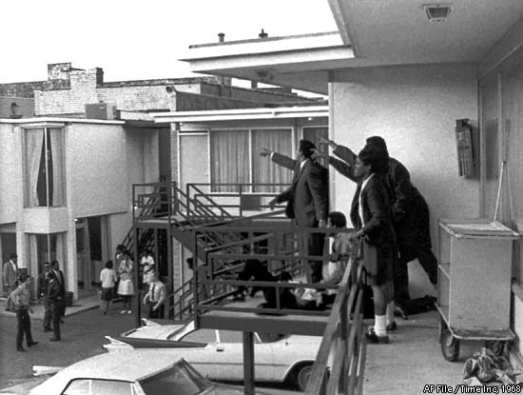
Divisions within the Movement
King was not happy with these developments
The "Black Power" slogan sounded too much like black nationalism which was in opposition to the goals of the Movement
SNCC activists began embracing ideas about the "right to self-defense" in response to attacks from white authorities, and booed King for continuing to advocate non-violence
Before his death King began to criticize the War in Vietnam and wished to have another march on Washington this time involving poor people, "a multiracial army of the poor“
He went to Memphis to aid in a sanitation workers strike and was assassinated on 4/4/1968 by James Earl Ray
Riots broke out in over 110 cities across the United States

Slide 27
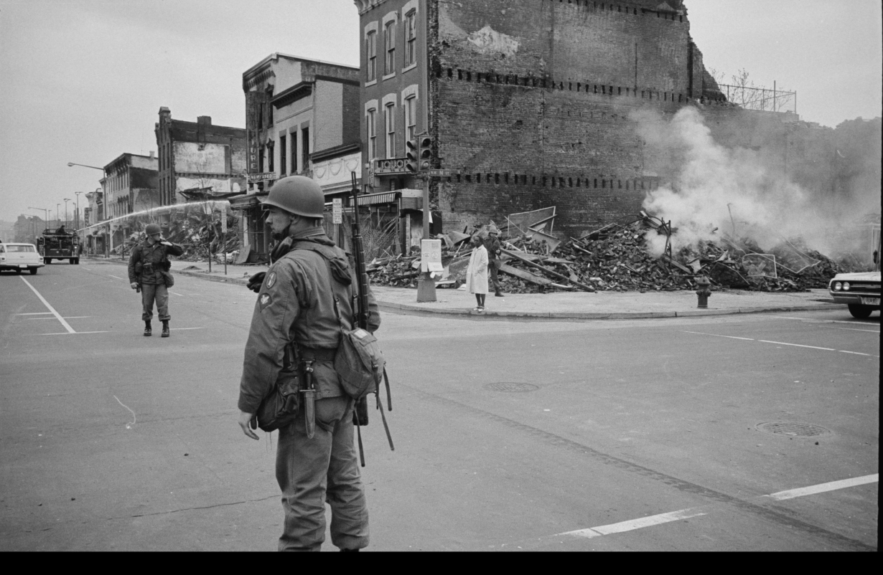
Divisions within the Movement
When King was murdered in 1968, Stokely Carmichael warned the assassination would cause riots
In major cities from Boston to San Francisco, racial riots broke out in inner cities following King's death
"White Flight" occurred from many cities leaving millions of African Americans in dilapidated and depressed cities
While King as not solely responsible for gains in the civil rights movement, it is certain the movement did take somewhat of a blow after 1968, but for mainly internal divisions not only King’s death

Slide 28
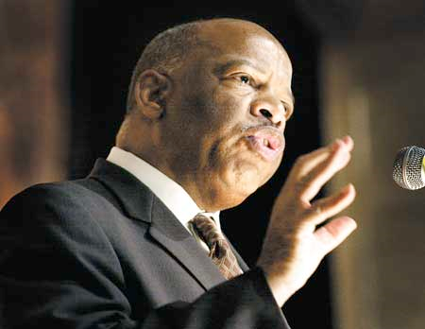
Civil Rights in the 21st Century
The Civil Rights Movement legally ended segregation and disfranchisement after the passage of the Civil Rights Act (1964) and the Voting Rights Act (1965)
De facto segregation remained in many cities until the 1980s and incidents of disfranchisement still persist
The Civil Rights Act has been used in dozens of cases to protect the rights of women and minorities against discrimination
The Voting Rights Act was renewed several times and got a 25 year extension in 2006

