Slide 1
Cell Growth and Genetics

Slide 2
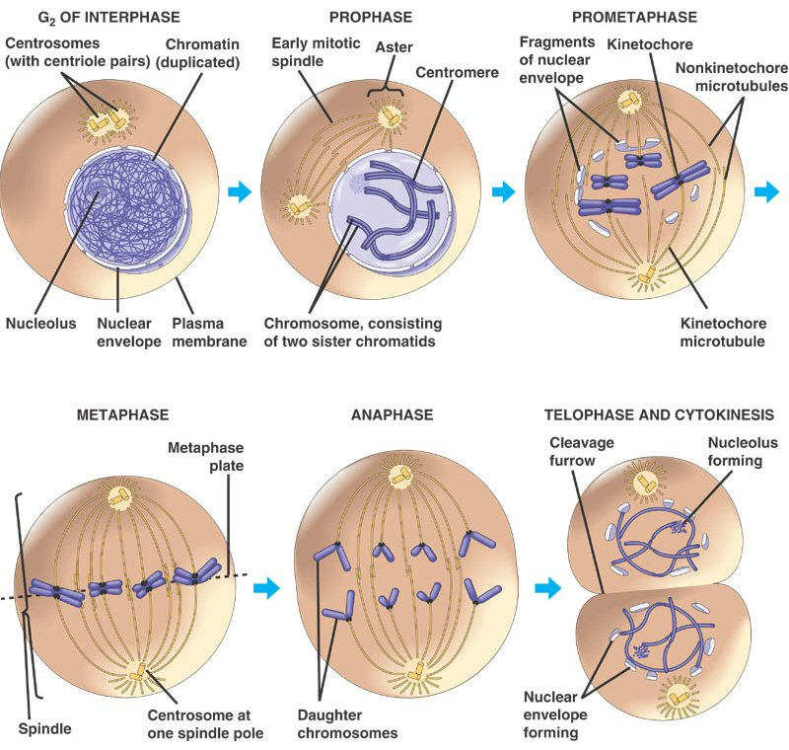
Cell Division (Mitosis)
Cell division results in two identical daughter cells.
The process of cell divisions occurs in three parts:
Interphase - duplication of chromosomes and preparing the nucleus for division
Mitosis – organized division of the nucleus into two identical nuclei
Cytokinesis- division of the cell and cellular contents into two identical daughter cells
Animation

Slide 3
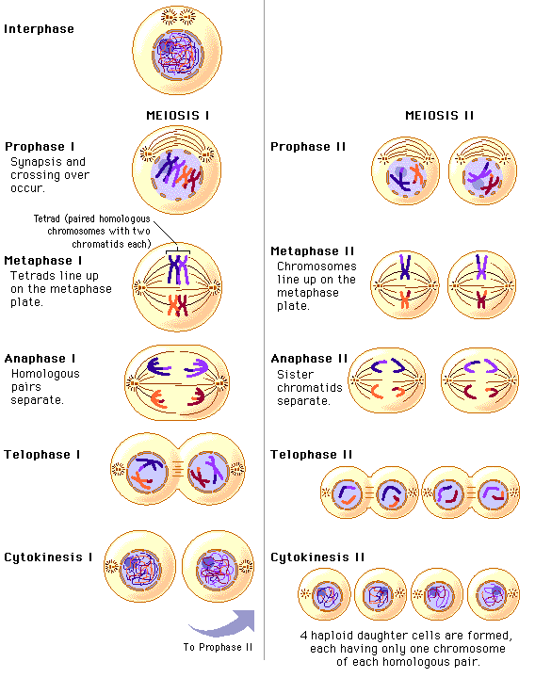
Meiosis
Meiosis occurs during the formation of sex cells (sperm and egg). It is necessary so that the sex cells only have half the number of chromosomes (23 in us) so that at fertilization, the normal chromosome number is returned (46 in us)
Meiosis involves two divisions. It begins with the replication of the chromosomes, divides up the cell into two cells, then divides again (without replication) into 4 genetically different sex cells with half the normal number of chromosomes

Slide 4
1.) Mitosis and meiosis are processes by which animal and plant cells divide. Which statement best describes a difference between mitosis and meiosis?
Meiosis is a multi-step process.
Both processes have multiple steps (prophase, metaphase, anaphase, and telophase, but meiosis has two sets of these stages with slight differences than the mitosis versions)
Mitosis occurs only in eukaryotic cells.
Mitosis occurs in prokaryotic and eukaryotic cells
Meiosis is used in the repair of an organism.
Mitosis is the process used to repair an organism by creating more of the same type of cell (for example, to heal a cut on the leg)
D. Mitosis produces genetically identical daughter cells. Meiosis produces genetically different cells as a result of crossing over and chromosome shuffling. Half chromosomes.

Slide 5
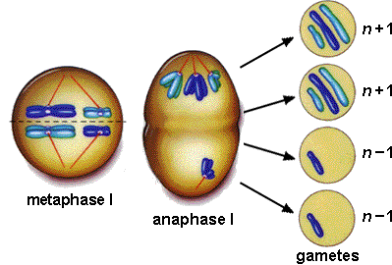
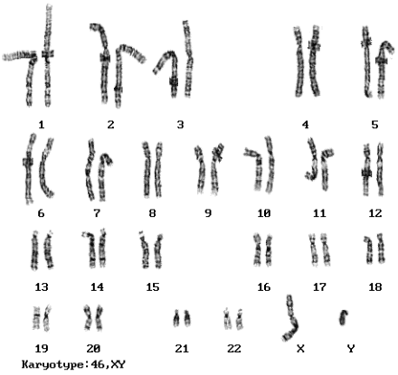
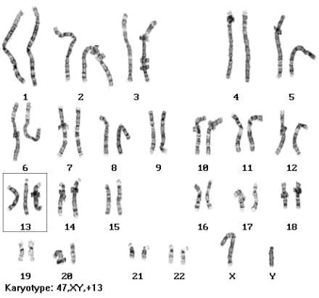
Nondisjunction and Patau’s syndrome
Nondisjunction
Karyotype of a normal male
Karyotype of a Patau’s male (notice chromosome #13 has three chromosomes instead of two

Slide 6
3.) Patau syndrome can be a lethal genetic disorder in mammals, resulting from chromosomes failing to separate during meiosis.
Part A: Identify the step during the process of meiosis when chromosomes would most likely fail to separate.
Most likely chromosomes would fair to separate during anaphase I or Anaphase II. In anaphase, chromosomes (anaphase I) or sister chromatids (anaphase II) are supposed to separate, or move AWAY from each other. This is called Nondisjunction.
Part B: Describe how chromosome separation in meiosis is different from chromosome separation in mitosis.
During meiosis cells and the genetic material is divided twice (the first set of division is meiosis I and the second set is meiosis II). In mitosis, the cell and chromosomes divide once.

Slide 7
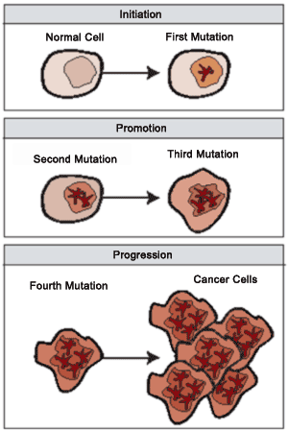
Part C: Compare the effects of a disorder caused by chromosomes failing to separate during meiosis, such as Patau syndrome, to the effects of chromosomes failing to separate during mitosis.
Due to the improper number of chromosomes, the organism has an improper amount of genetic material in the form of DNA of the sperm or egg. This mutation will be found in every cell of the organism’s body.
If chromosomes fail to separate during mitosis, it does not affect the sex cells but a body cell. This mutant body cell then can be reproduced and produce more of the abnormal cells. The cell either dies or is replicated quickly. This could possibly lead to cancer if the cells are not destroyed by the immune system.

Slide 8
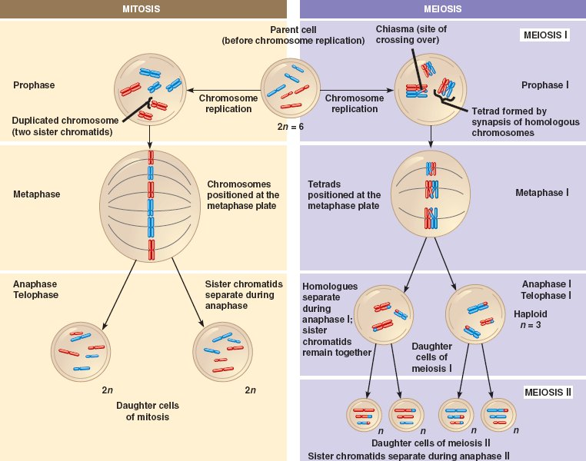

Slide 9
2.) Use the illustration below to answer the question.
Which statement best describes the phase of the cell cycle shown?
This diagram is showing the formation of two cells
The cell is in prophase of mitosis because the number of chromosomes has doubled.
The cell is in prophase I of meiosis because the number if chromosomes has doubled.
The cell is in telophase of mitosis because the cell is separating and contains two copies
of each chromosome.­
D. The cell is in telophase of meiosis because the cell is separating and contains two copies
of each chromosome.
At the end of meiosis, you would see 4 genetically different cells with only one copy of each chromosome (here you see 2 cells, and each has 2 matching “sticks” in it)

Slide 10
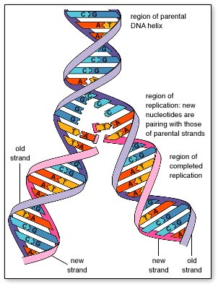
DNA Replication
This is key for DNA replication. DNA (a double stranded molecule) splits into two halves, and each half serves as a “template” or pattern to build the new half.
The result is two identical strands of DNA
  Adenine always pairs with Thymine (straight line letters AT go together) and Guanine always pairs with Cytosine (curvy letters GC go together)

Slide 11
4.) Which process helps to preserve the genetic information stored in DNA during DNA replication?
A.) The replacement of nitrogen base thymine with uracil.
B.) Enzymes quickly linking nitrogen bases with hydrogen bonds.
C.) The synthesis of unique sugar and phosphate molecules for each nucleotide.
D.) Nucleotides lining up along the template strand according to base pairing rules.

Slide 12
An embryonic cell divides repeatedly, with each new cell containing all the genetic information to form the entire organism. Which feature of DNA ensures that genetic information is conserved as it is replicated?
a. the role of DNA in proteinsynthesis
b. the polymeric nature of the DNA molecule
c. the complementary nature of DNA nucleotides
d. the triplet code with which information is stored on DNA

Slide 13
25.) In a flowering plant species, red flower color is dominant over white flower color. What is the genotype of any red-flowering plant resulting from this species?
Red and white alleles present on one chromosome.
Red and white alleles present on two chromosomes.
A red allele present on both homologous chromosomes
A red allele present on at least one of two homologous chromosomes.

Slide 14
Genetics
Dominant traits are represented by capital letters, while recessive (non-dominant traits) are represented by lower case letters.
  Each parent has two copies of the gene, so they will get two letters. The different letters represent the different alleles (flower pedal color) of a trait.
  Since white is the recessive trait, in order to have white petals, the flower has to be ff or pure for the white trait.
  Since red color is dominant, the red parent could be Ff or FF since it shows red petals. It is either pure for the red trait or a hybrid for red.
When the dominant trait shows, only one allele (form of the gene) must be present to show the trait.

Slide 15
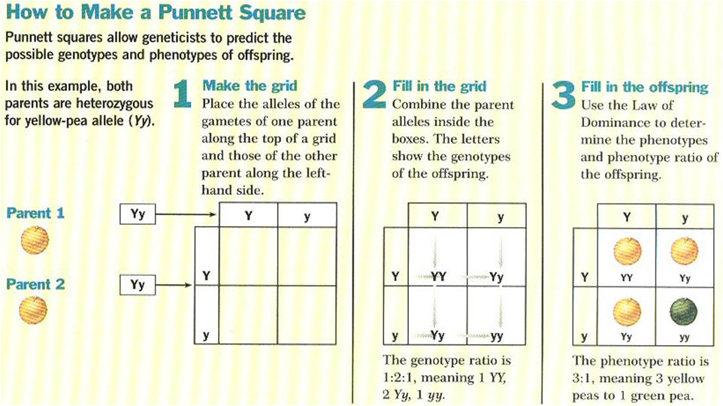

Slide 16
Punnet Square Animation
5. Green Pods are dominant over yellow pods in pea plants. What is the probability of producing a plant with green pods if two plants both heterozygous for pod color, are crossed?
a. ¼
b. ½
c. 3/4
d. 1

