Slide 1

Windows 7 and Office 2007
All you ever wanted to know!!
Come learn how to…

Slide 2
Create smartart
3
2
1
It’s as easy as…

Slide 3

Save as a Pdf

Slide 4
Change the color scheme
For an entire document or slide
  With just the click of a button!

Slide 5
Easily add
Page breaks
Tables
Hyperlinks
Headers and footers
Footnotes
And “building blocks”

Slide 6
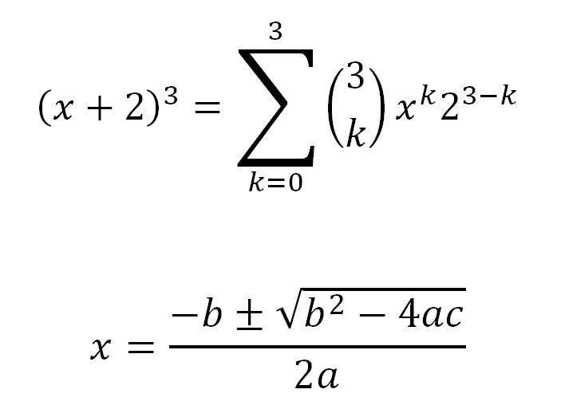
Create math formulas

Slide 7
Create tables and charts

Slide 8
Navigate Windows 7
Keyboard Shortcuts
Easily Connect your projector
Work on two documents at one time
Productivity Features

Slide 9
and navigate using all of the other updated features in Windows 7 and Office 2007!

